Slide 1
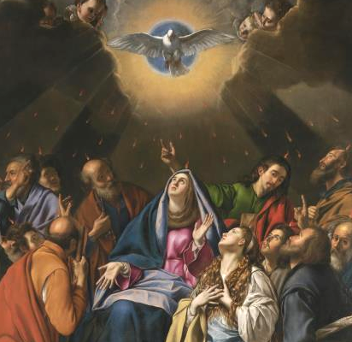
Sealed in Fire
Notes:
This PowerPoint contains all text and images recommended to be projected and/or read aloud in this unit.

Slide 2
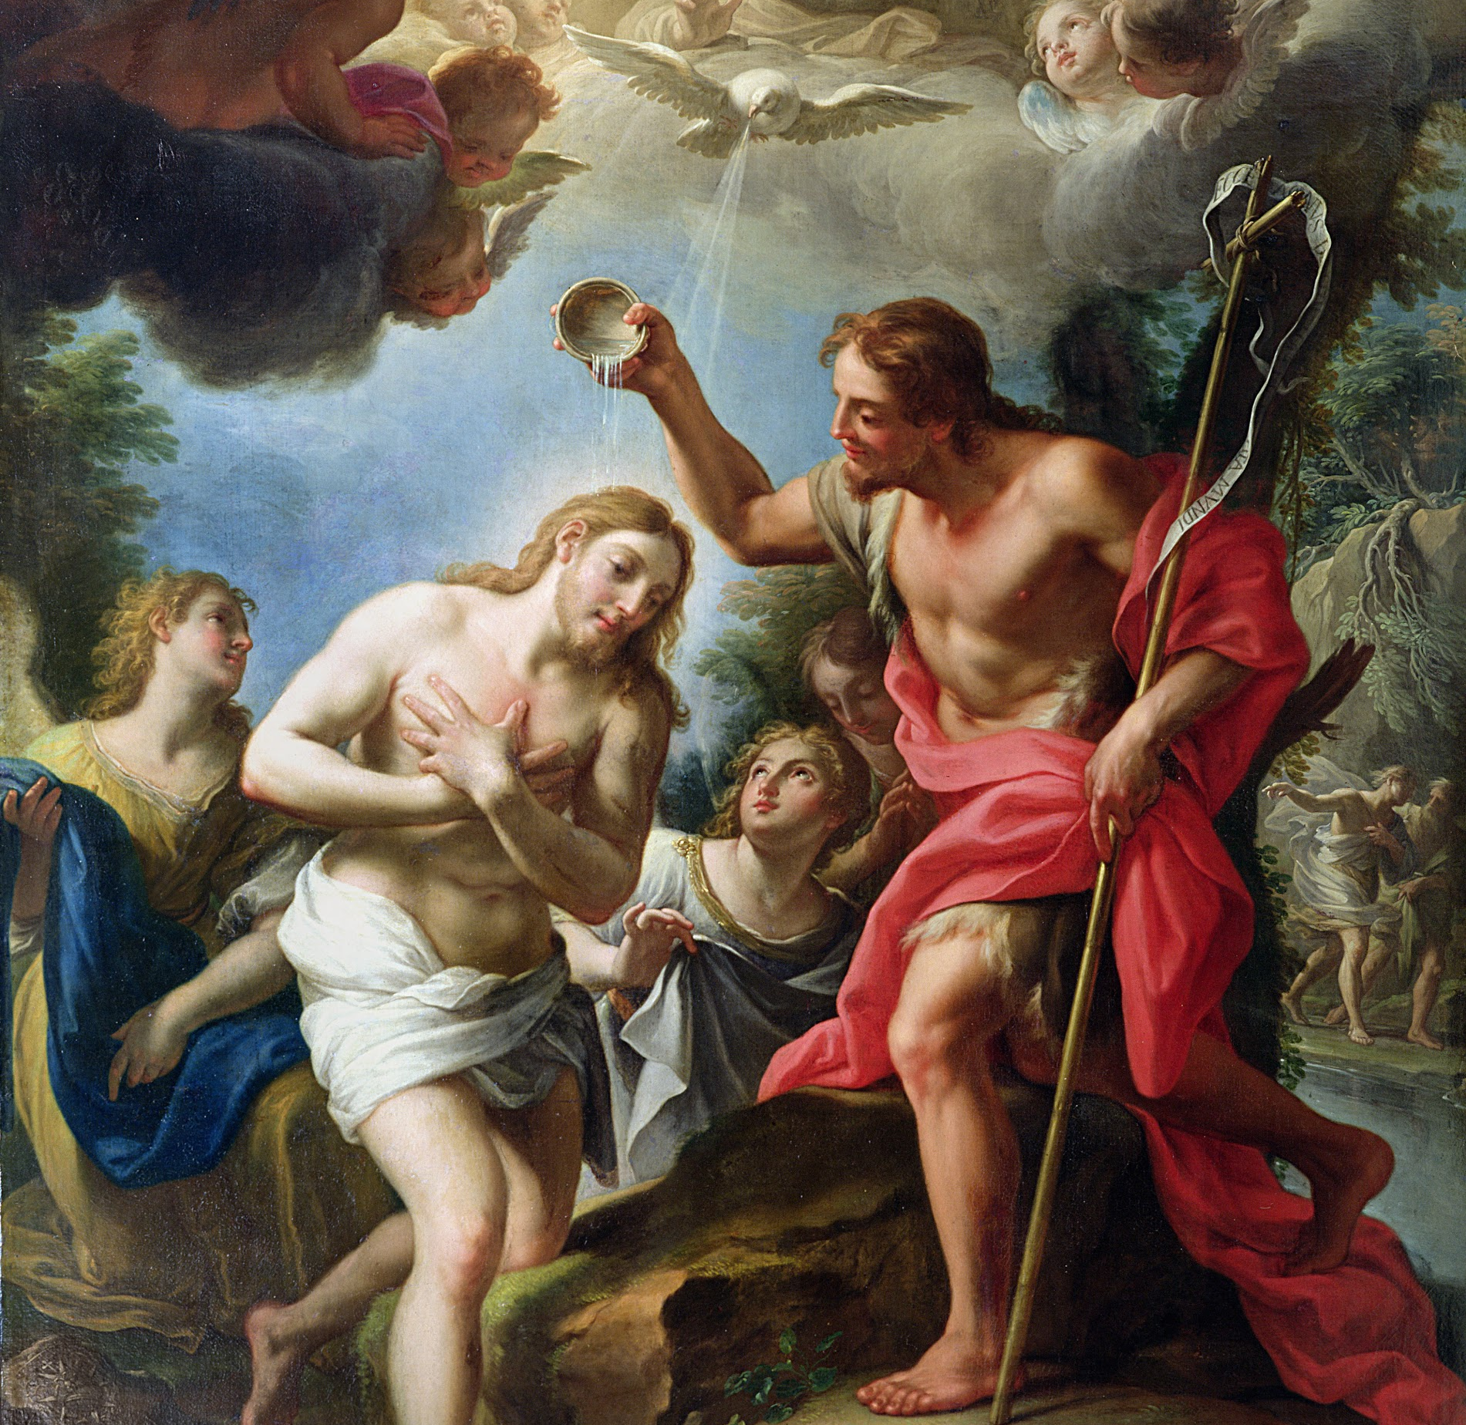
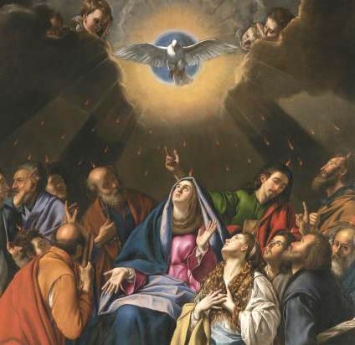
The Effects of the Sacrament of Confirmation
Lesson Five

Slide 3
Armor of God
Read Ephesians 6:11-17.
“Father send your Holy Spirit on us and on this oil which is before us and consecrate it, so that it may be for all who are anointed and marked with it holy myron, priestly myron, royal myron, anointing with gladness, clothing with light, a cloak of salvation, a spiritual gift, the sancti cation of souls and bodies, imperishable happiness, the indelible seal, a buckler of faith, and a fearsome helmet against all the works of the adversary”(CCC 1297). -Epiclesis for the consecration of the sacred chrism (myron) from the Liturgy of Antioch.

Slide 4
Armor of God
The words from the liturgy of the blessing of chrism are similar to the words of St. Paul in Ephesians. Both view the Sacrament of Confirmation as being clothed in a sort of armor of God preparing for battle to spread the good news of salvation in truth, righteousness, gladness, and strengthened by the Holy Spirit.

Slide 5
Armor of God
The main effect of the Sacrament of Confirmation is the special outpouring of the Holy Spirit that was also given to the Apostles on the day of Pentecost. This outpouring of the Holy Spirit clothes us in the armor of God, giving us a “special strength of the Holy Spirit to spread and defend the faith by word and action as true witnesses of Christ, to confess the name of Christ boldly, and never to be ashamed of the Cross” (CCC 1303).

Slide 6
Gifts of the Holy Spirit
The prayer of the bishop after the laying on of hands during the celebration of Confirmation:
“Almighty God, Father of our Lord Jesus Christ, who brought these your servants to new birth by water and the Holy Spirit, freeing them from sin: send upon them, O Lord, the Holy Spirit, the Paraclete; give them the spirit of wisdom and understanding, the spirit of counsel and fortitude, the spirit of knowledge and piety; fill them with the spirit of the fear of the Lord. Through Christ our Lord.”

Slide 7
Gifts of the Holy Spirit
The outpouring of the Holy Spirit received in Confirmation also increases the gifts of the Holy Spirit in us. We received the gifts of the Holy Spirit first at our Baptism. In the Sacrament of Confirmation we receive a greater portion of, or an increase in, these same gifts:
Wisdom
Understanding
Right Judgement/Counsel
Courage/Strength
Knowledge
Reverence
Wonder and Awe/Fear of the Lord

