Slide 1
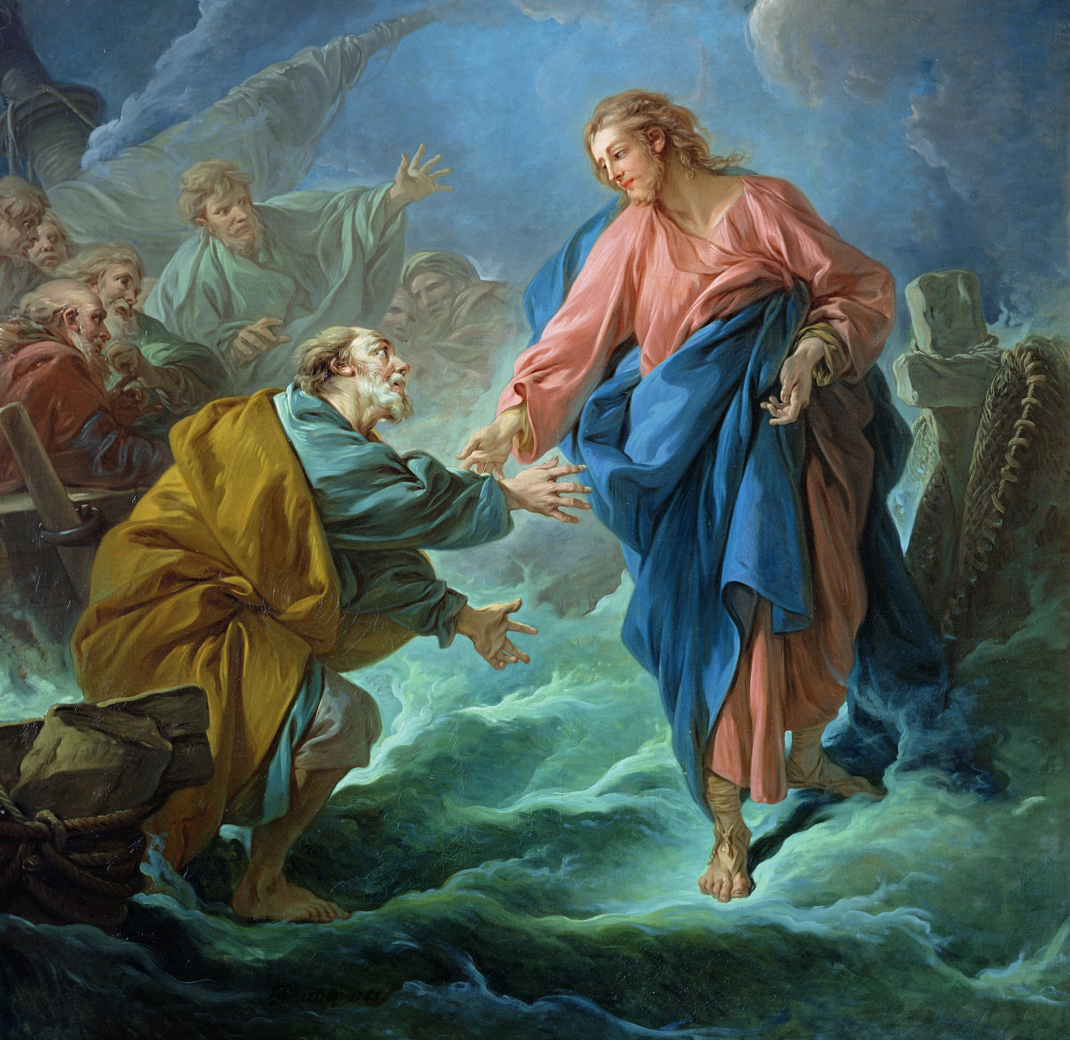
Personal Growth
Grade 7: Unit 1

Slide 2
Lesson 1: Exploring Personal Growth with Sacred Art

Slide 3
Living a Good and Holy Life
Read Ecclesiastes 12:1
Remembering God helps us handle evil days. Remembering God is also key to living a holy life. Remembering God helps us to live according to His will for us.

Slide 4
Living a Good and Holy Life
“The human person participates in the light and power of the divine Spirit. By his reason, he is capable of understanding the order of things established by the Creator. By free will, he is capable of directing himself toward his true good. He finds his perfection in “seeking and loving what is true and good.” - CCC 1704
If we use our reason to know and think of God, He will give us His light and power so we will be able to see what good we should choose. Remembering God helps us think of things in right order of importance and priority. The habit of remembering God helps us to use our reason and free will well.

Slide 5
Lesson 2: The human Person, Made in the Image and Likeness of God

Slide 6
We are Made in God’s Image
The teaching — that we are made in the image and likeness of God — is foundational for our understanding of who we are. If we really believe that every single person is made in God’s image, we must live our lives accordingly.

Slide 7
We are Made for Community
As human beings we are made for community. Alone, we are just one person, but together, we make a community of persons.

Slide 8
We are a Spiritual Family
Every person is made in the image and likeness of God.
If we are all God’s children, that makes us a spiritual family. A family means we are responsible for each other.
Not only do we recognize that we are one family, but we work toward the good of others.

Slide 9
Lesson 3: Human Growth and the Purpose of Existence

Slide 10
Journey of Life
In a certain sense, all of life is a journey. We are always moving forward, traveling from where we were to where we will be. On any journey, whether it’s a road trip or a walk down the street, it helps us to know where we’re going and to have a good map.
The same thing is true for our journey of life. As human persons, our ultimate destination is God Himself. We are made for the love of God, and He wants us to experience the perfect happiness of his love. Our journey of life is one that moves us closer to or away from God’s love for us.

Slide 11
Greatness
The world offers you comfort, but you were not made for comfort: you were made for greatness.” —POPE BENEDICT XVI
Christians have a word other than greatness for describing our purpose in life. We use the word holiness. Holiness is “the fullness of Christian life and ... the perfection of charity” (CCC 2013). God’s love, or “charity,” is perfect. The more we imitate Him, the happier and holier we will be.
It can be difficult to find our way, even with a map to happiness! As Catholics, we’re lucky to have guides along the journey. These guides are the saints.

Slide 12
The Struggle for Holiness
Read Romans 7:15-25
Because of the Fall of Man and the Original Sin of Adam and Eve, we all have concupiscence — the tendency to sin.
However, that’s not our only situation. Recall Romans 7:25: “Thanks be to God through Jesus Christ our Lord. Therefore, I myself, with my mind, serve the law of God but, with my flesh the law of sin.”
St. Paul sees a ray of hope in Jesus.

Slide 13
God Helps us through Grace
God gives us His help through grace.
The Catechism of the Catholic Church no. 1996 says, “Grace is favor, the free and undeserved help that God gives us to respond to His call to become children of God, adopted sons [and daughters].”
There are two different kinds of grace: sanctifying and actual.

Slide 14
Santifying Grace
Sanctifying grace is the life of God given as a stable, inherent quality in our souls. We receive it through the Sacraments.
We first receive sanctifying grace through Baptism.
Sanctifying grace is strengthened through Holy Communion.
If we sin mortally, we lose sanctifying grace. It is restored through Confession.

Slide 15
Actual Grace
Actual grace works a little differently. It is help from God in each moment to choose the good. No matter what we’re experiencing, this grace is always available to us!

Slide 16
Lesson 4: Physical and Sexual Growth

Slide 17
Our Bodies
Our bodies and our souls are connected. Pope St. John Paul II once said, “You are your body.”
Our bodies speak a language of their own. Our bodies communicate what is going on in our souls. What is going on in our bodies affects our souls too.
The relationship between our bodies and our souls is about more than simply smiling when we feel happy or crying when we feel sad.
Since our souls and bodies interact with each other so much, the fact that we have a very specific type of body - male or female - matters a lot. Our bodies matter!

Slide 18
Responding to God
We all have individual gifts to offer the world. We all need to respond to God the best we can as individual people.
The Church holds up certain men and women as examples for us. These saints are people who have followed Jesus with everything they had -- their individual gifts and talents, as well as their masculinity and femininity.

Slide 19
Litanies
A litany is a prayer that repeatedly asks a saint to pray for us, or repeatedly asks God to have mercy on us. What makes a litany unique is that every prayer request is different. We call on God or the saint by a different title or trait each time.

Slide 20
Types of Love
Loving pizza is love for something very specific, such as that it tastes good, and the toppings. People love pizza when they get something out of it.
We use the word love for a lot of different things.
Pizza Love = I care about something because I get something out of it.

Slide 21
Types of Love
Love for a person and love for pizza are two different types of love.
For example, if a person fell while crossing a busy street, people wouldn’t want to sit on the curb and watch. They would want to act. They would want to get help because a person -- any person -- is valuable in and of himself. A person is far more valuable than a pizza.
Person Love = I care about someone because he or she is valuable.

Slide 22
Lesson 5: Emotional and Intellectual Growth

Slide 23
Faculties of the Soul
There are specific powers of the human soul. Two of these powers, or faculties, are the intellect and free will.
Intellect - The ability to reason
Will - The ability to choose

Slide 24
Faculties of the Soul
The intellect, or our ability to reason, is more than just thinking. Even animals can think.
The intellect is our ability to know and to understand. We can understand the world around us, understand ourselves, and understand complicated, abstract things. Our understanding helps us to problem-solve and to produce ideas.

Slide 25
Faculties of the Soul
The will is the ability to choose freely. We are able to use our understanding of things to freely choose how we act.

Slide 26
Faculties of the Soul
Human beings (as well as animals) also possess emotions.
Emotions - The ability to feel
Our emotions are simply responses that our body and soul experience to some outward or inward stimuli. For example, when some people see a spider, they become afraid. The fear that they experience as a result of seeing the spider is an emotion.

Slide 27
Judging Whether an Action is Good or Evil
We have the ability to judge whether an action is good or evil. We judge whether something is good or evil in light of moral law.
Using our conscience means that we think about right and wrong. We apply knowledge of the moral law to particular actions so that we can make a decision. We think before we choose.

Slide 28
Passions
Our passions aren’t good or bad in themselves. It’s what we do with our passions that makes a difference. Sometimes our feelings are helpful, but other times they might in uence us to make the wrong decisions. It’s important to consider everything with our conscience.

Slide 29
Knowing Truth
There are a lot of things that we can know. Sometimes the amount we can know seems limitless!
It’s not always easy to know what’s true and what’s false on the Internet. It can be difficult to know what is true and what is not.

Slide 30
Knowing Truth
Our Faith gives us knowledge about a lot of things. Sometimes, however, we might question why something is the way it is or wonder whether things are really true.
Our ability to reason is a great gift from God. He wants us to use it to grow in knowledge. Learning the truth about the world around us goes hand in hand with our Catholic Faith.

Slide 31
Lesson 6: Social Growth

Slide 32
Gift of Self
God invites us to give the gift of ourselves. God invites us to be a gift of self to others.
Giving of ourselves could mean many things — sharing our talents and gifts, helping our family, volunteering, even sacrificing our lives for another.

Slide 33
Learning from Family
Not only do we learn how to walk and talk from our parents, but the family is the first place we learn about how to love and give of ourselves to help others.

Slide 34
Learning from Scripture
We can find in Scripture many examples of how to love others, but sometimes these examples might feel very far away from our daily experience.
For example, think about when Jesus healed a blind man (John 9). The man had been born blind. Jesus spit on the ground, made some mud with His saliva, and put it on the blind man’s eyes. Jesus then commanded the blind man to go and wash in a special pool in Jerusalem. The man did this, and miraculously his sight was restored.
How often do we see that today? Not often! This doesn’t mean, however, that the stories of Scripture can’t relate to us today.

Slide 35
Learning from Scripture
For example, we can help someone who is physically blind by getting something off a shelf for them, explaining what something looks like for them, or helping them walk across a busy street.
Being blind means that you can’t see. Sometimes we use the word see in other ways. In math class, if you can see how to solve a problem, if means you figured out what to do.
Although we might not ever heal someone’s physical sight, there are still ways we can help people “see.”

Slide 36
Lesson 7: Spiritual Growth

Slide 37
Relationship with God
Think about what makes a good friend. A good friend is trustworthy, fun, reliable, makes you happy to be around him or her, and so forth.
If you want to become friends with someone, you say hi, talk to the person, be kind, find out what the person likes and so forth.
If you want to stay friends with someone, you don’t talk unkindly about the friend, you stand up for him or her, treat the friend well, spend time with him or her, and so forth.

Slide 38
Relationship with God
It’s the same way with our friendship with God. God wants to be present in our lives. He wants to help us with our lives.
Sometimes it’s easy to think that because we go to a Catholic school, we know God pretty well. But think about it: If I’m not talking to God about my life, if I’m ignoring Him during the day, how good can our friendship be?

Slide 39
St. John Vianney
St. John Vianney was a priest in France about 200 years ago. He spent most of his time in small towns at simple parishes.
St. John Vianney took notice of a peasant man who would come to the church and stay for hours.
The saint asked the peasant what he was doing during his time in prayer. The peasant replied: I look at Him, and He looks at me.”
The peasant was referring to Jesus. He looked at Jesus, and Jesus looked at him.
One form of prayer is called meditative prayer.
” In meditative prayer, we engage our minds and hearts with a specific spiritual reading, usually from the Bible. Meditating on stories from the Bible helps to “deepen our convictions of faith, prompt the conversion of our heart, and strengthen our will to follow Christ” (CCC 2708)

Slide 40
Forms of Prayer
One form of prayer is called meditative prayer.
In meditative prayer, we engage our minds and hearts with a specific spiritual reading, usually from the Bible.
Meditating on stories from the Bible helps to “deepen our convictions of faith, prompt the conversion of our heart, and strengthen our will to follow Christ” (CCC 2708)

Slide 41
Lesson 8: Growth in the Virties and in the Gifts and Fruits of the Holy Spirit

Slide 42
Our Abilities
Think of book you’ve read or a TV show or a movie you’ve seen featuring a heroic character with special powers or abilities. Very few of these people hide their powers (even though some of them try to at first). Their abilities usually impact the people around them.
For example: Spider-Man. He has the ability to climb walls, shoot webs from his wrists, and sense danger, and he has super strength and agility. He got his powers from being bitten by a radioactive spider. He uses his powers for good to stop criminals and to keep his city safe.

Slide 43
Gifts of the Holy Spirit
Read Isaiah 11:2-3
As the Holy Spirit gave gifts to the Messiah whom Isaiah wrote about, He gives gifts to each of us. We received the Holy Spirit at our Baptism, and we receive a special outpouring of the Holy Spirit in the Sacrament of Confirmation, but we can also pray for an increase of these gifts of the Spirit in our lives.

Slide 44
Virtue
As with our fictional heroes, it takes time for us to develop our spiritual abilities so they can be a force for good in the world.
The gifts of the Holy Spirit give us the grace to desire God and to make good decisions.
Consider what it would be like if doing the right thing came as naturally and automatically as breathing.
When doing the good becomes a habit, it’s called a virtue.

Slide 45
Lesson 9: Challenges to Growth

Slide 46
Our Dignity
Saul was the first king of Israel, but he disobeyed God. Because of his unfaithfulness, God sent the prophet Samuel to appoint David, a lowly shepherd boy, the new king.
Read 1 Samuel 16:7.
You will be facing a lot of changes in the coming years and throughout your life. But, no matter what changes occur on the outside, God looks at our hearts.

Slide 47
Our Dignity
Our dignity comes from God and His love.
Our dignity does not depend on anything. We have it simply because we exist; we are created in God’s image and likeness.
As you grow and change, this dignity never changes. God loves us, and we are created in His image. It’s important to accept who we are. If our own idea of our value comes from our abilities (such as singing or playing basketball) or how we look, we’ll never be fully happy, because those things change. Only God and His love for us are unchanging.

Slide 48
The Effect of Our Choices
We are free human beings with the ability to make choices. We are not alone in our choices! The little decisions we make every day can have a big impact.

Slide 49
The Effect of Our Choices
When you throw the pebble into the water, what happens? Ripples spread throughout the whole pond.
This is what happens with our choices. When we do something wrong, it hurts people.
However, this “ripple effect” can be very good too. Imagine when we make the right choices. That affects people too! We have the power to do a lot of good in the world if we make choices that are holy and good and show love to others.

Slide 50
Our Gifts
CCC no. 1936 says, “The talents are not distributed equally.” This is a reference to Jesus’ parable of the talents from Matthew 25:14-30.
In this parable, Jesus tells of three servants, who were each given a different number of talents (a form of money) by their master before he went on a trip. When the master returned, he called upon each servant in order to collect on his talents.

Slide 51
Our Gifts
Two of the servants had increased their talents and were rewarded by their master. The third, however, buried his talents, and returned only what he was given. This servant was punished.
Jesus makes it clear with the parable that each of us is given different, sometimes unequal gifts from God. But the same thing is expected of each of us. God expects us to use our “talents” or gifts and multiply them, rather than bury them.

Slide 52
Our Gifts
As part of His plan, God wills that each receive what he needs from others and those endowed with particular “talents” share their benefit with others.
We are obliged to practice generosity, kindness, and sharing of goods.

Slide 53
Jesus and the Gospel Message
Grade 7: Unit 2

Slide 54
Lesson 1: Exploring Jesus and the Gospel with Sacred Art

Slide 55
God is Love
Read 1 John 4:8-11
“God is love” means that Love is the essence of who God is and everything He does.
God revealed His love for us by sending His only Son into the world so that we might have life through Him.
God did and does other things that show He is love, such as: He created us, He died for us, He gave us the Sacraments, and so forth.
Because God first loved us, what must love one another.
St. John made sure to explain that God is love so that we may know the essence of God and all He does, and so love Him better.

Slide 56
Jesus Reveals the Truth
In Jesus Christ, the whole of God’s truth has been made manifest. “Full of grace and truth,” he came as the “light of the world,” he is the Truth. “Whoever believes in me may not remain in darkness.” The disciple of Jesus continues in his word so as to know “the truth [that] will make you free” and that sanctifies. CCC-2466
The word “manifest” means to make something known. This Catechism reference tell us that Jesus made known to us the whole of God’s truth.
This passage tell us that Jesus is the Truth.
Jesus frees us by dying for us on the Cross and rising from the dead.

Slide 57
Lesson 2: Divine Revelation

Slide 58
Faith
Faith is not just a feeling or an emotion.
Intellect and will are required for us to submit to faith.
Faith is not simply believing in something we can’t see or trusting something that someone made up to explain the world around us.
Faith is trusting in something based on a certain amount of evidence. It requires an informed decision.

Slide 59
Revelation: Scripture and Sacred Tradition
As Catholics we believe that God’s revelation has come to us through Sacred Scripture and Sacred Tradition. Both are essential in helping us understand who God is and His plan for us.

Slide 60
Scripture and the Magisterium
When we read Scripture, how do we know what a particular passage refers to and what it means? We can’t simply assume and interpret it for ourselves. This is why Christ gave us the Magisterium of the Church.

Slide 61
Lesson 3: The Inspiration and Authorship of Scripture

Slide 62
Inspired by God, Written by Human Authors
Because Scripture is inspired by God and written by human authors, it has both a human meaning and a divine meaning.
By spending time praying with Scripture verses, we experience the spiritual power of Scripture.
Scripture is a living word, and it is one of the ways God continues to communicate with us today. It is one of the ways we can encounter God in our lives.

Slide 63
Senses and Genres of Scripture
Understanding that Scripture is inspired and knowing the senses of Scripture is crucial to helping us get the most out of Scripture.
Knowing the literary genre of the passage we are reading can help us figure out how to interpret the different senses of Scripture.

Slide 64
Lesson 4: The Old Testament and the New Testament

Slide 65
Salvation History in Old and New Testaments
Read the following verses:
Genesis 1:26-27
Genesis 2:7
Genesis 3:15
Genesis 9:8-17
Genesis 12:1-3
Genesis 17:1-13
Exodus 19:1-6
2 Samuel 7:1-16
Luke 1:26-38
Luke 22:14-20
Luke 24:13-35

Slide 66
Salvation History in Old and New Testaments
All of these passages can all serve as a summary of the major highlights in the story of Salvation History.
All the Old Testament passages point to and lead up to the events in the New Testament.
The New Testament passages are fulfillments of the Old Testament passages.

Slide 67
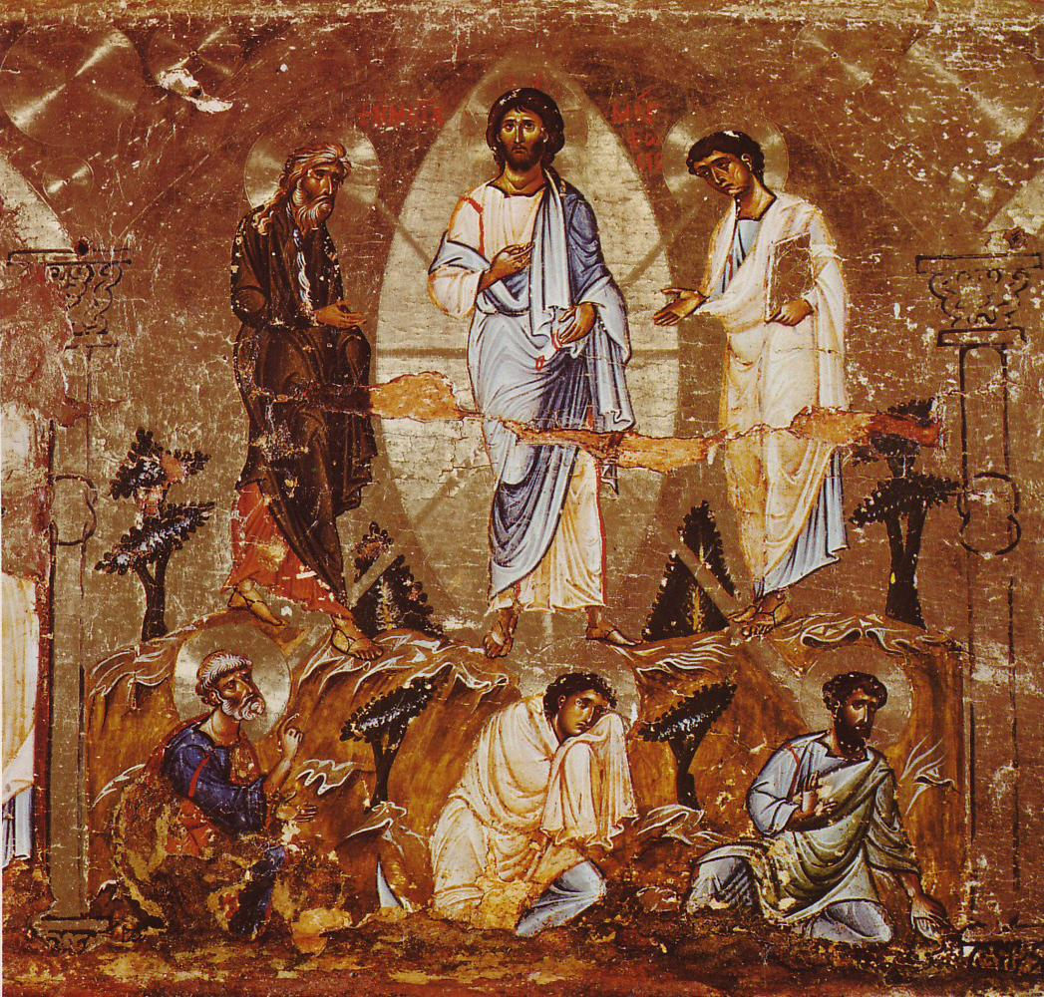
The Transfiguration: Old and New
This image depicts the Transfiguration.
Jesus, Peter, James, John, Moses, and Elijah are present in this image.
Read the story of the Transfiguration, found in Matthew 17:1-8

Slide 68
The Transfiguration: Old and New
Moses and Elijah are present because Moses represents the law and Elijah the prophets.
A key point this image and event communicate is that Jesus is the fulfillment of the law and the prophets. He came not to abolish the law but to fulfill it.
In other words, the unity and connection between the Old and New Testaments is made evident by the Transfiguration.

Slide 69
Typology: Old and New
St. Augustine said “The New Testament is hidden in the Old and the New Testament fulfills the Old.” He call the study of how the Old Testament is fulfilled by the New “typology.” Typology is the study of types in Scripture.
A type is a person, place, thing, or event in the Old Testament that foreshadows something greater in the New.

Slide 70
Typology: Old and New
For example, in the Tradition of the Church we refer to Mary as the New Eve. We also refer to Jesus as the New Adam or the New Moses. John the Baptist is referred to as the New Elijah.
They are referred to in this way because in some way they make new the things each of their Old Testament counterparts did. They bring the events of the Old Testament into fulfillment.
When we read the Old Testament in the light of Christ, it brings a whole new meaning to the events and helps us to understand more clearly what God is doing.

Slide 71
Lesson 6: World of the New Testament

Slide 72
The World of the New Testament
When we learn about Jesus and His life and teachings, there are a lot things that we don’t automatically understand.
Jesus lived more than 2,000 years ago in a place and culture very different from ours with preferences and customs that a person living in Jesus’ time would have instantly understood but we do not.
Therefore, before we do a deeper study of Jesus, it is helpful for us to consider the context in which He lived, the world of the New Testament.

Slide 73
Lesson 7: The Incarnation

Slide 74
Incarnation: God Entered Human History
Read Luke 1:26-38
What the angel announced to Mary, that God would become man in the Person of Jesus Christ, is the most important event in human history.
At the moment of Jesus’ conception, God Himself entered into human history. We call this the Incarnation: God become man in the Person of Jesus Christ.

Slide 75
Incarnation: God Entered Human History
It is said that the Incarnation is the hinge of history. That is, the Incarnation begins the act of salvation.
Everything before the Incarnation led up to this moment, and everything after the Incarnation is changed because of it.
The Catechism of the Catholic Church lists four reasons for the Incarnation, four reasons God the Son assumed a human nature in the Person of Jesus Christ.

Slide 76
God Became Man
Read Philippians 2:5-11
The mystery of the Incarnation is how the all-powerful, unlimited, eternal God could become one of His own creations, a man in a specific time and place.
Jesus was like us in all things but sin. That means that although He was 100 percent God, He was also 100 percent human. He knew what it was like to be like you and me, and most importantly, He knew what it was like to suffer.

Slide 77
Miracles Show that Jesus is God
We see all kinds of examples throughout Scripture of Jesus’ divinity: His miracles.
Each of the miracles of Jesus was, in part, meant to show that Jesus, as God, had all the power of God over creation. Jesus demonstrated His power over material things, over nature, over sickness and sin, and even over life itself.

Slide 78
Jesus is Like Us in All Things But Sin
Jesus, in His humanity, is like us in all things but sin. He knows what it means to be human. He has suffered and experienced pain. He knows joy and sadness, friendship and love, and everything in between.
The only thing that Jesus did not do, like us, is sin. Although He was tempted to sin, as we are, Jesus resisted all temptation.

Slide 79
Lesson 8: Jesus’ Life, Passion, Death, and Resurrection

Slide 80
The Kingdom of God is at Hand
Read Mark 1:15
This passage is the theme for Jesus’ entire public ministry. In fact, virtually everything He did and taught was connected to this statement in some way.
The time of fulfillment is Jesus’ coming, when all of God’s promises from the Old Testament will be fulfilled. Now is the time that the Jews had long been waiting for.

Slide 81
The Kingdom of God is at Hand
When Jesus says “The Kingdom of God is at hand,” He means that the Kingdom of God, which the Jews had been awaiting for centuries according to the prophets, was here and now. It had arrived. God’s reign had begun.
The word Gospel means Good News. The Good News that Jesus is preaching is salvation from sin. This is not just “good news” it is the best news! There is no greater news. In Christ, in God’s Kingdom, death and sin have been defeated and have no power over us. Therefore the Good News is that we are saved from death and sin and have been set free.

Slide 82
The Kingdom of God is At Hand
During Jesus’ three-year public ministry, He proclaimed this message in all He did.
He taught about what God’s Kingdom was like, sometimes directly and other times through stories called parables.
He taught us how to live in God’s Kingdom by loving God above else and loving our neighbor as ourselves.
He gave us the Beatitudes to be the Law of God’s Kingdom and to teach us how be fulfilled as sons and daughters of God.

Slide 83
The Kingdom of God is At Hand
He healed the sick, cast out demons, and forgave sins as signs of God’s grace and power.
He called Twelve Apostles to teach in a special way so that they could carry on His mission of salvation after He returned to the Father, and He gave them special powers to do as He did (forgive sins, heal the sick, cast out demons, and perform the Sacraments).
And He taught that He is the Bread of Life, the true food of eternal life. We must receive Him in the Eucharist to receive and participate in our salvation and continually renew the New Covenant He established in His blood.

Slide 84
The Resurrection Saved Us
Read 1 Corinthians 15:14-17
The Resurrection is one of the most important moments in the history of salvation. Without the Resurrection, sin and death would have won. We would still be sinners and still be enslaved by sin and death. There would be no hope of Heaven and no hope of salvation.

Slide 85
The Resurrection Saved Us
But Jesus did rise from the dead on the third day. He did defeat death and sin. And we do have hope of salvation and hope that we too will share in Jesus’ Resurrection.
This is the Paschal Mystery: how Christ’s Passion, Death, and Resurrection saved us from sin and death for new life as sons and daughters of God.

Slide 86
Lesson 9: The Gospel of Matthew

Slide 87
Who was St. Matthew?
Read Matthew 9:9-13
St. Matthew, also called Levi, was a disciple and Apostle who followed Christ. He was one of the witnesses of the resurrected Lord. He also witnessed the Ascension of Jesus into Heaven and, as one of the Apostles, was given by Christ the commission to make disciples of all nations. He was present in the Upper Room on the day of Pentecost and was with the other Apostles and Mary when they received the Holy Spirit. St. Matthew is the traditional author of the Gospel of Matthew (although some scholars believe the author was an anonymous person writing under Matthew’s name), which most scholars believe was written between AD 50 and 100.

Slide 88
Vocation
A vocation is a calling by God to holiness. God is calling all people to love and to be holy.
God also calls each person to a state of life: either marriage, religious life, or ordained priesthood.
The Church offers special care to those single persons who find themselves in circumstances not of their own choosing.

Slide 89
The Gospels
The Church constantly holds “that the four Gospels..., whose historical character the Church unhesitatingly asserts, faithfully hand on what Jesus Christ, while living among men, really did and taught for their eternal salvation.” -Dei Verbum 19
In order to better understand the Gospels, it is important for us as readers to understand the intended audience each Gospel writer was writing for, the arrangement or structure of the Gospel, and any important themes present in the Gospel.

Slide 90
The Gospel of St. Matthew
Everyone is called to enter the kingdom. First announced to the children of Israel, this messianic kingdom is intended to accept men of all nations. To enter it, one must first accept Jesus’ word. -CCC 543
Two of the main themes of Matthew’s Gospel are how Jesus fulfills the Old Testament promises of God and the proclamation of the Kingdom of God.
In other words, Matthew portrays Jesus as answering the first petition of the Lord’s Prayer, “your kingdom come.” In this Gospel, Jesus uses parables to teach about what the Kingdom of God is like and how we can enter into God’s Kingdom.

Slide 91
The Gospel of St. Matthew
The Gospel of Matthew is intended for a primarily Jewish audience. Matthew assumed his audience understood many Jewish customs and were familiar with the Old Testament Scriptures. Therefore, he made many connections, more than in any other Gospel, to the Old Testament and directly quoted often from the Old Testament.
Matthew begins his Gospel with a genealogy of Jesus. A genealogy is a listing of one’s ancestors, or a family tree. Matthew begins Jesus’ family tree with Abraham and traces it through many generations all the way to Jesus.

Slide 92
The Gospel of St. Matthew
Some of the names will seem strange to us today, but if you were a Jew living in Jesus’ time, you would have instantly recognized most of them.
The genealogy is an ancient literary device that draws attention to particular characters in a story.
Matthew is drawing attention to who Jesus is by showing His connection to Abraham and David as well as other significant people in Salvation History. By showing this connection, Matthew invites his audience to consider how God’s promises to three key Old Testament figures -- Abraham, Moses, and David -- are fulfilled by Jesus.

Slide 93
Lesson 10: The Gospel of Mark

Slide 94
The Gospel of St. Mark
The Gospel of Mark is the shortest and most action oriented of the four Gospels. It is also considered by most scholars to be the earliest written of the four Gospels. In fact, it is thought that the authors of Matthew’s and Luke’s Gospels used Mark’s Gospel as a source for their own Gospels.
Therefore, Matthew’s, Mark’s, and Luke’s Gospels are very similar to one another. All three present the story of Jesus’ life in a similar way with similar details, while each adds unique details to the story.
Traditionally, the author of Mark’s Gospel is thought to be a man named John Mark, who was not an Apostle, but was a traveling companion of St. Peter.

Slide 95
St. Mark Tells Us About Jesus
One of the main focuses of Mark’s Gospel is the mystery of Jesus. In the beginning of the Gospel we hear Jesus telling people to keep the fact that He is the Messiah secret.
Most scholars believe that this is because the Jewish people were expecting a Messiah who would be a military hero who would raise up Israel and free them from Roman or foreign oppression and reestablish Israel as an earthly kingdom.
But Jesus knew that was not the type of messiah He would be. He knew all along that He would give His life to save His people and establish not an earthly kingdom, but the Kingdom of God.

Slide 96
Outline of the Gospel of St. Mark
There are four main divisions in the “outline” of the Gospel of Mark:
1. The Preparation for the Public Ministry of Jesus (Mark 1:1-13) — In this division we hear about the ministry of John the Baptist, the Baptism of Jesus, and Jesus’ temptation in the desert.
2. The Mystery of Jesus (1:14-8:26) — Jesus calls the Apostles, Jesus cures people and casts out demons, and teaches about the Kingdom of God.

Slide 97
Outline of the Gospel of St. Mark
3. The Mystery Begins to Be Revealed (8:27–9:32) — Jesus asks who people say that He is, begins to predict His Death, is transfigured, and moves toward Jerusalem and His Passion. This section can be confusing because Jesus still teaches with parables and performs miracles throughout.
4. The Full Revelation of the Mystery (9:33–16:20) The priests try to nd ways to trap Jesus; Jesus’ Passion, Death, and Resurrection; and everything becomes clear to the Apostles.
Over the course of the Gospel Jesus reveals the mystery of who He is gradually and in stages until the full revelation is made clear in His sacrifice on the Cross, His Resurrection, and His Ascension.

Slide 98
Miracles in the Gospels
The Catechism of the Catholic Church defines a miracle as a sign or wonder, such as a healing or the control of nature, which can only be attributed to divine power.” Then ask your students if they or someone they know has ever witnessed a miracle.
For Mark and the other Gospel authors, a miracle is an act of God that is witnessed by people. In the Bible Jesus performs four main types of miracles.

Slide 99
Miracles in the Gospels
The first type of miracle are miracles of healing. Jesus healed people of their diseases or ills. He even raised the dead! Examples include the paralyzed being able to walk lepers being cured and the raising of Jairus’s daughter from the dead.
The second type of miracle are miracles of the supernatural. Jesus cast out demons that had possessed people; such people were then able to regain control and rejoin their community.
The third type of miracle are miracles of nature in which Jesus showed His power over nature. Examples include is walking on water and calming a storm.

Slide 100
Miracles in the Gospels
The fourth type of miracle are miracles of supply in which Jesus created something out of little or nothing or made one thing become something else. Examples include the multiplication of the loaves and fishes to feed the crowd of 5,000
We do see many of these types of miracles in the Old Testament and in the Acts of the Apostles, but Mark’s focus on Jesus performing miracles shows that He is the Messiah and the Son of God.

Slide 101
Lesson 11: The Gospel of Luke

Slide 102
The Gospel of St. Luke
Luke’s Gospel is perhaps the most complete of the four Gospels. In fact, at the very beginning of the Gospel, St. Luke tells us this was his purpose for writing:
“Since many have undertaken to compile a narrative of the events that have been fulfilled among us, just as those who were eye witnesses from the beginning and ministers of the word have handed them down to us, I too have decided, after investigating everything accurately anew, to write it down in an orderly sequence for you, most excellent Theophilus, so that you may realize the certainty of the teachings you have received.”

Slide 103
The Gospel of St. Luke
Written specifically to a man named Theophilus, Luke set out to write an orderly and detailed account of Christ’s life based on his own extensive research and investigation of the events. Luke’s is also the only Gospel that claims to be written chronologically.
The author of Luke’s Gospel is St. Luke. Luke was a traveling companion of St. Paul. He was also a physician and is mentioned multiples times in the New Testament Epistles. Luke was a Syrian convert to Christianity, which makes him the only Gospel writer who was not a Jew and not one of the first generation of Christians.

Slide 104
The Gospel of St. Luke
Even though Luke did not meet Jesus, his Gospel draws from extensive knowledge of Jesus’ life from those who did know Him, especially from His mother, Mary. It is very likely that Luke knew Mary and used her as a source for writing his Gospel. Luke’s Gospel has the most complete version of the birth and infancy narratives of Jesus, including details that only Mary would have known.
Luke was writing to an audience of Gentiles, non-Jewish converts to Christianity. As Luke wasn’t Jewish himself, he focused his Gospel on Jesus’ ministry to all nations, emphasizing that the Gentiles did not first have to become Jewish in order to believe in Christ.

Slide 105
The Gospel of St. Luke
Luke’s Gospel is also known as the Gospel of Mercy and stresses the importance of prayer and the working of the Holy Spirit.
Most scholars believe Luke’s Gospel was written after AD 70 because of references to the destruction of the Temple of Jerusalem. It is likely that the Gospel was written, then, around AD 85.

Slide 106
Sections of St. Luke’s Gospel
Luke’s Gospel can be divided into four basic sections, each with a major theme or focus of the narrative. These sections are:
1. The Prologue and Infancy Narrative: Explains why Luke wrote the Gospel; tells the Annunciation of Jesus’ birth, the birth story, and the stories of Jesus’ childhood.
2. The Preparation for and Ministry in Galilee: Focuses on Jesus’ preparation for His public ministry, including His baptism and temptation in the desert, and the beginning of His public ministry in Galilee, including some of Jesus’ basic teachings and stories of miracles. This section also highlights the difficulties and rejection Jesus experienced in Galilee.

Slide 107
Sections of St. Luke’s Gospel
3. The Journey to and Teaching Ministry in Jerusalem: The central portion of Luke’s Gospel focuses on Jesus’ journey towards Jerusalem and His Passion, which includes Jesus’ teachings on how to pray and the story of His triumphant entry into Jerusalem.
4. The Passion and Resurrection Narrative: Focuses on the story of the Last Supper and Jesus’ Passion, Death, Resurrection, and Resurrection appearances.

Slide 108
Mercy in Luke’s Gospel
One of the major themes of Luke’s Gospel is the mercy and forgiveness of Jesus.
Luke makes it clear throughout His Gospel that Jesus calls all who would follow Him to repentance of sin.
With the help of the Holy Spirit, everyone who responds in faith to the message of Jesus will receive forgiveness and salvation.

Slide 109
Lesson 12: The Gospel of John

Slide 110
The Gospel of St. John
John’s Gospel is very unlike the other three Gospels.
In fact, the other three Gospels (Matthew, Mark, and Luke) present the story of Jesus’ life in such similar ways that we call them the Synoptic Gospels.
The word synoptic means “to see together.” Matthew, Mark, and Luke see the story of Jesus’ life “together” and tell the story in much the same way, including their own details and emphasis wherever necessary.

Slide 111
The Gospel of St. John
John’s Gospel, however, is very different. The author of John’s Gospel assumes that his audience has read the other Gospels and knows their version of the story.
Therefore, John’s Gospel leaves out many details and stories the other three present. Instead, the Gospel spends a lot of time with certain important teachings and monologues of Jesus which deepen our theological understanding of the mystery of Christ. One could say that John’s Gospel fills in the spaces left by the other three Gospels.

Slide 112
Who was St. John?
The traditional author of John’s Gospel is John the Beloved Disciple, one of the Twelve Apostles and the Apostle to whom Jesus was closest. It is St. John alone among the Apostles who was present at the foot of the Cross, and it is to St. John that Jesus entrusted His mother’s care after His Death.
It is likely that John’s Gospel was the last Gospel written, sometime between AD 90 and 100. Therefore not only does the Gospel presents the story of Jesus from the point of view of an eyewitness but also reflects a much more developed theological understanding of who Christ is than the other three Gospels because of its later authorship.

Slide 113
How and Why St. John Wrote
Unlike the other synoptic Gospels, John did not set out to present a chronological or merely historical retelling of the story of Christ’s life. In fact, John states at the end of his Gospel in John 20:30-31, “Now Jesus did many other signs in the presence of [his] disciples that are not written in this book. But these are written that you may [come to] believe that Jesus is the Messiah, the Son of God, and that through this belief you may have life in his name.”
In this statement is revealed the true purpose of John’s Gospel: to reveal the deeper truths of Christ’s life so that his readers might believe that Jesus is the Messiah and Son of God and that through this belief we might have eternal life.

Slide 114
How and Why St. John Wrote
This is not to say that John’s Gospel isn’t historical — it is — but in stark contrast to the other Gospels, it is very poetic, symbolic, and literary. It is not told in a chronological way, but rather in a way that reveals the theological and spiritual truths of Christ’s life, specifically that Jesus is the Incarnate Word of God who has always existed with God from the beginning.
John’s audience was primarily Jewish, but decades later than that of Matthew’s Gospel. The Jews who would read John’s Gospel had already experienced the destruction of Jerusalem and the Temple and were being persecuted (just as Christians were).

Slide 115
How and Why St. John Wrote
There were many false ideas being taught about who Jesus was, and John’s Gospel helped to combat those ideas to present Jesus’ full humanity and full divinity. In other words, John wrote to develop a more complete Christology, or theology of Christ.
Certain stories, such as the wedding at Cana, the raising of Lazarus, and the Bread of Life discourse, appear only in John’s Gospel.
Further, John devotes a large portion of his Gospel to Jesus’ teaching at the Last Supper, which interpret the meaning of Christ’s Passion, Death, and Resurrection.

Slide 116
How and Why St. John Wrote
The narrative of John’s Gospel focuses on seven “signs,” or wondrous deeds, of Jesus. After each sign, Jesus teaches using dialogue with the disciples or crowds that turns into monologues. The movement from a dialogue to a monologue emphasizes that Christ’s teachings are now meant for the entire world.

Slide 117
Seven “I AM” Statements
St. John paints a very beautiful and vivid picture of who Jesus is in his Gospel through seven “I AM statements.”
In the burning bush, God revealed His name to Moses: YAHWEH or I AM WHO AM. The fact that God has a name means that he is knowable, and He invites us to know Him and be in relationship with Him. God’s name means God exists; He is being and existence.
In John’s Gospel, Jesus makes seven “I AM” statements. In other words, Jesus clearly speaks and claims the name of God.

Slide 118
Seven Signs
Throughout John’s Gospel there are seven key signs that all communicate the greater reality of Jesus’ ultimate mission: our redemption and freedom from sin.
When John uses the word signs, he’s really referring to miraculous or wondrous deed or events in the life of Jesus.
It is not these seven miracles or wondrous deeds of Christ that are truly important. Rather, the greater truth they symbolize is what is most important.

Slide 119
The Sacraments
Grade 7: Unit 3

Slide 120
Lesson 1: Exploring the Sacraments with Sacred Art

Slide 121
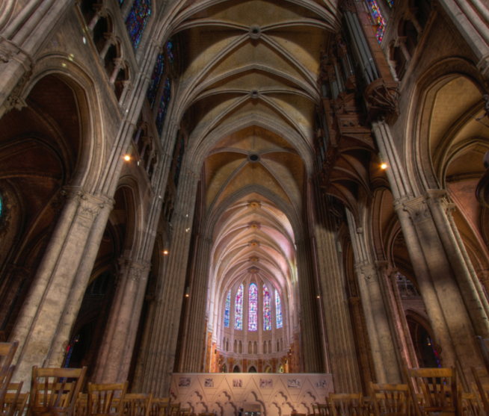
The Church as a Sacrament
The seven sacraments are the signs and instruments by which the Holy Spirit spreads the grace of Christ the head throughout the Church which is his Body. The Church, then, both contains and communicates the invisible grace she signifies. It is in this sense, that the Church is called a “sacrament.” -CCC 774

Slide 122
The Church as a Sacrament
Read John 19:33-35.
The Church understands this moment as the birth of the Sacraments, specifically, Baptism and the Eucharist.
The blood that poured out of Jesus’ side represents the Eucharist, and the water from Jesus’ side represents Baptism. Each angel in the Raphael painting catches Jesus’ Precious Blood in a chalice, signifying the birth of the New Covenant in Christ’s Blood.

Slide 123
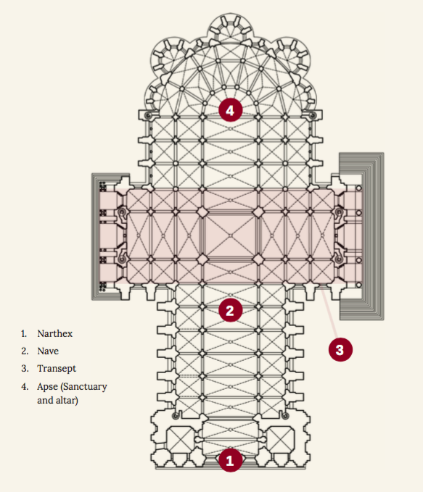
The Church as a Sacrament
Cathedrals and many church buildings are built in the shape of a cross to remind us of the Crucifixion.
We enter the Catholic Church through the Sacraments, and the way we enter a physical church building through the side reminds us of how the Sacraments were born from Christ’s side.

Slide 124
Lesson 2: What is a Sacrament?

Slide 125
Called to Be Perfect
Read Matthew 5:48.
Jesus teaches us a lot of hard things in the Sermon on the Mount: be poor in spirit, be meek and merciful, turn the other cheek, love your enemy. These are hard. But this last teaching seems totally impossible.
How can it be possible that He calls us to be perfect? Isn’t that a totally unrealistic expectation, in light of Original Sin?
Jesus’ teaching is totally unrealistic if we count on ourselves to do it. If we rely only on ourselves to be perfect, we will surely fail.

Slide 126
Called to Be Perfect
But Jesus does not leave us on our own. God is always with us and will never abandon us. We should ask the Holy Spirit to guide us every day.
To allow us to receive His grace in a special way, Jesus instituted and gave to the Church special signs, called Sacraments. When we receive them, we share in His life. If we cooperate with that grace, we can become more like Him.
A Sacrament is an efficacious sign of grace instituted by Christ and entrusted to the Church by which divine life is dispensed to us through the work of the Holy Spirit.

Slide 127
The Sacraments
Grace is the free and undeserved gift of God’s life in us.
The Sacraments are about God’s life moving within us, and not about anything we do or “earn.” God gives us His grace freely, and not because we have done anything to deserve it.
Across time and place, we have special ways of marking the important moments of our lives. Jesus elevated seven important moments to Sacraments. Although Jesus is not with us in the exact same way He was with the Apostles, He is still with us. He is acting in the world and in our lives.

Slide 128
The Sacraments
He entrusted the Sacraments to the Church — the visible sign of His Kingdom on earth. When He tells us to be perfect, He knows we need to depend on Him to do it.
The Trinity is an unbreakable bond of life-giving love. The exchange of love between the Father and the Son is the Holy Spirit, and it is through the Holy Spirit that God makes us His children and shares His life with us in the Sacraments.

Slide 129
Lesson 3: Baptism: History and Celebration

Slide 130
This First Sacrament
By this first of Sacraments we are made members of Christ’s Church and cleansed of all sin, receiving a portion of the Holy Spirit in our lives.
Baptism is necessary for salvation and has been prefigured throughout Salvation History to prepare for its institution by Christ’s Baptism and His command to His Apostles. By Baptism we are made new creations, and with the support of the whole Christian community we advance on the journey toward salvation.
Baptism is “the sacrament of regeneration through water in the word” (CCC 1213) and “the washing of regeneration and renewal by the Holy Spirit” (CCC 1215).

Slide 131
God Prefigured Baptism
God prefigured the Sacrament of Baptism throughout His saving work in Salvation History.
From the very beginning, when the Spirit of God hovered over the primordial waters, to Noah and the Great Flood, to the crossing of the Red Sea and the River Jordan, we have always understood these events as the signs that point the way to Baptism.
God’s people pass from chaos, death, slavery, and sin, through powerful and life-giving waters, to new life in grace and freedom as a new creation.

Slide 132
Jesus’ Baptism
Jesus Christ is God’s love fully revealed and the culmination of Salvation History.
Although He had no sin, it was fitting that He be baptized as a model of holiness.

Slide 133
Lesson 4: Baptism: Effects and Living the Sacrament

Slide 134
Effects of Baptism
Read Acts: 2:38.
The effects of Baptism that St. Peter proclaims to the people are forgiveness of sins and receiving the gift of the Holy Spirit. These are the two main effects of Baptism.
There are others that we recognize. The effects of Baptism are the forgiveness of sins, becoming a new creature, becoming a member of the Church, forming bonds of Christian unity, and the imprint of an indelible mark on the soul.

Slide 135
Lesson 5: Confirmation: History and Celebration

Slide 136
Confirmation: Gift of Courage
Confirmation fills a baptized person with a special strength of the Holy Spirit that enables him or her to proclaim the Faith. It is not a recognition of your readiness; it is what readies you.
As with every Sacrament, God does all the work. Our role is to receive His grace and cooperate with it so it will bear fruit. Although we might be required by our parishes to do certain things as part of a preparation program, we do not do anything to earn any Sacrament.
Jesus gave us this Sacrament because He knows that sometimes what we need isn’t simply more faith, but the courage to live that faith and share it with others.

Slide 137
Anointing Prefigured
It has been this way since the beginning of Salvation History. In the Old Testament, Levitical priests and kings descended from David were anointed with holy oil as a sign of their status as a priest or king and of the task given to them according to their position. Prophets were anointed as well and set apart for the task of proclaiming the Word of God.
Messiah means “anointed one.” We use the word today to mean Jesus Christ alone, but in its original meaning all those who were anointed were messiahs. That means that the kings descended from David in the Jewish royal kingdom were messiahs because they were all anointed. This anointing gave the person an outpouring of God’s Spirit to empower him for the tasks given to him by God.

Slide 138
Our Anointing
From the very beginning through the New Testament and even today, God desires His people to be a “royal priesthood ” anointed and consecrated as His chosen people who will announce the praises of His saving work.
The Sacrament of Confirmation completes the work begun in us at our Baptism and sets us apart as this very royal priesthood proclaimed since the Old Testament.
We can see this exact understanding in the New Testament. Read 1 Peter 2:9.

Slide 139
Foundation of the Sacrament of Confirmation
Read Acts 1:8 and 8:14-17.
Not only were the Apostles empowered by the Holy Spirit to baptize others and to make them members of the Church, but they very soon went out from Jerusalem and gave others the very same gift of the Holy Spirit that they had received.
This is the basic foundation for the Sacrament of Confirmation. Jesus promised the gift of the Holy Spirit, which was received by the Apostles at Pentecost. From there, the Apostles followed Jesus’ command to make disciples of all the nations by baptizing them, and they bestowed upon them what they had received, the gift of the Holy Spirit, so that these new disciples could do as the Apostles did and proclaim Jesus as Lord.

Slide 140
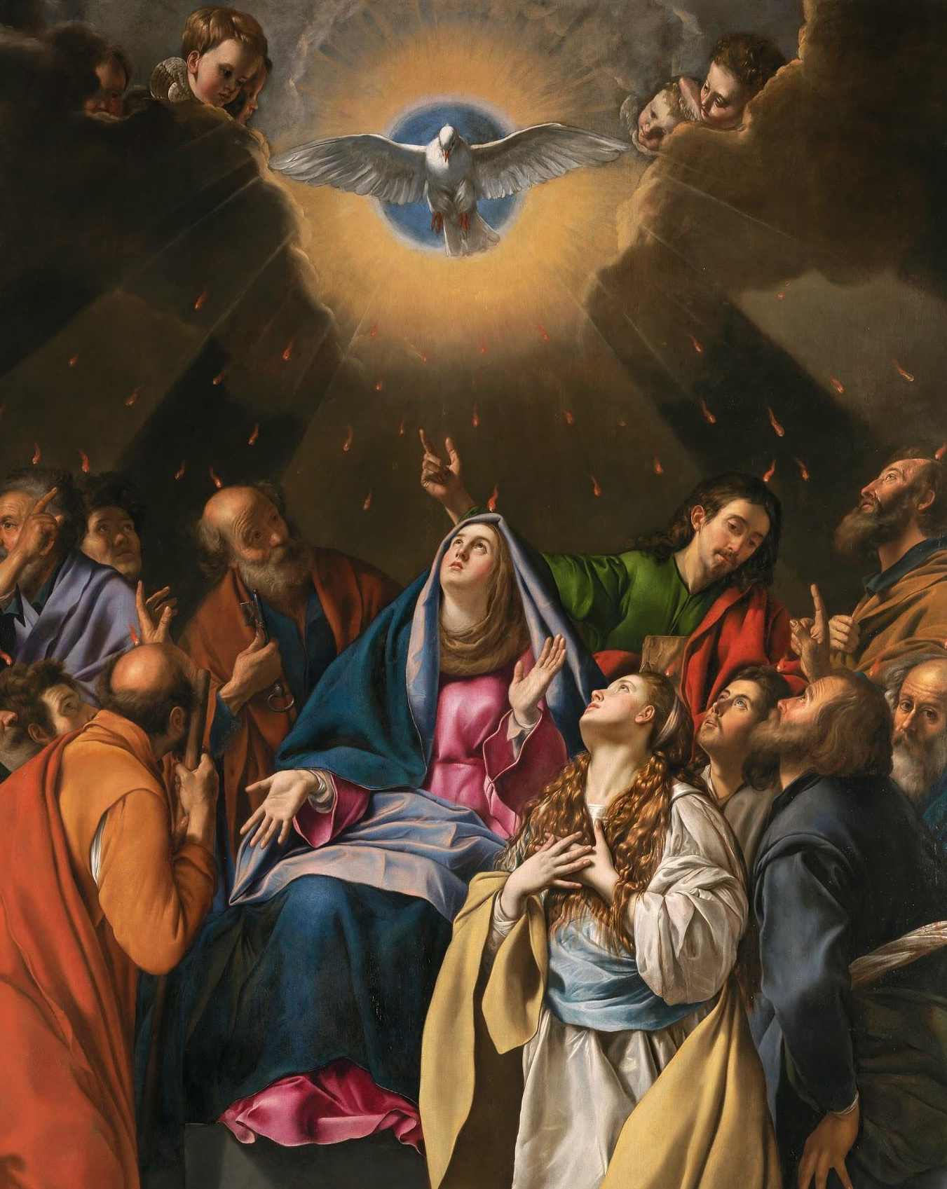
Pentecost: Strengthening of Jesus’ Followers
In this painting of Pentecost, the men are the Apostles. The woman seated in the center is the Blessed Virgin Mary. The woman kneeling is St. Mary Magdalene. Both the Blessed Mother and St. Mary Magdalene remained with Jesus at the foot of the Cross.
The Blessed Mother was the first of Jesus’ disciples, and St. Mary Magdalene was the first to witness the resurrected Christ on Easter Sunday. It is fitting, then, that they be among the first to receive the Holy Spirit at Pentecost.

Slide 141
Lesson 6: Confirmation: Effects and Living the Sacrament

Slide 142
Laying On Of Hands
Read Acts 8:14-17
Not only were the Apostles empowered by the Holy Spirit to baptize others and to make them members of the Church, but they very soon went out from Jerusalem and, by laying hands on them, gave others the very same gift of the Holy Spirit that they had received.
This is the foundation for the Sacrament of Confirmation.

Slide 143
Lesson 7: Eucharist: History and Celebration

Slide 144
Eucharist: Source and Summit of Our Faith
The Eucharist is “the source and summit of the Christian life.” -CCC 1324
The Catechism puts it like this: “The other sacraments, and indeed all ... ministries and works ... are bound up with the Eucharist and are oriented toward it. For in the blessed Eucharist is contained the whole spiritual good of the Church, namely Christ himself” (CCC 1324).
In other words, the whole of the Christian life begins with the Eucharist and is directed toward the Eucharist. It is the “source and summit” of our Faith.

Slide 145
Unless You Eat the Flesh of the Son of Man...
The Eucharist is Jesus’ Body and Blood under the appearance of bread and wine.
Jesus commands us to eat His Body and drink His Blood. In the Gospel of John He tells us in no uncertain terms: “Unless you eat the flesh of the Son of Man and drink his blood, you do not have life within you” (6:53).
Why would He tell us to do something that sounds so strange? Yet there are reasons why it made perfect sense for Jesus to tell us to do these things.

Slide 146
Unless You Eat the Flesh of the Son of Man...
It takes faith to believe this mystery.
Read the story of “doubting” St. Thomas, whom Jesus told, “Have you come to believe because you have seen me? Blessed are those who have not seen and have believed” in John 20:24-29).

Slide 147
Unless You Eat the Flesh of the Son of Man...
St. Thomas Aquinas (a brilliant theologian who lived in the 11th century and believed that what we know by faith and what we know by the power of human reason are compatible and complementary) and ancient Greek philosophers such as Aristotle, believed that you could fully explain something, even if they could not penetrate the mystery, by answering four basic questions about that thing.
What is it?
What is it made of?
These four questions are known as the “four causes” and that if you can answer each question successfully and satisfactorily then you have fully explained the thing you’re trying to explain.
Who or what made it or caused it to happen?
What is it for?

Slide 148
Lesson 8: Eucharist: Effects and Living the Sacrament

Slide 149
Unity
There is a very special kind of closeness that can be described as being united. For example:
A husband and wife are united in marriage.
A mother or father and their child are united in a family. Even if all the members of a family don’t live together, they will always be parent/child.
Siblings are united through their parents.

Slide 150
Unity
When we receive this Sacrament, we are taking into ourselves the Body and Blood of Jesus Christ. He is united with us, and we are united with Him. All Christians are united with each other: when we eat the Body of Christ, we become the Body of Christ: united with Him and with each other.
Read John 15:5.

Slide 151
Lesson 9: Penance and Reconciliation: History and Celebration

Slide 152
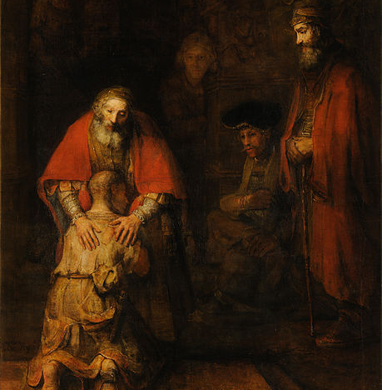
Parable of the Prodigal Son
The Parable of the Prodigal Son teaches us about unconditional, self-giving love. When we go to Confession, we are like the younger son who goes to the father and asks for forgiveness. God the Father completely forgives us and is overjoyed when we come home.

Slide 153
The Authority to Forgive Sins
Jesus gave St. Peter the authority to make decisions for the Church that would be binding on earth and in Heaven; He gave the Apostles (the first bishops) the power to forgive or retain sins.

Slide 154
Lesson 10: Penance and Reconciliation: Effects and Living the Sacrament

Slide 155
Spiritual Restoration
Read Isaiah 1:18
The Eucharist is the source and summit of our Faith. Jesus is the Lamb of God whose sacrifice takes away the sin of the world. When we receive the Eucharist we become more like Christ: pure.
Recall the main difference between venial and mortal sin. Mortal sin severs our relationship with God. Venial sin hurts — but does not sever — our relationship with God. We need Confession to be forgiven of mortal sins and return to God’s grace.
The sacrament of Reconciliation with God brings about a true “spiritual resurrection,” restoration of the dignity and blessings of the life of the children of God, of which the most precious is friendship with God. -CCC 1468

Slide 156
Lesson 11: Anointing of the Sick: History and Celebration

Slide 157
Strengthening in the Face of Suffering
All good things come from God. and happiness in this life is meant to give us a taste of the happiness we will experience in Heaven.
As with happiness on earth — all suffering in this life is also temporary. But the wages of sin is death — eternal separation from God. Jesus came to free us from suffering, sickness, and death through His own suffering and Death on the Cross.
In the Sacrament of Anointing of the Sick, we receive an outpouring of God’s grace to strengthen us to face suffering and sickness and even death that results from Original Sin.
When we are sick, we feel better if someone is with us. Jesus knows what it was like to be lonely and experienced it Himself. Visiting the sick is a Corporal Work of Mercy.

Slide 158
Anointing of the Sick Prefigured
In the Old Testament and up through the time of Jesus, the people believed that sickness and suffering were the direct result of sin. Therefore, they looked to God for healing of their sickness and suffering by the forgiveness of their sins.
Some even believed that God would save them from death, which was also the direct result of the sin of Adam and Eve.
In the end, through the prophecy of Isaiah, the people believed that when the Messiah came to usher in God’s kingdom, He would be announced by miraculous healings and the forgiveness of all sin.

Slide 159
Anointing of the Sick Prefigured
Although sin can certainly be the direct cause of our sickness and suffering (both personal sin, and structures of sin), often sickness and suffering serve another purpose: so that the works of God might be made visible through our suffering.
In Jesus, our suffering and sickness can be redemptive. In other words, we can come to know God and experience conversion because of our suffering and sickness.
This is a change from the Old Testament understanding of suffering and sickness. In Christ, suffering takes on new meaning. In fact, it is a requirement of being a disciple.

Slide 160
Lesson 12: Anointing of the Sick: Effects and Living the Sacrament

Slide 161
Christ and Suffering
Christ not only allowed Himself to be touched by the sick, but He made their miseries His own.
“Often Jesus asks the sick to believe. He makes use of signs to heal: spittle and the laying on of hands, mud and washing” -CCC 1504.
Read Isaiah 33:24. The place that is referred to is The Kingdom of God.
Jesus ushered in the Kingdom of God by fulfilling the prophecy of Isaiah, healing the sick and forgiving sins.
The rite of Anointing of the Sick is based in large part on the example of Jesus, as well as his command to the Apostles to heal the sick.

Slide 162
Christ: Meaning in Suffering
“Suffering ceases to be suffering at the moment it finds a meaning, such as the meaning of a sacrifice.” -Victor Frankl, Man’s Search for Meaning
Frankl was a physician who endured life in a Nazi death camp. In his book Man’s Search for Meaning, he wrote about his experiences in the camp and the various ways his fellow prisoners dealt with their extreme suffering. He concluded that the only way to endure such suffering is to invest it with meaning.
Jesus made suffering meaningful by offering it for the redemption of the world. We can unite our suffering to His for the sake of ourselves and others.

Slide 163
Lesson 13: Holy Matrimony: History and Celebration

Slide 164
God Established Marriage and Made It a Sacrament
Marriage is a covenant that has existed since God made it when He created Adam and Eve. The first consequence of the Fall was a rupture in communion between Heaven and earth, and in the communion between husband and wife.
Marriage existed even after the Fall because it is in our natures.
When Jesus came, He first revealed Himself to the public as the Son of God and Savior in the midst of a wedding. By doing so, Jesus announced that the time had come for God’s relationship with His people to be restored at the same time that He elevated marriage to a Sacrament.

Slide 165
Marriage Reflects God’s Divine Nature
Now that Jesus has redeemed us and made marriage a Sacrament, marriage too reflects God’s divine nature.
If it seems strange to see Jesus at the Creation of Adam and Eve where we usually see God the Father depicted, remember that God is the Blessed Trinity: one God in three Divine Persons. As we say in the Nicene Creed, Jesus is the same substance as the Father, born of Him before all ages.

Slide 166
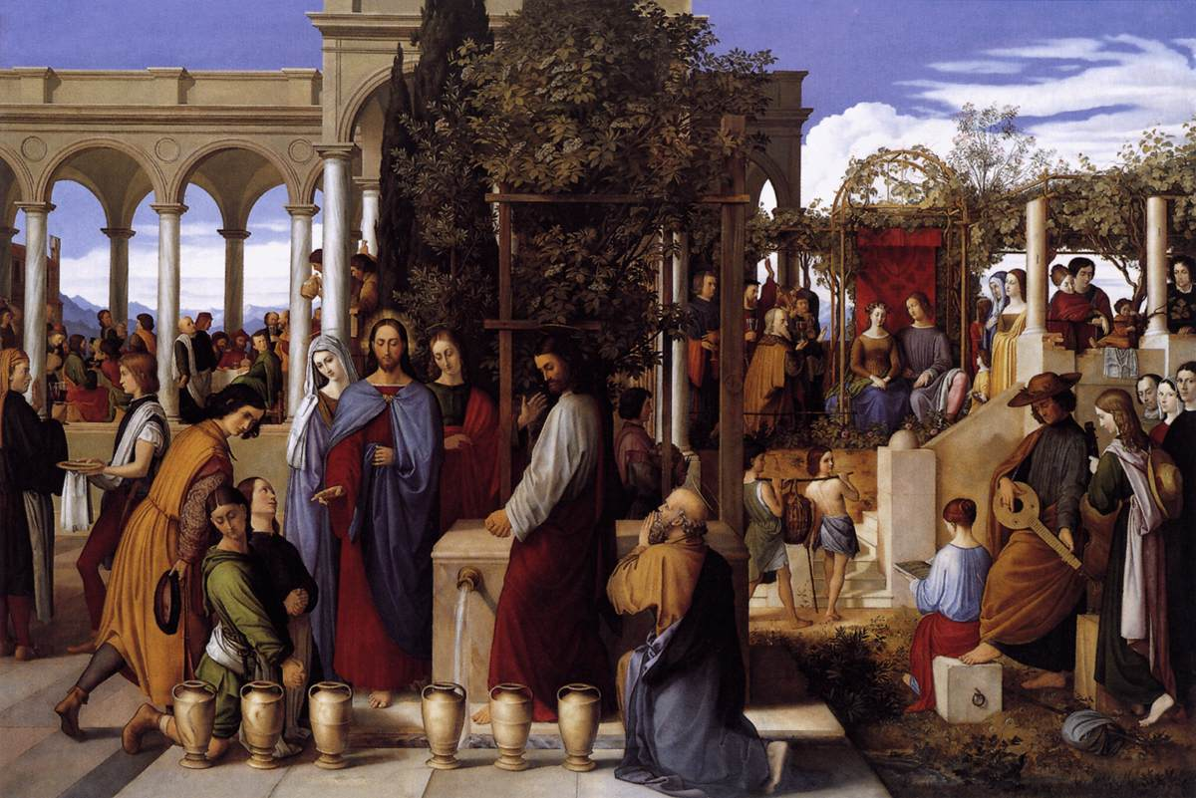
Jesus Gives the Grace for Good Marriages
Jesus is first revealed to the public as the Messiah, the Son of God and Savior, at the Wedding at Cana.
In this painting, Jesus is central, in blue and red. Mary is to the left of Jesus, and John to the right. Peter is kneeling.

Slide 167
Jesus Gives the Grace for Good Marriages
The man standing in red and white is likely an Apostle, probably James. The two men kneeling in green are servants, and the man in yellow is likely the headwaiter.
The man and woman sitting in the back right are the bride and groom. All the other people are guests.
Just as Jesus was present at the Wedding at Cana, He gives husbands and wives the graces and the strength to live the Sacrament of Matrimony as a Sacrament of love.

Slide 168
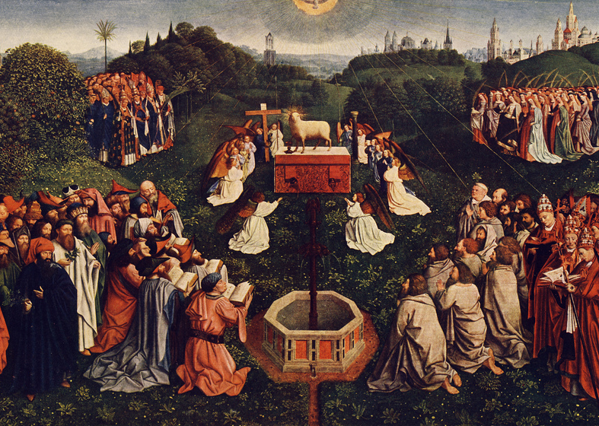
God’s Love is Reflected in Marriage
God’s love for us has four components or parts: it is free, total and self-giving, faithful, and fruitful.
Human love, particularly the love shared between spouses in marriage, or marital love, is a reflection of how God loves. There is no love apart from God.

Slide 169
God’s Love is Reflected in Marriage
1 John 4:8 tells us, “Whoever is without love does not know God, for God is love.”
The opposite of this statement is true as well: “Whoever knows love knows God, for God is love.”
The characteristics of God’s love are comparable to those of marital love. The characteristics of marital love are also known as the Goods of Marriage.”

Slide 170
Lesson 14: Holy Matrimony: Effects and Living the Sacrament

Slide 171
Living In Charity
The theological virtues are supernatural virtues that we receive from God in Baptism and are the source of many other virtues.
The practice of all the virtues is animated and inspired by charity, which “binds everything together in perfect harmony”; it is the form of the virtues; it articulates and orders them among themselves; it is the source and the goal of their Christian practice. Charity upholds and puri es our human ability to love, and raises it to the supernatural perfection of divine love. -CCC 1827

Slide 172
Living In Charity
The fruits of charity (love) are joy, peace, and mercy (CCC 1829).
In a marriage rooted in virtue, the spouses and their children are joyful, at peace, and merciful to one another, ultimately reflecting with each other God’s love for us.

Slide 173
God’s Plan for Marriage
Read Matthew 19:3-8.
The most important part of Jesus’ answer is the last line “from the beginning it was not so.” Whatever the state of marriage in our world today, it was not how God created or intended it to be.
Jesus suffered and died on the Cross to save us from sin and all of its effects which includes the effects of sin on marriage. Marriage forms a bond of love between the husband and the wife that cannot be dissolved.

Slide 174
God’s Plan for Marriage
From the beginning this was God’s plan for man and woman for marriage and for family.
Though some families include divorced, remarried, and single parents, God still brings forth goodness and love from them. However, this does not minimize God’s original plan for humanity and marital love, which Jesus seeks to restore in our hearts.

Slide 175
Lesson 15: Holy Orders: History and Celebration

Slide 176
Vocation
The word vocation, in its religious context, means a call to a state in life, such as married life, ordained priesthood, or religious life. It comes from the Latin vocare, meaning “to call.” (Words such as advocate, vocalize, provocation, and evocative contain this same root.)
God calls each and every one of us to holiness, and we must all discern whether we have a vocation to religious or ordained life.

Slide 177
Vocation to Holy Orders
While we are all called by Jesus to follow Him and lead holy lives, the call to the Apostles was very special: He made the Apostles the first priests at the Last Supper. For the last 2,000 years, Jesus has called certain men to be His priests.
Holy Orders is the Sacrament through which Christ continues His ministry in the Church until the end of time.
Jesus became man to be with us, and He is still with us! The priesthood makes this reality visible. Called men receive the Sacrament of Holy Orders to give their lives to Jesus’ flock. Priests’ authority comes from Christ Himself.

Slide 178
Lesson 16: Holy Orders: Effects and Living the Sacrament

Slide 179
Vocation to Holy Orders
Bishops and their collaborators, priests, are the successors of the Apostles.
The authority that bishops and priests are given to act in the person of Christ, the Head of the Church, comes from Jesus Himself.
Jesus’ choice of only men to serve as Apostles does not mean that women are somehow inferior or less talented.

Slide 180
Prayer
Grade 7: Unit 4

Slide 181
Lesson 1: Exploring Prayer with Sacred Art

Slide 182
Prayer is Conversation with God
Read 1 Samuel 3:4-10, 19-21
Read Luke 5:4-11
Prayer is a conversation with God. In these Bible stories, god initiated both conversations. God always invites us to pray first.
“Whether we realize it or not, prayer is the encounter of God’s thirst with ours. God thirsts that we may thirst for him” . -CCC 2560

Slide 183
Lesson 2: Prayer

Slide 184
Prayer is Our Lifeline
Prayer is like our “lifeline” to God.
How long can you hold your breath? Not very many of us can even make it a whole minute without gasping for air. We know that air is essential for our life, so we breathe. We don’t even have to think about it. It just comes naturally.
What if we treated prayer the same way? What if we prayed “without ceasing,” as Paul tells us to do in 1 Thessalonians? If God is our Creator and our Sustainer, then He is like the very breath that we breathe. We need God just as we need air in our lungs. If we viewed prayer the same way as we viewed oxygen, we would all be a lot holier.

Slide 185
Prayer is Our Lifeline
The Church tells us that humility is the foundation of prayer. We must come to God with an open heart, knowing who we are and how we stand in front of Him. We are His creation, His sons and daughters.
St. John Damascene tells us that “prayer is the raising of one’s mind and heart to God or the requesting of good things from God.”

Slide 186
Five Types of Prayer
There are several types of prayer. First, we must always remember that the Holy Spirit is a part of our prayer. It is through Him that we are able to call out to God as our Father.
The five types of prayer are blessing and adoration, petition, intercession, thanksgiving, and praise.
Blessing and adoration is man’s response to God’s gift. To bless is to wish for or to give good things to another. To adore is to worship. God blesses us all the time - our very lives are a blessing! Because God is good and gives us all good things, we can in turn give good things back to him in worship. of Him.

Slide 187
Five Types of Prayer
Prayer of petition is to ask God for our own needs. The first need we must ask for is forgiveness. Then, for God’s Kingdom to come and for the grace to cooperate with its coming. And then, for all good things that we may need and even want. God wants us to trust Him enough to ask Him for everything.
Intercession is prayer for the needs of others. We can pray for our family, our friends, anyone in need of prayer, and even for those who are in Purgatory.

Slide 188
Five Types of Prayer
Prayer of Thanksgiving is just that - thanking God for all that He is and all He has given us. St. Paul teaches us to “give thanks in all circumstances” so even in times of difficulty we can thank God for the good He may bring out of our mess.
Last, praise is when we tell God that He is good and great for His own sake, not because of what He has done, but because of who He is. We recognize that God is God and we are His children.

Slide 189
Five Types of Prayer
Prayer can be expressed in different ways. Sometimes in class we pray out loud. And sometimes you’re asked to close your eyes and meditate on a certain Scripture passage or scene.
God even calls us to become so close with Him that we enter into contemplative prayer, which is when we just sit with Him in silence and allow Him to speak to us.

Slide 190
Difficulties in Prayer
Prayer is necessary but it can be difficult. We often picture the saints having beautiful experiences of prayer, sitting in silence all day praying to God. Well, maybe some of them did that ... but they did a lot of work to get to that point.
We all need to seek the voice of the Lord, and the more we tune in to His voice, the easier it will be to hear Him and understand Him.
Christ tells us that His sheep listen to His voice; He knows them, and they follow Him. This is our desire in prayer — to hear the voice of God and follow Him.

Slide 191
Difficulties in Prayer
But sometimes the biggest practical difficulty in prayer is distraction. We seem to be able to focus during our sports games, during our conversations with friends, and even during tests. But have you ever noticed that the moment we try to enter into prayer, we start thinking about all kinds of other things? “What’s for lunch?” “What is that guy wearing?” “Did I turn in my homework?” “Do I smell bad?”
You’re not weird if you can’t concentrate during prayer. Prayer can really be more like a battle sometimes — a battle to sit in the silence, stay still, and just listen. But keep persevering! The more you pray, the better you’ll get at it.

Slide 192
Difficulties in Prayer
Prayer is a two-way street, just like a phone call with a friend. We shouldn’t expect to talk the whole time, telling our friend about our hopes or troubles, and then just hang up the phone. We need to take time to listen to our friend on the other end of the phone, too.
Sometimes this can be really difficult to do in prayer, to let God speak to us. We can experience dryness in prayer when it feels as if nothing is happening. We can be tempted to ask, “Is God really listening? Does He even care? Will He really answer me?”
Again, keep persevering. Trust that God has a plan for you and whatever you are worried about. Remember to take it all to the foot of the Cross.

Slide 193
Difficulties in Prayer
Use whatever tips and tricks help you in prayer. For example, pray with Scripture, a sacred image, a sacramental such as the Rosary, or a song (St. Augustine said, “He who sings prays twice”). Use whatever works in prayer to let you hear the voice of God through the Holy Spirit.

Slide 194
Lesson 3: Prayer in Salvation History

Slide 195
Jesus Revealed God as Our Father
We learn a lot about God through the stories of the Old Testament, but there was still more to learn about Him (and there always will be).
Jesus Christ came in the fullness of time and revealed more of the Father. Jesus taught His disciples to pray in a specific way. He taught us that we must first come to God in humility. But e also taught us to be bold in asking for help. He said “all that you ask for in prayer believe that you will receive it and it shall be yours” (Mark 11:24).
All of these concepts were new to the Jewish people. The people were familiar with faith in God but did not know God as a Father.

Slide 196
Jesus Revealed God as Our Father
Just like a good earthly father, our Father in Heaven longs to give us good things. In other words, He wants us to go to Him in prayer and ask for whatever we need.
Often, we bring our doubt into prayer with questions like “Does He even care?” or “Why would He want to help me?” But always remember that God is a good Father. He wants to give His children the best. Although His answers to prayers aren’t always what we expect, He always listens and wants to give us good things.

Slide 197
Adhering to God’s Will
Christ also taught us that prayer must involve adherence to the will of God. For example, even in the most difficult time during the Agony in the Garden, Jesus prayed for His Father’s will. “My Father if it is possible let this cup pass from me yet not as will but as you will” (Matthew 26:39).
It was, in fact, the will of the Father that Christ suffer and die for us, so Christ “took up His cross” and followed the will of God.
Surely, if Christ can follow God’s will to the point of death, we can learn to follow His will in small ways daily through prayer.

Slide 198
Lesson 4: The Lord’s Prayer

Slide 199
Jesus Revealed God as Our Father
Christ’s disciples often asked Him about prayer. Even before they understood His divinity, they knew that He was greater than anyone they had met before. So, consider why Christ chose to teach His disciples the Lord’s Prayer. Think about how it differs from what they were used to.
First Jesus revealed a filial relationship with God. Filial means of or due from a son or daughter. o lial love is the love from a child to a parent. We can approach God as our Father.

Slide 200
Jesus Revealed God as Our Father
Fathers are so important that Jesus had not just a heavenly Father but also an earthly one: his “foster father,” St. Joseph. By choosing to be raised by a mother and a father, Jesus elevated the dignity of the family and affirmed how essential the love between parent and child is.
This love God offers us makes perfect sense. Our families may not all live together but every human being on this planet was born to a mother and a father. On a very human level, we know this kind of love intimately. It makes sense—a child needs and wants his or her parent’s loving support, and a parent instinctively wants to share his or her child’s joy and sorrow.

Slide 201
Jesus Revealed God as Our Father
Second, you’ll notice that there are many elements of prayer within the Our Father.
For example, we can see a prayer of blessing and adoration in the words, “hallowed be Thy name,” reminding ourselves that God is holy and adoring im for is goodness.
We also recognize a prayer of petition in the words, “give us this day our daily bread,” which refers not just to bread in the literal sense but to all of our daily needs.

Slide 202
The 7 Petitions of the Our Father
Read aloud Matthew 6:9-13.
In the Our Father, there are seven petitions:
Hallowed be Thy name.
Thy Kingdom come.
Thy will be done.
Give us this day our daily bread.
The number seven symbolizes perfection in the ancient world, and the seven petitions are one sign that the Our Father is a perfect prayer.
Forgive us our trespasses.
Lead us not into temptation.
Deliver us from evil.

Slide 203
Filial Love and God’s Love
Our parents’ love for us means that they want to share our joys and sorrows.
God’s love is even greater than our parents’ love, and because He is all knowing, He knows our sufferings and can be with us in our deepest hurts. Our sufferings can bring hope because we know that God makes all things new.
God also understands our greatest joys. He rejoices with us when we do good, obey His will, and grow closer to Him.

Slide 204
Lesson 5: Praying to the Father, to the Son, and to the Holy Spirit, in Communion with Mary, the Mother of God

Slide 205
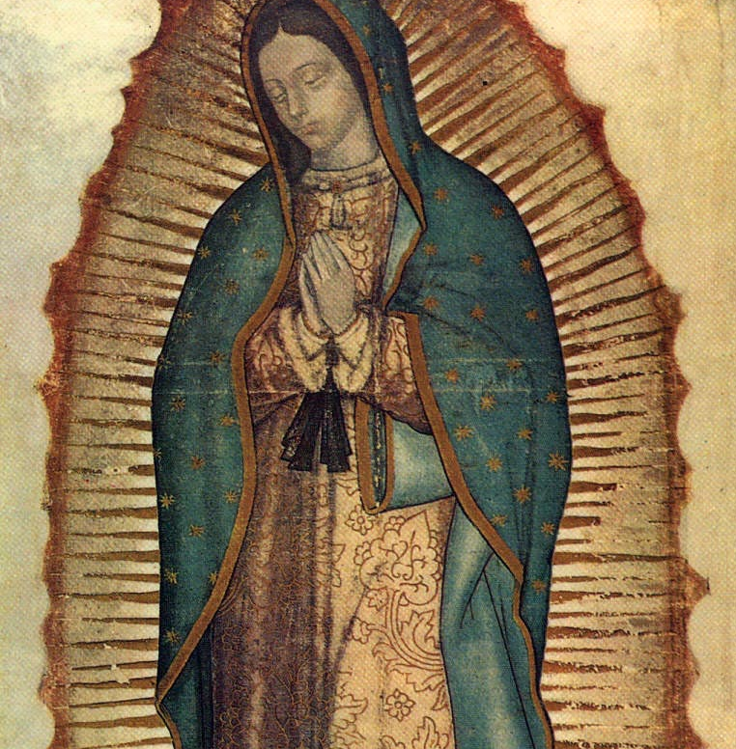
Mary
Mary can teach us so much about prayer and what it means to be a child of God.
The image of Our Lady of Guadalupe demonstrates Mary’s profound obedience and receptivity. Our Lady was carrying the Savior in her womb in this apparition. Today she is patroness of the unborn -- protector of babies in the womb.

Slide 206
Mary
When she said yes to the Lord’s will, she was saying yes to a lot. Take a moment to think about what it would be like if you were in Mary’s situation. What if the Lord came to you today and asked you to do something radical for Him that would your response be would it be difficult to say yes?
In those days, women who were pregnant and unmarried could be stoned for their actions. Also, Mary was so close with the Lord that it is possible that she knew the suffering that would come in the Passion and Death of Christ. She personified perfect obedience and trust in the goodness of God.
Through Mary’s yes, the world was saved, and we are taught deeper obedience to the will of God.

Slide 207
The Visitation: Prayer in Joy
We see Mary’s joy and exaltation of God in the Visitation. Her response to her cousin’s joy is to pray! She focuses not on herself but on God -- on His goodness and is fidelity to His promises.
The words of the Magnificat, Mary’s prayer in the Gospel story, can be used in our own prayer.
We are all called to “proclaim the greatness of the Lord” and “rejoice in God” our Savior. Mary speaks these beautiful words to Elizabeth but she also gives them to us. In times when we want to praise God’s works we can go back to this Gospel and pray these words.

Slide 208
The Crucifision: Prayer in Sorrow
However we also know that Mary was a woman of many sorrows. She underwent one of the worst things that a person can ever endure, the torturous death of her child.
Even in her sorrow and pain, she teaches us about what it means to be a disciple of Christ. She was sorrowful but she did not lose hope. Mary trusted that God had great plans and that we can make “all things new ” just as Christ promised. We can learn much about prayer through Mary’s joy as well as through her suffering. Through it all she continued to be obedient to God whom she trusted as Father and Savior. Mary at the foot of the Cross invites us to face sorrow and pain with her, praying for her intercession in these times of suffering.

Slide 209
Mediatrix
The Visitation is one of the joyful mysteries, and the Crucifixion is one of the sorrowful mysteries. These events from Jesus’ and Our Lady’s lives help us learn to pray.
The Church gives Mary many titles such as “Mother of God” and “Our Lady ” which you have probably heard before. The Church also refers to Mary as the “Mediatrix” of grace.
A mediator is one who serves as a go-between between two people or parties. The graces we receive from Jesus all come through Mary -- the God-bearer through whom the Savior entered the world.

Slide 210
Mediatrix
Mary was and is so close with the Holy Spirit the Paraclete that the title “Spouse of the Holy Spirit” has been given to her to express this relationship. She was obedient to the Lord and close to Him in prayer, teaching us about trust and assent to God’s will. Mary’s will was (and is) so united to God’s that we can say she is “conformed” to Him while still retaining her free will. This is our goal as well!
We ask for Mary’s intercession to present our petitions to her Son. In other words, she brings our prayers to Jesus on our behalf. Mary does not replace Christ in any way but she participates in our salvation in a very active way.

Slide 211
Lesson 6: Ways of Praying: The Liturgy

Slide 212
The Eucharist
The Eucharist is the public prayer of the Church. The Eucharist is meant to include everyone. Everyone may still have their preferences as to how they best connect to the Lord in prayer, but when they come to the public sphere, they all share in the same prayer, which was given to us directly by Jesus.
As people of God, we are called to full, conscious, and active participation in the prayer that is the Eucharist.
The Eucharist is the “source and summit” of our Faith. It is the source of everything else we do because we are spiritually fed through the Word of God, and then we go forth into the world to share the Good News with others.

Slide 213
The Eucharist
It is the summit in that it is the highest point we can reach here on earth because we become one with Jesus by receiving His Body and Blood in the Eucharist.
We are called to be fully, consciously, and actively participating. Full means:
(1) containing or holding as much or as many as possible; having no empty space;
(2) not lacking or omitting anything; complete.

Slide 214
Sacraments: Entering the Liturgies of the Church
The Sacraments are signs of God’s grace that give the grace they signify. They help build up the Church and make it holy since God bestows His grace upon His people through the Sacraments.
The Sacraments are not merely symbolic: they actually change us and help us grow closer to Christ.
And they are opportunities for us to participate in the public prayer - the liturgies - of the Church.

Slide 215
The Liturgy of the Hours
Read 1 Thessalonians 5:12-22.
We can pray unceasingly in our hearts, speaking to God all through the day. In addition, the Church has given us an official way to pray without ceasing; it is called the Liturgy of the Hours.
The Liturgy of the Hours is intended to become the prayer of the whole People of God. In it Christ himself “continues his priestly work through his Church.”
His members participate according to their own place in the Church and the circumstances of their lives: priests devoted to the pastoral ministry, because they are called to remain diligent in prayer and the service of the word; religious, by the charism of their consecrated lives; all the faithful as much as possible:

Slide 216
The Liturgy of the Hours
“Pastors of souls should see to it that the principal hours, especially Vespers, are celebrated in common in church on Sundays and on the more solemn feasts. The laity, too, are encouraged to recite the divine office either with the priests or among themselves or even individually.” -CCC 1175
What that means is the whole Church can participate in the Liturgy of the Hours, so at any point during the day, someone around the world is praying that prayer of the Church. The Pope, Cardinals, Bishops, Priests, Nuns, Sisters, Brothers, and Monks are all obligated to pray the full sequence of the hours, observing as closely as possible the true time of day.

Slide 217
The Liturgy of the Hours
When laypeople pray the Liturgy of the Hours, they are joining the greater Church in doing so. The tradition of praying the Hours came from communities setting aside times for prayer as part of the routine to call people to be with the Lord and their community. The Liturgy of the Hours is based almost entirely on Scripture, and is on a four-week cycle.

Slide 218
Lesson 7: Ways of Praying: Devotional Prayer

Slide 219
Contemplation
St. John Vianney was a priest in Ars, France, in the 1800s. St. John Vianney transformed the faith of the town of Ars through his prayer and works.
Every day the saint saw the same peasant in his small church. The peasant sat on the last bench, apparently doing nothing.
One day St. John Vianney approached the peasant and asked him, “My good fellow, what are you doing here? You seem to be doing nothing. Are you praying?”
The peasant pointed to the Blessed Sacrament and said in reply, “I look at Him, and He looks at me.”

Slide 220
Contemplation
That quote sums up what contemplative prayer is, and the type of prayer we can experience when we participate in Adoration of the Blessed Sacrament.
To contemplate something is to think deeply about it. But, rather, than seeking to understand it or learn facts about it (as we do when we meditate), contemplation seeks to know it intimately and to love it.
Contemplation is like the loving gaze of a mother upon her sleeping child, or standing in awe and taking in the beauty of a sunset over the ocean. As simple as it may seem, contemplation can be difficult. It requires us to stop “doing” and just “be.” It requires silence and for us to allow the object of our contemplation to speak to us.

Slide 221
Adoration
Adoration of the Blessed Sacrament is spending time with Jesus as He is truly present in the consecrated host.
The host is placed in a golden vessel called a monstrance. The word monstrance comes from the Latin word monstrare which means “to show.”
Adoration is available in most parishes on the evening of Holy Thursday, and many parishes offer Adoration on a particular day of the week. Some parishes have perpetual Adoration, which means that it is available 24 hours a day, 7 days a week. In those parishes, people sign up as adorers for certain times each week to make sure someone is with Jesus at all times.

Slide 222
Types of Prayer
Meditative prayer seeks to focus our minds on God and speci cally to discern what He is calling us to do.
When we pray with Scripture, we seek to understand and unite our hearts with the One “behind and beyond” the text. We encounter God Himself in Sacred Scripture.
Devotional prayers come from where the Gospel and our own faith and culture meet.
The Liturgy -- the official prayer of the Church -- is the center of the Church’s life and ideally where all other forms of prayer should point us.
In all forms of prayer, our hearts are in communion with God.

Slide 223
Lesson 8: Ways of Praying: Praying with Scripture

Slide 224
The Psalms
St. Augustine said “singing is praying twice.” Music has a way of helping us express things that could not be conveyed through words alone. You probably listen to different music based on your mood or what you are doing. Different types of music can lift your mood, calm you down, or get you excited. Music works the same way in prayer.
The book of Psalms is made up of 150 songs, poems, and prayers. The sacred authors of the Psalms wrote different kinds of music for different occasions. Bible scholars believe that King David wrote more than 70 of the psalms.
Many are hymns or songs of praise that were written to be a part of official worship praising God for His creation and work.

Slide 225
The Psalms
Psalms of thanksgiving thank God for saving the sacred author from a dangerous or sorrowful situation.
The wisdom psalms focus on increasing one’s understanding and following the ways of the Lord. These often show evidence of the historical time in which they were written.
In the psalms of lament, the sacred authors lifted their sorrows to God (even as most end on a hopeful note). Most of the psalms are psalms of lament.
In a somewhat different category are the royal psalms. These were written to praise the reigning king. Later Christians interpreted these as being about the Savior, Jesus Christ.

Slide 226
Praying with Scripture
We do many activities and tasks when we read a text:
Look for main ideas.
Critically analyze what is being communicated.
Examine symbolism.
Notice literal and figurative language.
Detect irony.
Use the text as evidence to support an idea.
Tell your students that we do NOT do any of these things when we pray with Scripture. Praying with Scripture is different from analyzing Scripture.

Slide 227
Praying with Scripture
We should look for main ideas and critically analyze what is being communicated, and so forth when we are interpreting Scripture in a scholarly manner.
But, praying with Scripture is different. Praying with Scripture is to enter into a dialogue with Him. This means to have a conversation with God where we take turns listening and talking. God speaks to us in His Word. And we must listen.

Slide 228
Praying with Scripture
God Himself is in the Sacred Scripture. When we read the Bible, we are not reading a piece of information or history or literature. It is an encounter with God Himself! God is Truth, and He is all-knowing.
Since He knows our hearts even better than we do, He will communicate to us through His word exactly what we need at any given moment.
This is one reason we don’t stop reading the Bible once we’ve read it once. We read it at every Holy Mass, and throughout our lives!

Slide 229
Lesson 9: Witnesses of Prayer: Mary and the Saints

Slide 230
Mary, Our Intercessor
Read John 2:1-5.
This brief episode teaches us about prayer. Jesus performed His first public miracle at the request of His mother. This can encourage us to bring our own petitions to Jesus through Mary.
Notice the last thing Mary says: “Do whatever He tells you.” We can apply Mary’s direction to our own prayer lives. Mary was Jesus’ first disciple. Throughout her life, even though she didn’t understand the reasons for certain things, she was always willing to serve God.

Slide 231
Mary, Our Intercessor
She lived out the words she spoke to the servants “Do whatever He tells you” (John 2:5). Mary does not seek attention or glory for herself but she points us to her on. We ask for Mary’s prayers in a special way because she has such a close relationship with Jesus. She can take our intentions and present them to Jesus more perfectly than we can.

Slide 232
Mary and Jesus Teach Us How to Pray
Read 1 Thessalonians 5:17.
To cease is to stop.
St. Paul is telling us here that we should never stop praying! Recall the example of Mary as someone who responded to God with prayer throughout her life.
In the Bible, Jesus teaches us how to pray as well. Most notably He gives us the Our Father, but He also teaches us that we should pray with faith, persistence, hope, directness, and forgiveness.

