Slide 1
Glorious Mysteries

Slide 2
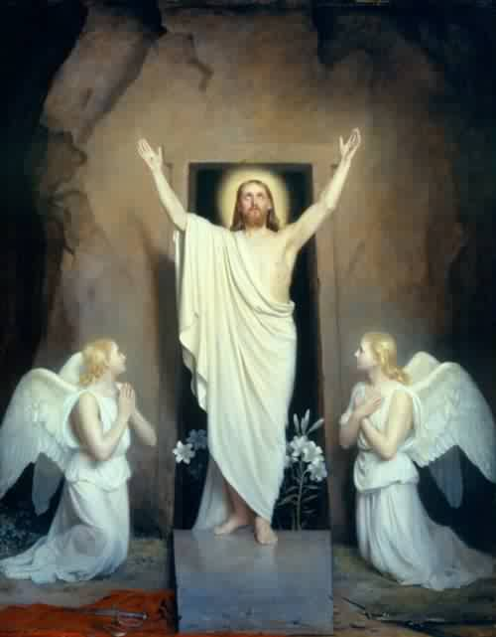
1. Resurrection

Slide 3
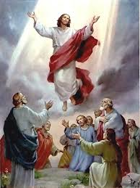
2. Ascension

Slide 4
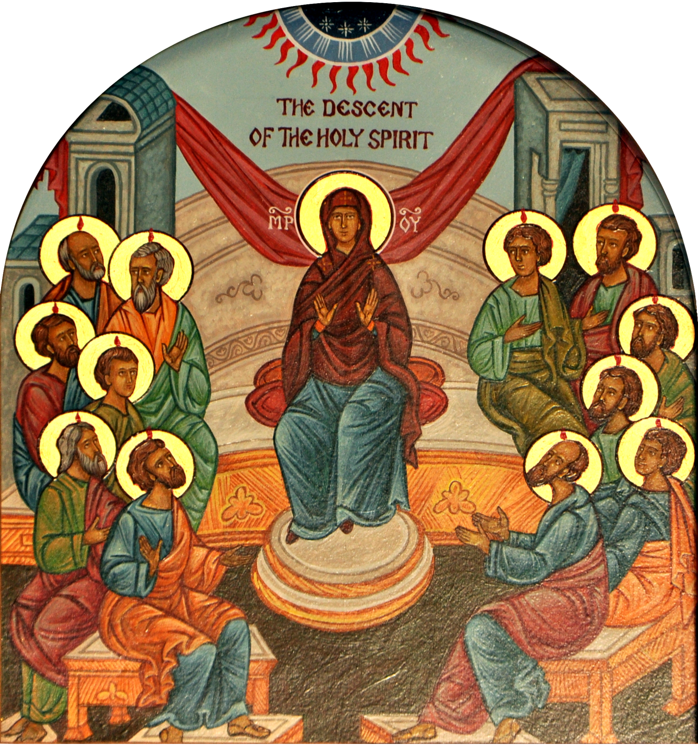
3. Descent of the Holy Spirit

Slide 5
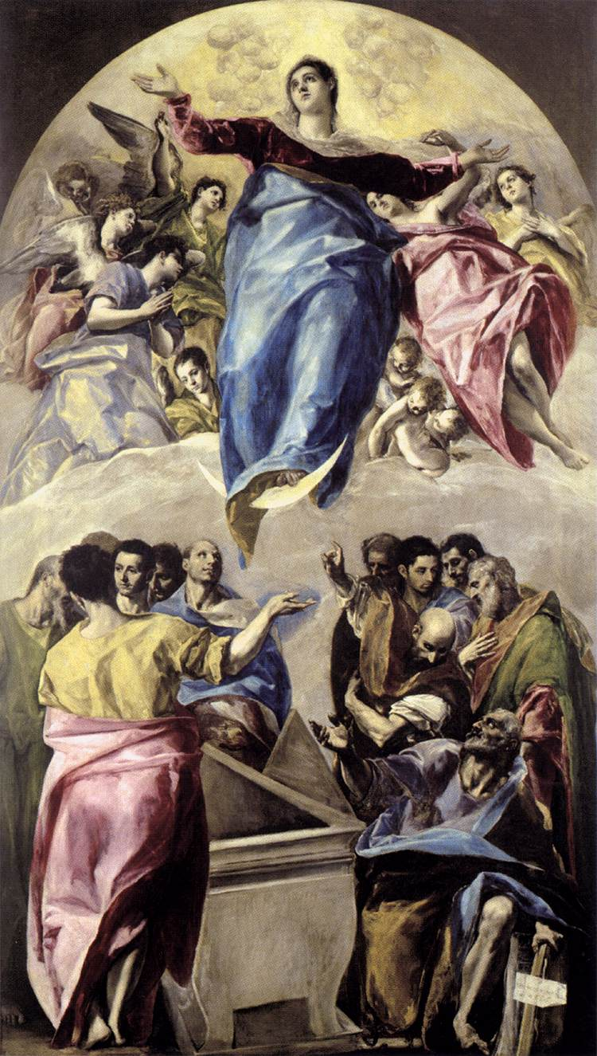
4. Assumption

Slide 6
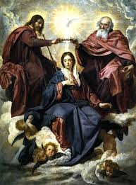
5. Coronation of Mary

Slide 7
Art Credits
“Resurrection” by Carl Heinrich Bloch http://joyintruth.com/blog/wp-content/uploads/2013/04/Resurrection.jpg
Ascension http://www.pewsitter.com/view_news_id_8307.php
Descent of the Holy Spirit http://communio.stblogs.org/2013/05/
“The Assumption of the Virgin” by El Greco http://buscandomontsalvatge.blogspot.com/2013/09/toledo-convento-de-santo-domingo-el.html
“Coronation of the Virgin Mary” by Velazquez http://www.fansshare.com/community/uploads100/8332/velazquez_corronation_of_the_virgin_mary/

