Slide 1
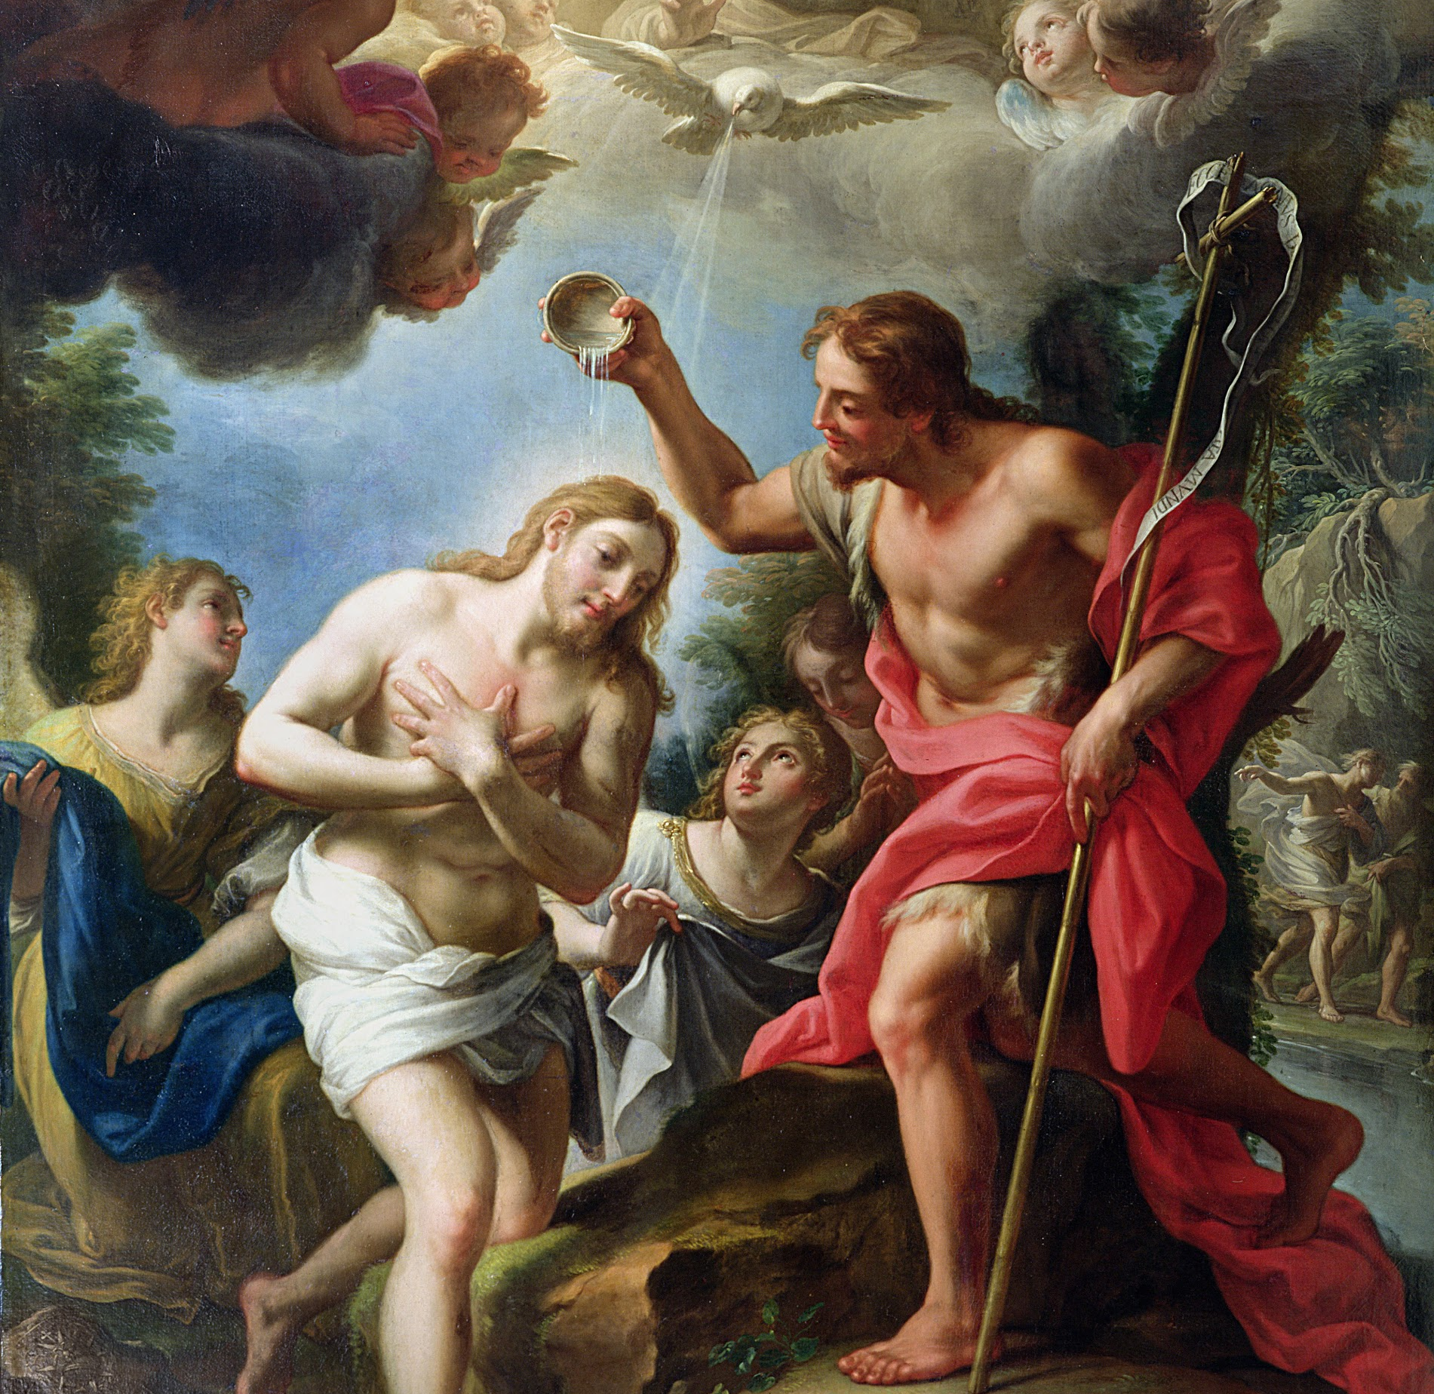
Session 11: The Need for and the Effects of the Sacrament of Baptism

Slide 2
Effects of Baptism
Read Acts 2:38.
The two main effects of Baptism are forgiveness of sins and receiving the gift of the Holy Spirit.
There are other effects of Baptism that we recognize; they are the forgiveness of sins, becoming a new creature, becoming a member of the Church, forming bonds of Christian unity, and the imprint of an indelible mark on the soul.
The Sacrament of Baptism is essential for salvation and is the ordinary means of salvation. Yet God can operate outside of the ordinary means of salvation in extraordinary ways.

