Slide 1
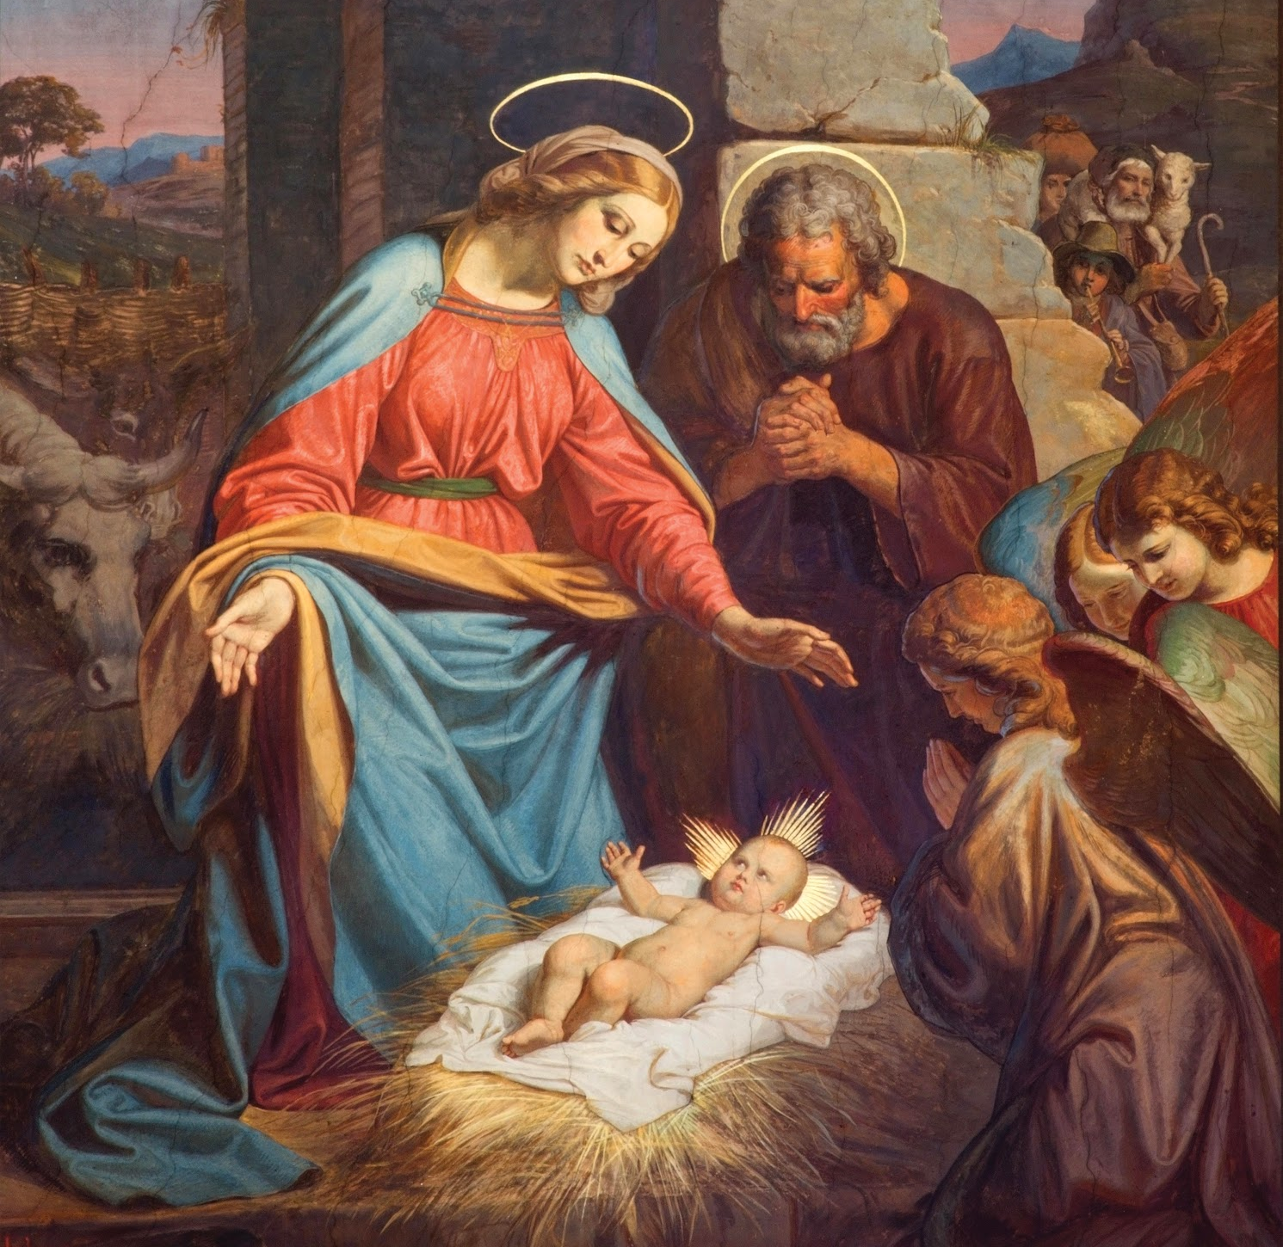
Jesus Made Many Friends
Unit 4, Lesson 19

Slide 2
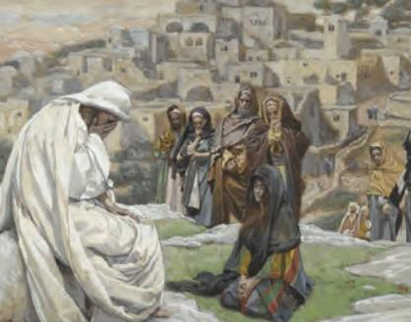
Jesus and Lazarus
Read John 11:1–44.
Jesus brought Lazarus back to life because He loved Lazarus very much.
Notes:
This image is on page 2 of the student book.

Slide 3
Disciples
A follower of Jesus is called a disciple. The word disciple comes from the Latin word for student, discipulus.
A disciple is a student or follower. Jesus had many disciples. We are His disciples too!
Jesus had many disciples when He was on earth, but there were twelve who were his most special friends. They are called the Twelve Disciples, or the Twelve Apostles.
Notes:
This image is on page 2 of the student book.

