Slide 1
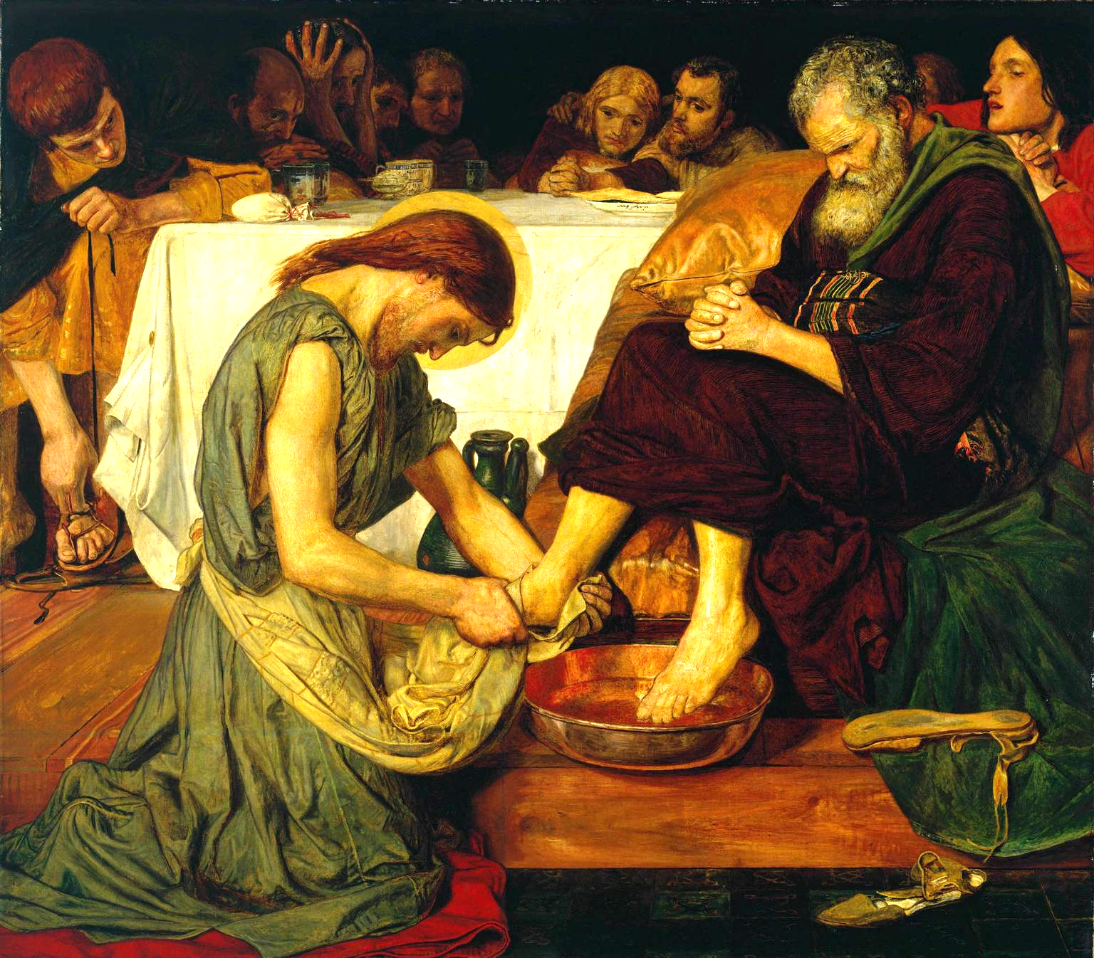
Lesson 2: Come, Holy Spirit

Slide 2
God’s Call to Us, Our Response
Read Ephesians 2:8
Read James 2:26
God boths calls us to Him, and yet we also can freely choose Him.
This mystery of Faith is not something we have to solve. The fact that God initiates the relationship to which He calls us does not diminish our ability to choose freely to respond to His grace.
God was with His Chosen People and established covenants throughout Salvation History to bring humanity back into communion with Him.

Slide 3
God’s Call to Us, Our Response
The Old Covenant — made with Adam, Noah, Abraham, Moses, and David was brought to fulfillment in the New Covenant in Jesus Christ. Jesus offers His promise of salvation not only to one group of people but to all of humanity. Just as God was with the Chosen People, making them His own, so God is with us today, making us His own.
The Holy Spirit enables us to respond to His covenant of love.

Slide 4
God’s Call to Us, Our Response
“Moved by grace, man turns toward God and away from sin.” -CCC 1989
Grace is an entirely free gift from God.
His grace is more powerful than our intellect or will.
We did nothing to earn this grace, as St. Paul says in his epistle to the Ephesians.
Our faith is a personal act on our part to respond to God’s initiative.
We choose to believe and keep God’s commands and so show our faith in our works.
Faith without works, as St. James writes, is dead.

