Slide 1
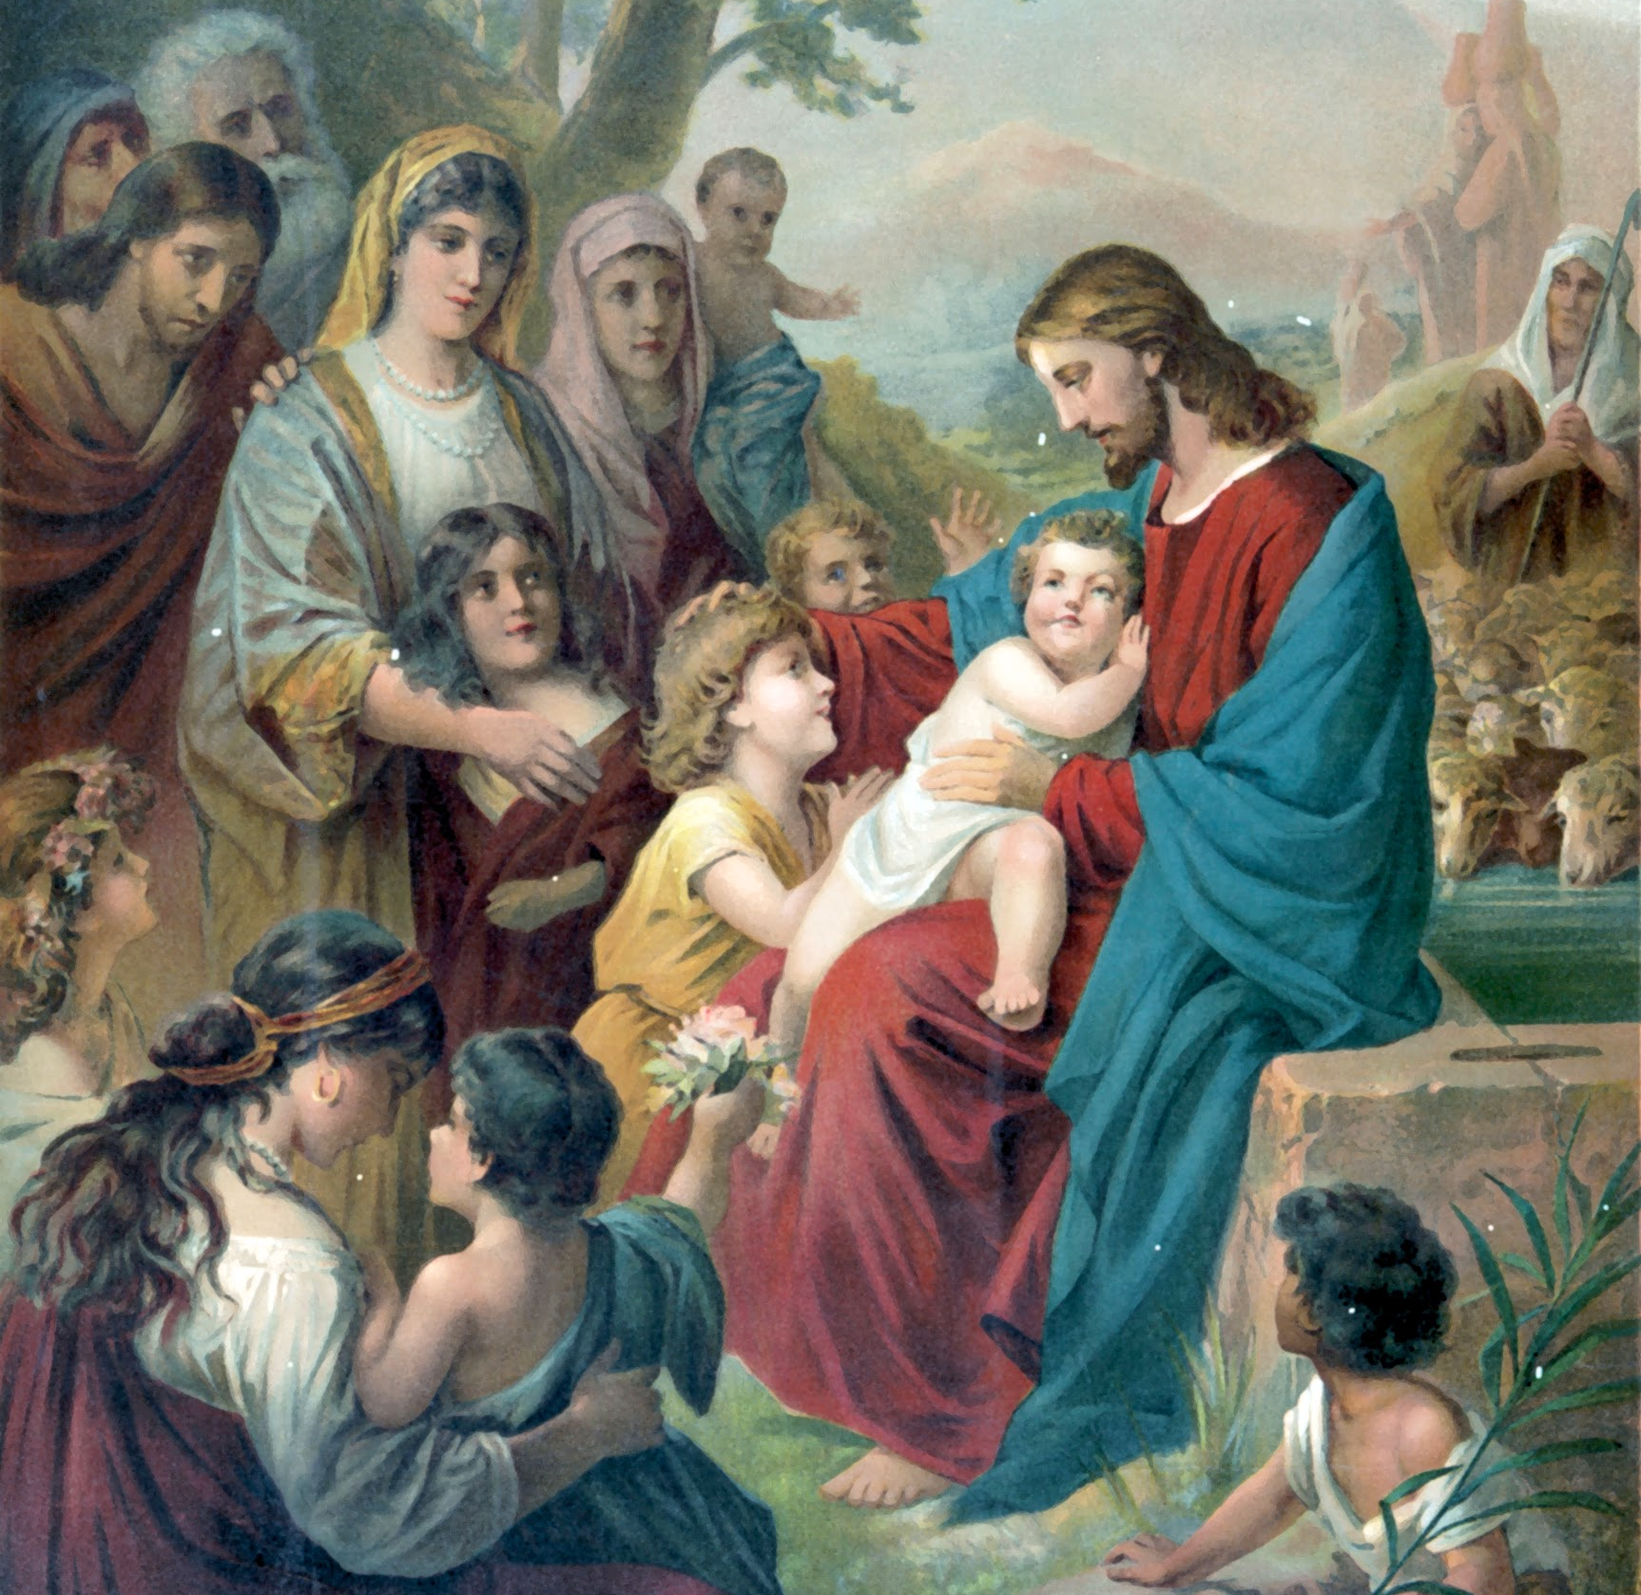
Lesson 3: The Mass is the Memorial of Christ’s Passion and Dead on the Cross

Slide 2
The Mass
a memorial is a way of remembering and celebrating the past. It is connected to the word remember, which means “to make present again.” When we remember something, we make the memory of something present to us again, almost as if we are there again.
On the night before He died, at the Last Supper, Jesus asked His Apostles to “remember” the events that night and that would soon occur. Rather than simply thinking about Him and what He would endure, Jesus meant to memorialize His suffering, Death, and Resurrection.
In other words, Jesus commanded His Apostles to make His sacrifice present to the world.

Slide 3
The Mass
Every time the Mass is celebrated, Christ’s command is faithfully carried out. The Mass is the liturgical celebration and memorial of Christ’s sacrifice on the Cross and His Resurrection from the dead.
A liturgical celebration, or liturgy, is the public work of the Church. In other words, it is the participation of the People of God in “the work of God,” which is our salvation from sin. The liturgy is our worship.
At every Mass, the priest changes bread and wine into Christ’s Body and Blood in the Eucharist. At every Mass, the events of our salvation are made present to us on the altar in the Sacrament of the Holy Eucharist, and we are invited take part in this memorial of our salvation.

Slide 4
The Mass
The Mass is a memorial that includes a gathering of God’s family (the Church coming together as a community for worship), telling the stories of our Faith (readings from Scripture), and a special meal (the Eucharist).
The Mass has two parts: the Liturgy of the Word and the Liturgy of the Eucharist. The Liturgy of the Word is the first part of the Mass in which we receive the written Word of God. In this part of the Mass, the Scriptures are proclaimed and the priest teaches us in his homily. We also join together in prayer for others and profess our Faith.

Slide 5
The Mass
The Liturgy of the Eucharist is the second part of the Mass, in which we receive the Body and Blood of Jesus Christ in the Eucharist. In this part of the Mass, the priest prays the words of consecration and changes the bread and wine into the Body and Blood of Christ. We also come to the altar of the Lord to receive Holy Communion.
In the Liturgy of the Word we share the stories of our Faith from Scripture, and in the Liturgy of the Eucharist we share a special meal.
In the first part of the Mass, the Liturgy of the Word, we receive the Word of God in the Scriptures that are proclaimed.

Slide 6
The Mass
During the second part of the Mass, the Liturgy of the Eucharist, we receive the Lamb of God, Jesus Himself, in the Holy Eucharist. The priest offers the gifts of bread and wine as a holy sacrifice. Then, by the power of the Holy Spirit, they become the actual Body and Blood, Soul and Divinity of our Lord and Savior Jesus Christ in the Eucharist. We are invited to receive the Eucharist and to participate in this moment made present to us again on the altar.

Slide 7
Liturgical Cycle
The Church wants us to make the most of the time that God has given us. The Church helps us to mark the passage of time with a liturgical cycle beginning with the first week of Advent and ending a year later before the next Advent begins.
One liturgical year in the Church is marked by many seasons, remembrances, feasts, celebrations, and so forth. A careful examination of the seasons in the cycle reveals that we spend time as a Church preparing, celebrating, focusing, and remembering.

Slide 8
Liturgical Cycle
The liturgical year begins with Advent, a time when we prepare ourselves for the Incarnation, God’s becoming man in the Person of Jesus Christ. We prepare for the birth of Jesus, our King. We prepare not only for the coming of Jesus as a baby, but also for His Second Coming at the end of time.
This season is represented by the color violet, or purple, which represents penance and humility. Priests wear violet or purple vestments to match the color of the season.

Slide 9
Liturgical Cycle
Then, during the Christmas season, we spend time celebrating the Incarnation. There’s a lot to be joyful about during Christmas! Not only do we receive gifts, but we celebrate the birth of our Savior Jesus Christ, the best gift ever!
This season is represented by the color white, which represents light, purity, and joy, or gold, which represents joy. Priests wear white or gold vestments during the Christmas season.

Slide 10
Liturgical Cycle
During Lent we focus on the Paschal Mystery. We reflect on Jesus’ life, Passion, Death, and Resurrection, and how He redeemed us of our sins! That’s good news for sure, but we have to remember how this victory was achieved, and the suffering that Christ endured for us.
During Lent we do penance and prepare our hearts to receive the salvation won for us by Christ, so the color of this season is violet, or purple. As in Advent, priests wear violet or purple vestments during Lent. Notice that these two seasons of preparation for important events in our Christian faith share the same color and even some of the same habits of penance and reflection.

Slide 11
Liturgical Cycle
Following Lent, we have the great celebration of the Resurrection of Jesus called Easter. All of Jesus’ suffering was redeemed by the glory of His Resurrection. This is inspiring to us! We are reminded that we will eventually gain the reward of eternal salvation despite the difficulties of our own crosses. Notice that Easter is more than just a day; it’s a season!
Like the Christmas season, the Easter season is a time of joy and celebration, and so it is represented by white or gold. Priests wear white or gold vestments during the Easter season, as during Christmas.

Slide 12
Liturgical Cycle
Most of the liturgical calendar is marked as Ordinary Time. In fact, there are two large sections of Ordinary Time. In this context, Ordinary does not mean “common” or “usual”. Ordinary in this context means in order. It comes from the Latin “ordinalis,” which means showing an order of succession. Ordinary time, the longest season, reminds us that the whole Church year is ordered towards Christ’s reign culminating in the Feast of Christ the King.
During Ordinary Time, we reflect on Christ’s life and strive to become more like Christ ourselves. Ordinary Time is represented by green, which represents life and hope. Priests wear green vestments during Ordinary Time.

Slide 13
Liturgical Cycle
Throughout the liturgical season, we remember special events in the life of the Church or celebrate the saints. For example fifty days after Easter we celebrate the coming of the Holy Spirit at Pentecost. During Holy Week, we celebrate the Triduum a three day period in which we reflect in a particular way on Christ’s suffering and Death.
Pentecost and Good Friday (during Triduum) are represented by red which reminds us of fire, love, Jesus’ Passion, and the blood of the martyrs. In these special days, priests wear red vestments.

