Slide 1
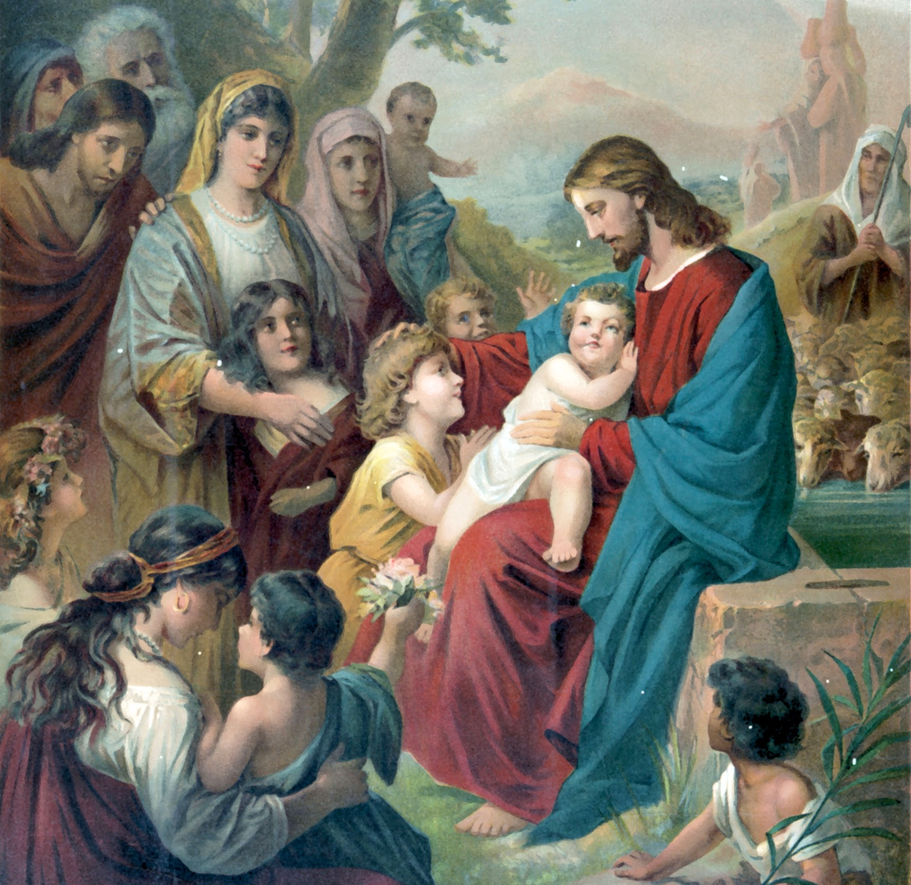
The Mass Is the Memorial of Christ’s Passion and Death on the Cross
Unit 7, Lesson 3

Slide 2
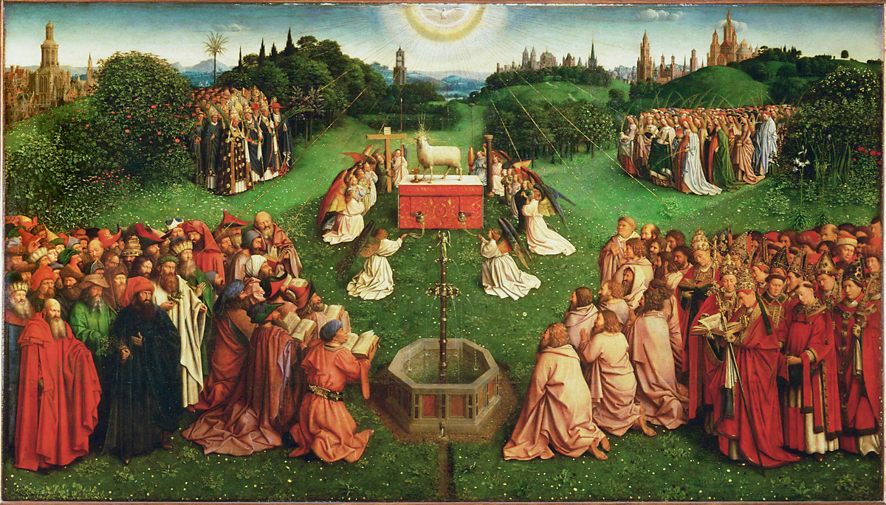
Adoration of the Lamb
Notes:
This image is on page 371 of the student book.

Slide 3
Notes:
This image is on page 376 of the student book.

