Slide 1
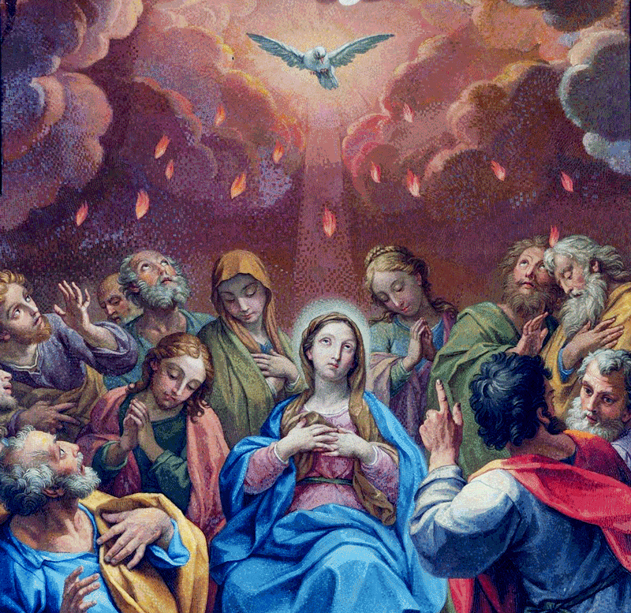
Lesson 37: Mary Shows Us How to Love
Notes:
This PowerPoint contains all text and images recommended to be projected and/or read aloud in this unit.

Slide 2
Mary Shows Us How to Love
Though we may not automatically think about it, Mary, Jesus’ mother, was also Jesus’ disciple. In fact, she was Jesus’ first disciple! As we learned in the last lesson, Mary is Jesus’ mother. Just as she raised and taught Jesus as a child, she also learned from Him, knowing that He is the Son of God. She was obedient to God’s will and followed Jesus throughout His earthly ministry. She was there at the foot of the cross when Jesus was crucified. According to Tradition, she was present when the Holy Spirit descended on the Apostles at Pentecost.

Slide 3
Mary Shows Us How to Love
To follow Jesus, we must deny ourselves and accept pain and suffering along with joy. As Catholics, we have each been called to be disciples of Jesus. By following Mary, we can see the way to follow Jesus more deeply and appreciate how much she loves us.
During the wedding feast, the bride and groom ran out of wine. Mary noticed the problem and asked Jesus to help. She trusted Jesus completely. She instructed the servers to do whatever Jesus asked. Jesus performed His first public miracle by changing water into wine. Mary played an important role in the beginning of Jesus’ public ministry, and she continues to play an important role in the lives of all the faithful today.

Slide 4
Mary Shows Us How to Love
The Catholic Church honors Mary throughout the liturgical year with many different feast days, or special liturgical celebrations, of Mary’s life. We honor Mary and show our love for her by participating in these celebrations during the course of the Church year. In today’s lesson, we are going to learn about seven of the most important of these special feast days, most of which celebrate moments in the life of Mary that we have learned about in this unit. In fact, three of these feasts are so important, they are solemnities.
A solemnity is a very special feast day celebration that the Church treats the same way as a Sunday Mass. They are holy days of obligation, days when all the faithful are obligated to attend to Mass, as if it was Christmas or Easter Sunday!

