Slide 1
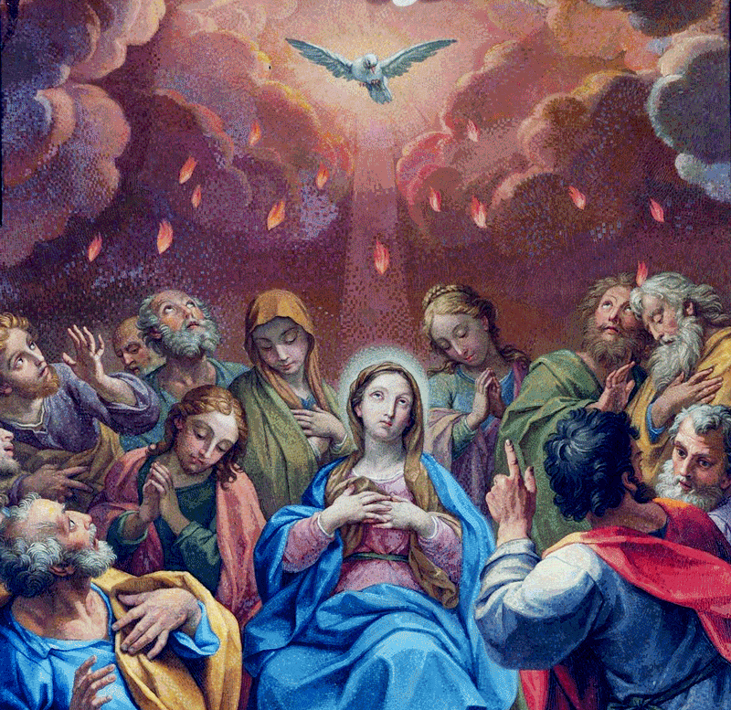
Mary Shows Us
How to Love
Unit 6, Lesson 37

Slide 2
Opening Prayer
Hail, Mary, full of grace, the Lord is with thee. Blessed art thou among women and blessed is the fruit of thy womb, Jesus. Holy Mary, Mother of God, pray for us sinners, now and at the hour of our death. Amen.

Slide 3
John 2:5
His mother said to the servers,
“Do whatever he tells you.”

