Slide 1
Lesson 6: Who is Jesus? The Incarnation

Slide 2
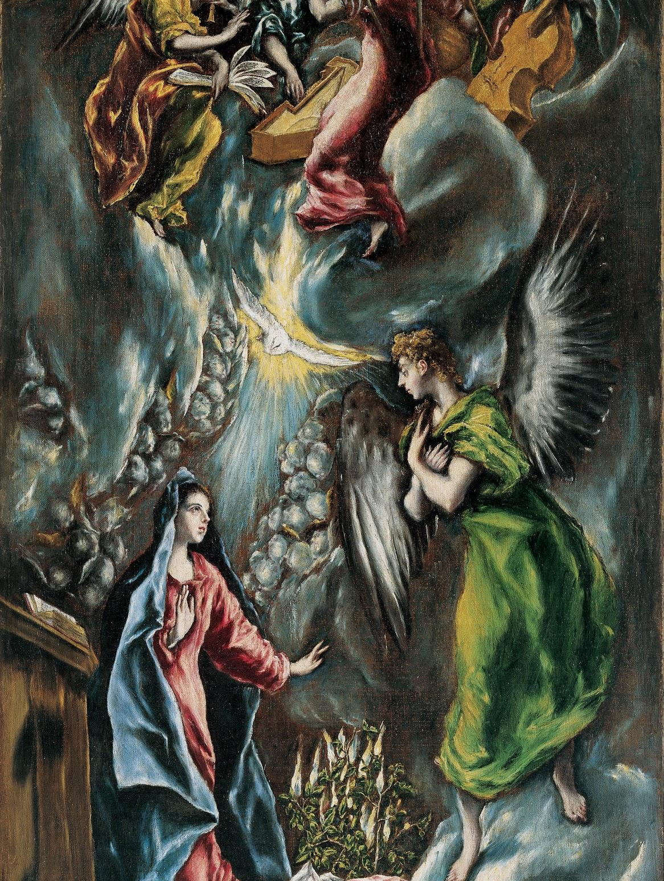
The Incarnation
In this painting, the angel Gabriel has appeared to Mary and is announcing that Mary will be the mother of Jesus.
Heaven is opened to earth as the power of the Holy Spirit comes upon Mary. The choirs of angels in Heaven are playing music to rejoice and celebrate that God has become man.

Slide 3
The Incarnation
This is a painting of the moment of the Incarnation. The Incarnation is when God took on a human nature: He came down from Heaven and became man. It is the most important event in human history.
The God of the universe came to us and lived among us in order to save us from sin.

Slide 4
The Incarnation
This was God’s plan all along. At this moment, the final steps in God’s plan of salvation were being fulfilled.
The angel Gabriel appeared to Mary to announce to her that she would be the Mother of God and give birth to the baby Jesus.

Slide 5
The Incarnation
The Jewish people had been waiting for thousands of years before Jesus’ birth for the gift of salvation that God had promised them.
From the very beginning, with Adam and Eve, through the major figures of the Old Testament Abraham, Isaac, Jacob, Moses, David, and all the prophets, God had promised to send the Messiah to bring about salvation.

Slide 6
Messiah
Read Isaiah 9:5–6.
The people listening to the prophets expected the Messiah to be a mighty king who would fight for them. Instead, He was a humble baby born in a stable who sacrificed His life on a Cross.
We know now that Jesus is the Good News, even though His coming and what He accomplished was not exactly what the people expected!

Slide 7
Messiah
Read Isaiah 7:14.
We know today that the young woman Isaiah spoke of is the Blessed Mother, Mary.
The word Emmanuel means “God with us.” Mary’s son, Jesus, is the only Son of God, God Himself, who came to earth to be “with us.”

Slide 8
The Incarnation
Read Luke 1:26–38.
The Incarnation — the Son of God assuming a human nature — was made visible to the world at the birth of Jesus.
Jesus’ birth is a very important and joyful moment in history, one that we still celebrate on Christmas.
God sent His only Son to be with us on earth and to save us from sin. This is the Good News that God had promised us!
There are four reasons for the Incarnation

Slide 9
Incarnation: To Save Us from Sin
Sin is something we say, do, think, or fail to do that does not love God, our neighbor, or ourselves, as God has taught us.
When we sin, we hurt, and can even destroy, our relationship with God. When we are separated from God because of our sin, we live in spiritual darkness.
In the beginning, the first people, Adam and Eve, sinned against God. But God always had a plan to save us from our sin. God sent Jesus to take away our sin by dying on the Cross for us.

Slide 10
Incarnation: To Know God’s Love
God loves us so much! He sent Jesus to show us His love.
How deep is His love for you? How wide? As deep as the oceans and as wide as his arms spread out on the Cross.
That is how much He loves you. Enough to suffer humiliation and hurt for love of you.

Slide 11
Incarnation: To Show Us How to be Holy
God sent Jesus to show us how to live holy lives. Everything Jesus did during His earthly life is an example for us of how to be holy.
Jesus’ Holiness was shown through simple actions like doing honest work, caring for the poor, talking to the outcast, and loving one another as God loves us.

Slide 12
Incarnation: To Give Us a Share in God’s Divine Life
God wants to give us His own divine life so that we can be His adopted sons and daughters.
The free gift of God’s divine life given to us in our souls is called sanctifying grace. He sent Jesus to give us His grace and make us His sons and daughters.
We receive this grace in and through the Sacraments.

Slide 13
Incarnation: Fully God and Fully Man
When Jesus came and became man, He did not stop being fully God. Jesus is fully God and fully man. In the beginning, God made human beings in His image and likeness.
God made us like Him. As we have learned, He made human beings stewards of His creation. He asked us to care for what He had made. He gave us the ability to understand the world around us and know ourselves and Him.

Slide 14
Incarnation: Fully God and Fully Man
He gave us the ability to make choices. And He gave us the ability to love and be loved.
The first people, Adam and Eve, however, freely chose to turn away from God’s love. They sinned against God. This was the first sin.
Because they sinned, every human being after them sins too. All except for Jesus and Mary, His mother, that is!

Slide 15
Incarnation: Fully God and Fully Man
When God the Son became man, He became like us in all things but sin.
He was not just like God; He is God! Jesus is perfect and never sinned. But, like all of us, He also experienced happiness and sadness. He had friends and parents like we do. He ate meals, laughed and played, walked around, and talked to people.
Jesus was fully human. And fully God.

Slide 16
Incarnation: Fully God and Fully Man
We describe this mystery of our faith by saying that Jesus has two natures in one Person.
The word nature means “what a thing is.” Jesus’ two natures are God and man. The word person, as we have learned, means “a unique individual who can know and love.”
Jesus’ two nature (God and man) come together in the one divine Person, Jesus Christ.

Slide 17
Incarnation: Fully God and Fully Man
Each of us possesses only one nature and is one person. I am a human, and I am me. You are a human, and you are you. Jesus is both 100 percent God and 100 percent human, and He is Jesus Christ.
Now, this might still be a bit confusing and that is okay! We believe it because God has revealed it to us, and we know that everything He tells us is good and true.
As we get to know Jesus better, we come to understand what a wonderful gift God has given us!

Slide 18
We Know Jesus
Even though it is a mystery of our Faith that Jesus is both fully God and fully human, and even though Jesus lived on earth more than 2,000 years ago, we can still know Jesus today.
The best way to get to know Jesus is through the Gospels in the Bible. Rather than simply being a collection of stories about Jesus, in the Gospels, we actually meet Jesus.
We can walk with Him and grow to love and trust Him in His Word. And then, we can actually be with Jesus when we receive the Eucharist at Mass, which is truly the Body and Blood, Soul and Divinity of Jesus Christ.

