Slide 1
Jesus is the Son of God
Grade 1
Unit 2

Slide 2
Who Is Jesus? — The Incarnation
Unit 2, Lesson 6

Slide 3
Isaiah 7:14
“Therefore the Lord himself will give you a sign; the young woman, pregnant and about to bear a son, shall name him Emmanuel.”

Slide 4
Isaiah 9:5
“For a child is born to us, a son is given to us; upon his shoulder dominion rests. They name him Wonder-Counselor, God-Hero, Father-Forever, Prince of Peace.”

Slide 5
Hail Mary
Hail Mary, full of grace, the Lord is with you; blessed are you among women, and blessed is the fruit of your womb, Jesus. Holy Mary, Mother of God, pray for us sinners now and at the hour of our death. Amen.

Slide 6
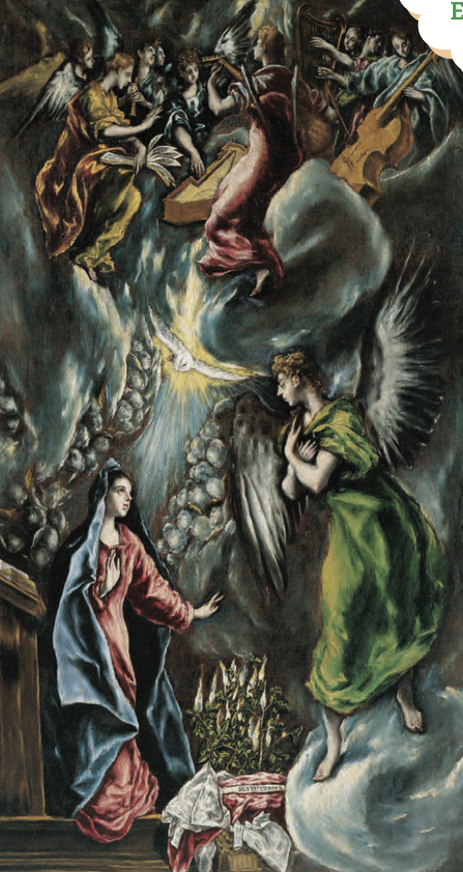
The Annunciation

