Slide 1
Luminous Mysteries

Slide 2
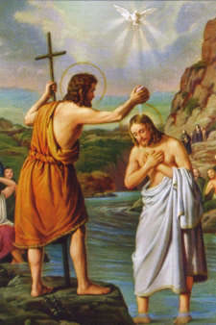
1. Baptism of Jesus

Slide 3
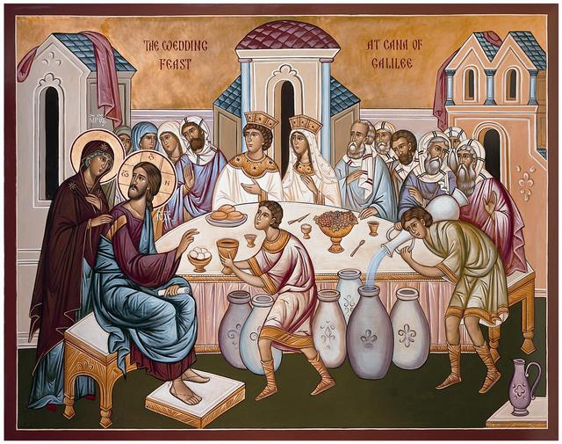
2. Wedding at Cana

Slide 4
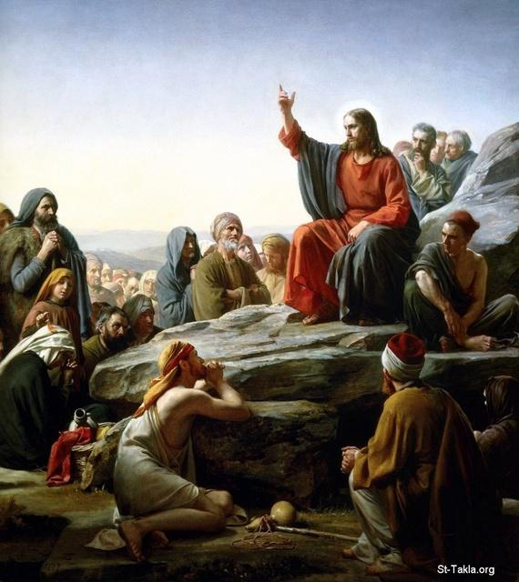
3. Kingdom Proclaimed

Slide 5
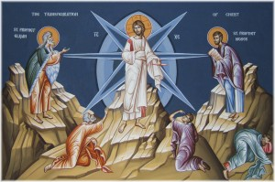
4. Transfiguration

Slide 6
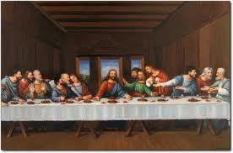
5.Institution of the Eucharist

Slide 7
Art Credits
Baptism of Jesus http://olivyaz.blogspot.com/2011/01/baptism-of-christ-feast.html
Wedding at Cana http://www.christthesaviourhbg.org/news_130608_4.html
Kingdom Proclaimed “Sermon on the Mount” by by Carl Heinrich Blochhttp://st-takla.org/Gallery/Jesus-Christ/10-General-Jesus-Scenes/Sermon-on-the-Mount/Jesus-Sermon-on-the-Mount-001-Carl-Bloch-1890.html
Transfiguration http://classicalchristianity.com/category/bysaint/blessed-augustine-ca-354-430/
Institution of the Eucharist “Last Supper” by da Vinci http://www.lemieuxberube.com/secondskin/assignment-4/image1/

