Slide 1
Adult Meeting

Slide 2
Agenda
Notes:
This PowerPoint includes:
Slides for opening questions to help begin to contextualize what they will be learning.
Slides with Sacred Art and reflection questions
Other guidance for the meeting
Closing reflection

Slide 3
Opening Questions
What is the purpose of our life?
We cannot get to Heaven on our own. What are some signs God gives us to help us on our journey there?

Slide 4
Opening Questions
How is the human person different from the rest of God’s creation?

Slide 5
Opening Questions
What causes us to lose our relationship with God? How does He respond to this?
Notes:
Once parents have answered the opening questions, discuss the guidance God gives us in a manner similar to the following:
God knows our weakness and gives us signs along the way to help us get to Heaven.
These signs are the Beatitudes and the Ten Commandments, helping us to stay on the path that leads to God. Our life has meaning and infinite value because we are made in the image of God.
This is a beautiful truth that affects our whole existence.
We are willed by God for His own sake, to know, love, and serve Him, and be happy with Him in Heaven forever. It is because we were made in His image that we can reason, choose between right and wrong, and love God and one another—setting us apart from the rest of creation. Our soul is immortal and will live forever. When Adam and Eve sinned, they caused us to lose our friendship with God, but He did not abandon us. Instead, He sent His Son, Jesus, to restore our relationship with God through His Passion, Death, and Resurrection.
However, our tendency to sin remains, and throughout our life we must make every effort to stay on the path of goodness!

Slide 6
Lecture/
Essay Content Review

Slide 7
Universal Questions
-Who am I? -Where do I come from? -Why am I here? -Where am I going? -What is happiness? How do I find it?
Notes:
We all ask ourselves these questions at some point. We all long to have them answered.

Slide 8
What We’ve Covered
1. Salvation History tells us God’s Story.
2. We have become part of His story through the Sacraments.
3. Now we must figure out how to play our part in the story: morality.
Notes:
We have asked and reflected on some of these questions already as we have journeyed through
the A Family of Faith program. (Omit this slide if you have not done Volumes I-II)

Slide 9
Morality
Morality is not just about a bunch of do’s and don’ts. Rather it provides for us a roadmap for how to get to where we are meant to be. Morality shows us how to be happy.

Slide 10
Our journey through life is similar to going on a trip. What must you do before you go on a trip?
Notes:
Before going on a trip, you must decide where you are going and learn how to get there. In the same way, if we want to figure out how to enter into life with Christ, we must begin by reflecting on the destination.

Slide 11
How many sports teams do you think play without thinking about winning the highest title as a team?
Notes:
If an NFL team doesn’t play with the goal of winning the Super Bowl, then what is the point? If a college basketball team doesn’t play with the goal of winning the NCAA championship, do you think they have any chance of winning it? They may not win it in the end, but if they don’t play with that as the goal then they have no chance of achieving it.

Slide 12
How many of us here want to get to Heaven? How many of us want our children to get to Heaven?
Notes:
What are we doing now to work towards Heaven? Are we doing everything we can to help our children work towards it? The parents are here, so it is obvious they have a vested interest in this.
Morality taught without the goal of eternal happiness in mind has no meaning – it is just a list of “rules.” So we begin with our end in mind!

Slide 13
Beatitude: The Kingdom of God
Notes:
We are all called to choose the path that leads to God. As St. Augustine said, “You have made us for Yourself O Lord and our heart is restless until it rests in You.” The Catechism of the Catholic Church tells us our destiny is to live in the blessedness of God, or live in His beatitude.

Slide 14
Beatitude
Notes:
We often associate the word “beatitude” with the 8 promises Jesus gives us in the Sermon on the Mount.
Beatitude means “blessedness” and refers to the vocation (or calling) we all have. If our destination is beatitude, what does that mean?
“The Beatitudes reveal the goal of human existence, the ultimate end of human acts:
God calls us to His own Beatitude.” (CCC 1719)
We are not only made by God, but also made for God!

Slide 15
The New Testament shows us what beatitude means:
Being called to be part of God’s Kingdom
Entering into the vision of God
Sharing in God’s joy
Entering into God’s rest
Ultimately, it means being called to spend eternity in Heaven with Him!
Notes:
As St. Augustine puts is: “There we shall rest and see, we shall see and love, we shall love and praise. Behold what will be at the end without end. For what other end do we have, if not to reach the kingdom which has no end?”

Slide 16
We cannot get to Heaven on our own.
The blessedness we are called to is a free gift from God. Christ came down from Heaven so that He could walk this path to Heaven and show us the way.

Slide 17
How do we know if we are on the right path toward Heaven?
Notes:
How do we know we are going the right direction in our vehicles toward whatever our destination is? How do we know we are playing the game of tennis correctly? How do we know how to bake a cake?
We rely on our GPS or a map to help us get somewhere. We rely on the rules of tennis to make sure we are playing correctly. We rely on a recipe to follow in order to bake a cake.

Slide 18
Three signs on the path that leads to Heaven:
The Decalogue, or Ten Commandments
The Sermon on the Mount
Apostolic Catechesis.

Slide 19
The Ten Commandments
Notes:
The Ten Commandments are also known as the Decalogue. Decalogue literally means “10 words”. God gives the Israelites the Ten Commandments in the book of Exodus after He delivered them from slavery in Egypt. The Israelites agree to follow them as a loving response to Him. They show a relationship rooted in covenant.
The Commandments are part of God’s revelation to us. They help us see who God is and how He desires for us to relate to Him and one another. These commandments only make sense in the context of relationship. They are not simply a list of arbitrary rules. We will study them in-depth later this year.

Slide 20
The Ten Commandments and the New Covenant
Notes:
“Do not think that I have come to abolish the law or the prophets. I have come not to abolish but to fulfill. Amen I say to you, until heaven and earth pass away, not the smallest letter or the smallest part of a letter will pass from the law, until all things have taken place.” (Matthew 5:17-18) Even though the Ten Commandments are given in the Old Testament, they still apply to us today.

Slide 21
The Beatitudes
The Beatitudes fulfill the promises of the Old Covenant and the Ten Commandments. “The Beatitudes are at the heart of Jesus’ preaching” (CCC 1716).
Notes:
The Beatitudes reveal to us the true face and heart of Christ. They call us to a high standard of living. They even seem paradoxical. They provide us with hope and show us the true path to happiness. When we live out the Beatitudes we are living out the Kingdom of Heaven here on earth. We will study the Beatitudes in-depth later this year.

Slide 22
The Meaning of Life
We can fall into the trap of reducing the teachings of the Ten Commandments and the Beatitudes as simply a set of arbitrary rules. However, they are about being who God created us to be.
Notes:
The Commandments and the Beatitudes are challenging to live, but the more we strive, the better we can become at living a moral life and the more fulfilled and happier we become.
It is like anything else in life. We might need the GPS or map when we are first getting to know an area but eventually we don’t need it anymore and we can get there without even thinking about it. At some point we no longer need to consult the rule book while we are playing a game of tennis, and if we bake a cake often enough, eventually we don’t need to look at the recipe.
The same goes for the Christian life. The more we strive to live the life of a Disciple we don’t even think about the “rules” and the path to Heaven becomes “familiar” to us.

Slide 23
Why does it matter that we are made in God’s image and likeness? What can we learn from this?
Notes:
Part of understanding what a thing is made for is to understand what a thing is; something’s purpose is part of its nature. A chair is made to be sat in. Clothing is made to be worn. A human is made in the image and likeness of God, which means we are made to live like the Lord lives: in love.

Slide 24
Made in God’s Image
“God created mankind in his image; in the image of God he created them; male and female he created them.” (Genesis 1:27) You have probably heard or read this verse a million times. But what does it mean?
Notes:
The verse means that we are created with intellect, free will, and the capacity to love.

Slide 25
We Are Made in God’s Image
This means that we can:
Use our reason to know things.
Choose between right and wrong.
Love God and one another.
Notes:
All of these things mean we are created with the ability to enter into real communion with God and each other. Of all the creatures on earth, human beings are the only ones that are capable of sharing in the divine life of God.

Slide 26
We are made with an immortal soul
We are the summit of God’s creation (CCC 343).
Notes:
When God created Adam He “blew into his nostrils the breath of life, and man became a living being.” (Genesis 2:7) This “breath” is the gift of God’s own life given to human persons. It sets us apart from the rest of creation.

Slide 27
Humanity has a unique place in creation

Slide 28
In the beginning
God made humanity in friendship with Him. Adam and Eve were filled with God’s divine life, or sanctifying grace.
Notes:
This grace is a FREE gift that cannot be lost unless we choose to reject God. Adam and Eve rejected God through their disobedience and we do as well when we commit mortal sin. We have to be in a state of sanctifying grace to live with God in Heaven.

Slide 29
The Result of Original Sin
When Adam and Eve fell they lost their friendship with God along with sanctifying grace.
Notes:
They also lost their gift of self-mastery. Prior to their Fall, their intellect was in proper control of their passions and emotions. We have inherited this fallen state. Because of this, we are inclined and attracted to sin.

Slide 30
The Good News
Out of His great love for us, God sent His only Son to restore us in friendship with Him and to allow us the opportunity to once again share in His blessedness in Heaven. Through His Passion, Death, and Resurrection, Jesus wins our Salvation.
Notes:
Jesus also established the Church on earth as a way of making His Salvation accessible to all people for all time. However, even though our relationship with God has been restored by Christ, our inclination toward sin still remains. The great journey of the moral life is to work toward restoring the harmony of self-mastery within us so that we can enter into the blessedness of Heaven.

Slide 31
Free Will
We have the ability to choose between God’s will and our own will.
Notes:
The choice is harder because our souls have been weakened by Original Sin and by our own personal sins as well.

Slide 32
Sin
We are attracted to sin; no one would sin if it weren’t attractive.
Notes:
Truth, beauty, and promises of God are also very attractive, but we cannot have both. This is our choice. It is the choice we must make—in fact, it’s the choice we can’t help but make. “If you choose not to decide you still have made a choice” goes the Rush song!

Slide 33
Our Choice
The Gospel of Matthew talks about two paths. One path “leads to life,” the other “leads to destruction.”
Notes:
It is much easier to choose sin than to choose God’s way or the path to life. However, the rewards of the hard path are infinitely greater than the “rewards” of the easy path.

Slide 34
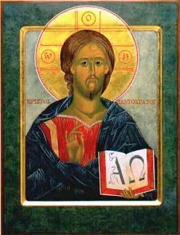
We have returned to where we started.
God is our beginning,
and our end.
Notes:
The path of life leads to Heaven! We come back to where we started: we are made for Heaven. If we journey toward what we are made for then we will be truly happy and truly fulfilled. If we journey toward sin then we may gain some kind of temporary pleasure or trick ourselves into thinking we are happy, but ultimately it will harm us because it is not who we are or what we are made for. We can only come to the true fulfillment when we live in the blessedness of God.

Slide 35
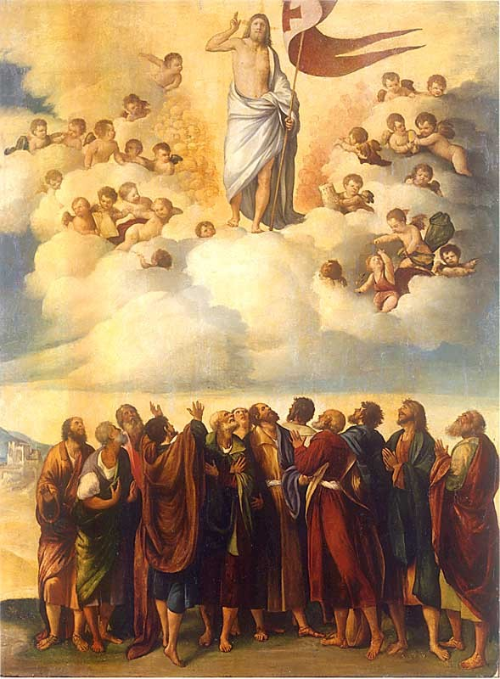
What do you first notice about this painting?
Notes:
Accept all answers.

Slide 36
Where is your eye drawn? What is your favorite part?
Notes:
Accept all answers.

Slide 37
The painting has a clear top half and bottom half. Why do you think the artist divides the scene like this?
Notes:
Suggested answer: The composition shows us Heaven (the top half) and earth (the bottom half),

Slide 38
What is happening in the painting? What event does this depict?
Notes:
Suggested answer: Christ is shown ascending into Heaven as His disciples watch in amazement. The event depicted is known as the Ascension of Christ into Heaven. The Feast of the Ascension is a one of the great Solemnities of the liturgical calendar (it is often referred to as “Ascension Thursday”) that we mark each year 40 days after Easter.

Slide 39
Who do you think the people on the bottom, earthly part of the painting represent?
Notes:
Answer: They represent not just those disciples who were present at the Ascension, but the whole Church.

Slide 40
Christ ascended into Heaven 40 days after His Resurrection. Why do we start the year with this event from the end of Christ’s ministry?
Notes:
Answer: Because we must always begin with our end in mind. God created us in love: He is our beginning and our end. Our eternal destiny is Heaven. Jesus helps us on the path to get there through His teaching and through His example. His Ascension into Heaven shows us that we too will go to Heaven if we have loved and followed Him.

Slide 41
Group Discussion/Sharing

Slide 42
Reminders and Announcements
The upcoming Community Meeting will take place at [location] on [date/time].
Notes:
Be sure to let parents know that the upcoming Community Meeting will take place before Mass.
Remind parents to put up their new Fridge Page and the Car Conversations hang tag for this month. These can be found in their Parent’s Guide at the beginning of this month’s lesson.
Remind them that they do NOT have to do all the activities in the book. They should choose only the activities they believe will work best for their family. Think quality, not quantity.
Also emphasize that this program is first and foremost about their own formation, and secondarily about helping them teach their children. “Put your own mask on first,” as they say!
Their children will learn the Faith better from their parents’ witness than through any structured activity.

Slide 43
By virtue of their ministry of educating, parents are, through the witness of their lives, the first heralds of the Gospel for their children. Furthermore, by praying with their children, by reading the word of God with them and by introducing them deeply through Christian initiation into the Body of Christ—both the Eucharistic and the ecclesial Body—they become fully parents, in that they are begetters not only of bodily life, but also of the life that, through the Spirit’s renewal, flows from the Cross and Resurrection of Christ. –Pope St. John Paul II, Familiaris Consortio (The Family in the Modern World)

Slide 44
Closing Prayer
Dear Lord, thank you for bringing all of us here together. Your love is ever life-giving. Thank you for your gift of children and the duties of parenthood. Pour down on these families the graces they need to be the first heralds of the Gospel to their children and to prepare them to receive your life-giving love. Help them always follow the path you have shown us that leads to happiness with you forever in Heaven.

