Slide 1
Scriptural Stations of the Cross

Slide 2
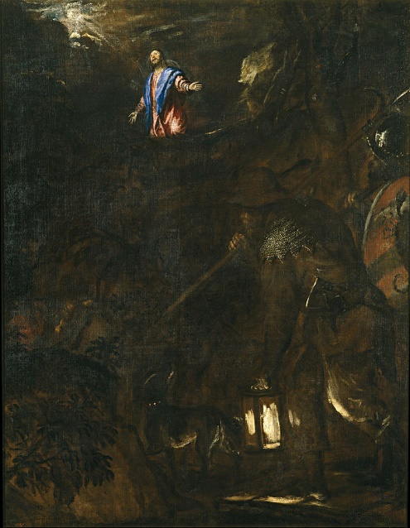
First Station: Agony in the Garden by Titian

Slide 3
Second Station: Capture of Christ by Fra Angelico

Slide 4
Third Station: Christ Before Caiaphas by Matthias Storm

Slide 5
Fourth Station: The Denial of St. Peter by Carvaggio

Slide 6
Fifth Station: Jews Bring Jesus Before Pilate by Munkascy

Slide 7
Sixth Station: Jesus Is Crowned with Thorns (stained glass)

Slide 8
Seventh Station: Way to Calvary by Andrea di Bartolo

Slide 9
Eighth Station: The Road to Calvary by Sodoma

Slide 10
Ninth Station: Christ Falling on the Way to Calvary by Raphael

Slide 11
Tenth Station: Christ on the Cross by Eugene Delacroix

Slide 12
Eleventh Station: Christ and the Good Thief by Titian

Slide 13
Twelfth Station: What Our Lord Saw from the Cross by James Tissot

Slide 14
Thirteenth Station: Crucifixion by Raphael

Slide 15
Fourteenth Station: Entombment of Jesus (mosaic)

