Slide 1
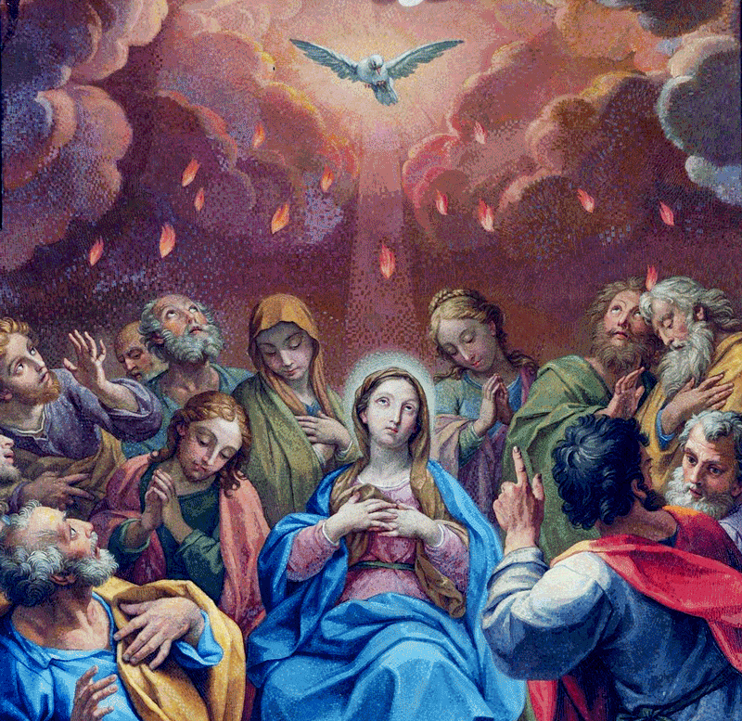
Session 27: The Sacrament of Baptism
Notes:
This PowerPoint contains all text and images recommended to be projected and/or read aloud in this unit.

Slide 2
Baptism
The Church has seven Sacraments. Of those seven Sacraments, we recognize three that are called the Sacraments of Initiation because they introduce us to and make us members of the Church, strengthen us for our life’s journey, and give to us our calling as Christians. They are Baptism, Confirmation, and the Eucharist.
Baptism is necessary for our salvation.

Slide 3
Baptism
Jesus instituted or began the Sacrament of Baptism during His public ministry. In fact, He began His public ministry with His own Baptism! (Jesus, however, did not need to be baptized because He was sinless. He did so in order to show us how to be holy and get to Heaven.)
Baptism is the first Sacrament we receive. It makes us members of the Church and forgives our sins. The Catechism of the Catholic Church no. 1213 describes Baptism as “the sacrament of regeneration through water in the word.” This means that Baptism gives us new life in Christ.

Slide 4
Symbol
A symbol is something that stands for or represents something else. Often a symbol is a visible sign of something that is invisible or difficult to understand. The symbol summarizes the thing it represents.
An example of this is a red stoplight. The light is not “stopping” itself, nor does it physically cause us to stop. But we understand that it is a visible sign, a symbol, that tells us to stop.
There are many symbols in the Sacrament of Baptism. Each represents a different invisible truth happening within the celebration of the Sacrament. By recognizing these symbols the newly baptized person is introduced to the many blessings of the Sacrament of Baptism.

Slide 5
Jesus’ Baptism
Jesus is like us in all things but sin. This means that Jesus was born without Original Sin and remained sinless throughout His life. All of us, on the other hand, are born with Original Sin and tend to sin throughout our lives. We are in need of the Sacrament of Baptism to free us from Original Sin and to give us God’s grace.
Although Jesus was not in need of the forgiveness of sin, He was baptized to set an example for all of us. Because Jesus was fully human, He submitted to the will of the Father and showed us the way to holiness and to salvation.

