Slide 1
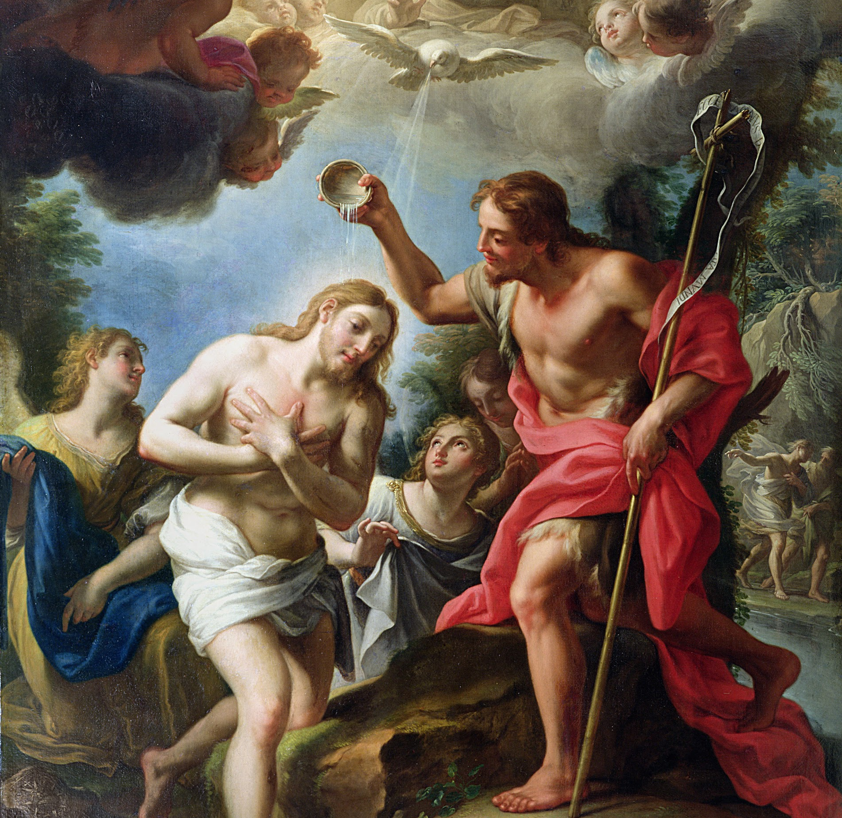
Session 27: The Sacrament of Matrimony in Salvation History

Slide 2
The Complementarity of Marriage
The Church understands (and has always understood) that there is a certain complementarity between man and woman — that is, that the differences between male and female complete and complement each other.
In marriage, as we were created in the beginning, we fulfill that complementarity and this our mission in this world to love and to seek holiness.

Slide 3
Adam and Eve
God created both man and woman (Adam and Eve, though not yet named) in His image and likeness. To be made in God’s image and likeness is, in part, to be male and female, in order to carry out God’s one command in the beginning: to be fertile and multiply and fill the earth.
Genesis 2 more fully describes the creation of woman and the unity shared between the sexes. God tells Adam it is not good the he is alone, so He will create a helper for him. God brings all of the animals to Adam in search of a companion, not because God thought any of the animals was a suitable mate for Adam, but rather so that Adam would recognize the he is unique out of all creation.

Slide 4
Adam and Eve
While sharing certain characteristics with the animals, man is also different from all of them. Only then does God create woman from Adam’s side. Rather than the popular notion that woman was made somehow less than man, man and woman are in fact equal in dignity, and close to one another’s hearts.
When Adam meets his wife for the first time, she causes him to speak in verse, bringing forth the best of man in recognition of the beauty before him. Adam proclaims that at last there is one like him, a person who is unique out of all creation, but shared in the same dignity and vocation to love and holiness as he, “bone of my bones, flesh of my flesh.”

Slide 5
Adam and Eve
Man and woman become “one body,” and cling to one another united in marriage to fulfill God’s command to fruitfulness.
The foundation of marriage, both as natural law and a sacramental covenant, is found in the very beginnings of the creation of man and woman and is an integral part of what it means to be human.

Slide 6
Marriage in the Bible
The Bible, the story of Salvation, begins with the first marriage of the original man and woman and the Bible ends with a vision of Heaven that shows us that Heaven is the wedding celebration of the Lamb, Jesus, who is united for all eternity with His Bride, us, His Church.
We are truly blessed as Christians to be invited to partake of the wedding feast of the Lamb every time we receive the Eucharist, the Body and Blood of Jesus Christ.

Slide 7
Marriage in the Bible
Whereas the Bible begins with a wedding and ends with a wedding feast, Jesus begins His public ministry with a miracle at a wedding. This is no coincidence!
Jesus is first revealed to the public as the Messiah, the Son of God and Savior, in the midst of a wedding. By doing so, Jesus is announcing that the time has come for God’s relationship with His people to be restored.

Slide 8
Marriage in the Catechism
The Catechism of the Catholic Church states: “The Church attaches great importance to Jesus’ presence at the wedding at Cana. She sees in it the confirmation of the goodness of marriage and the proclamation that thenceforth marriage will be an efficacious [effective] sign of Christ’s presence” (CCC 1613).
It is for this reason the Church places such a great importance on the Sacrament of Matrimony and defends the union of one man and one woman so vigorously.

