Slide 1
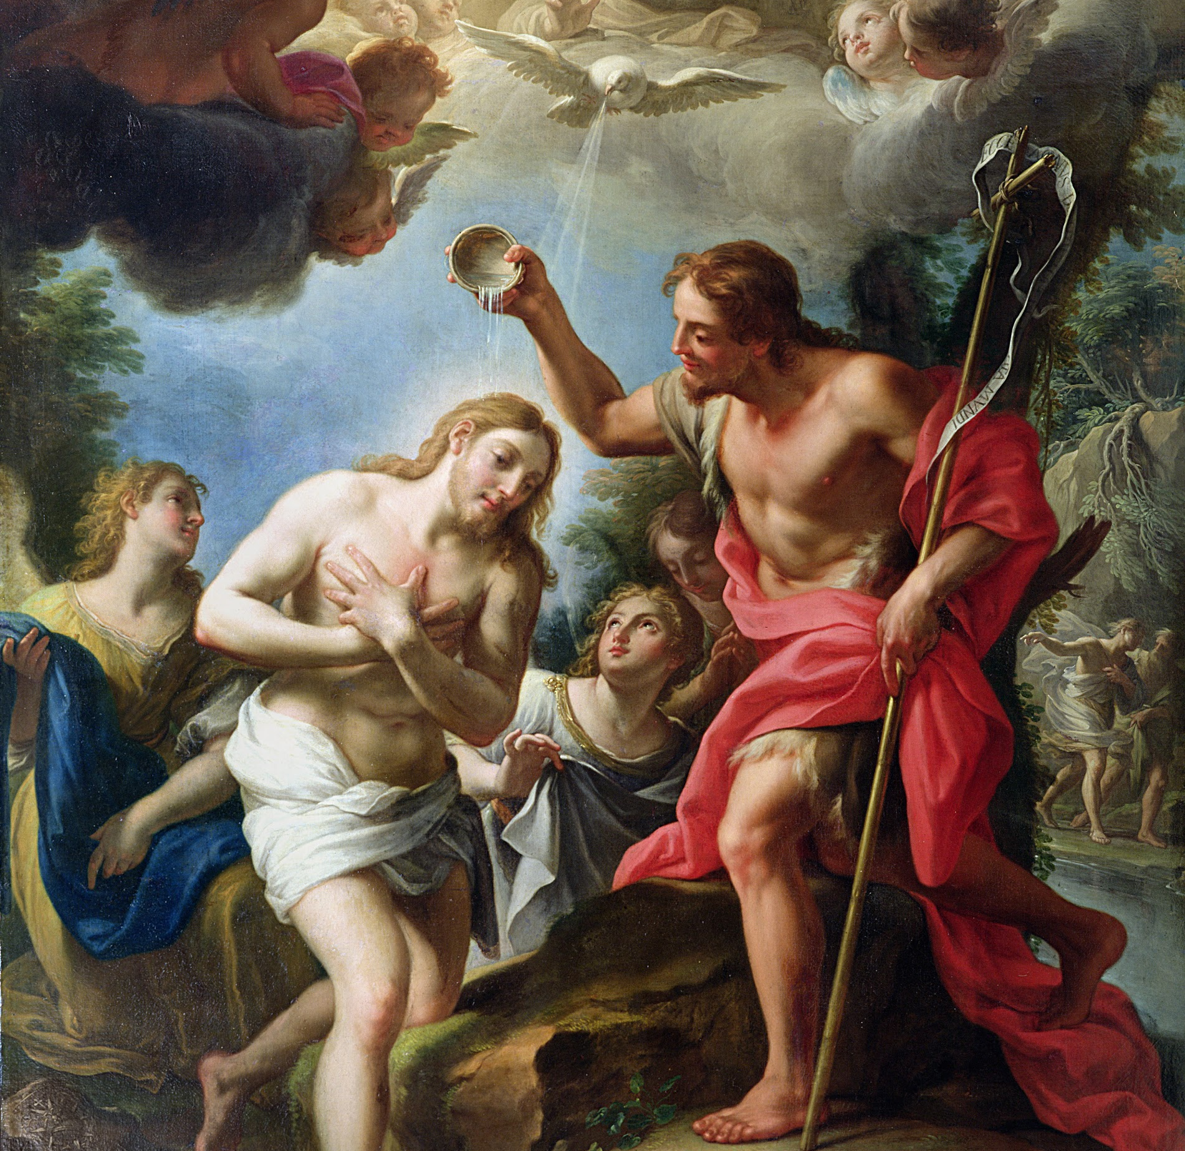
Session 28: The Celebration and Symbolism of Holy Matrimony

Slide 2
God Is Love
God IS love. Love is not just something that God does, it is who He is. God does not just act and choose to give love to others, rather, in the very core of who God is, He IS love.
God sent His only Son into the world to die for our sins so that we might have life.
If we love one another, God remains in us, and His love is brought to perfection.

Slide 3
Holy Matrimony
In the Sacrament of Holy Matrimony, mankind fulfills his imaging of God in a special way.
United in marriage, man and woman open themselves up to the creation of life, children, and thus become an icon of the Trinity, three Persons in one God, who is Love.

