Slide 1
Sorrowful Mysteries

Slide 2
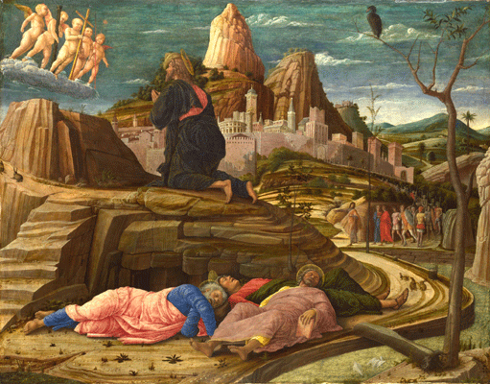
1. Agony in the Garden

Slide 3
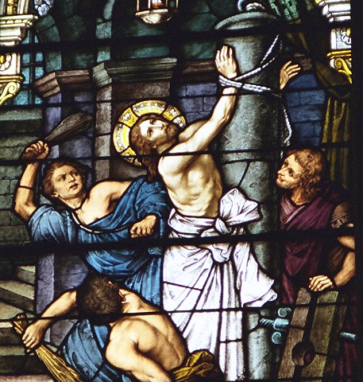
2. Scourging at the Pillar

Slide 4
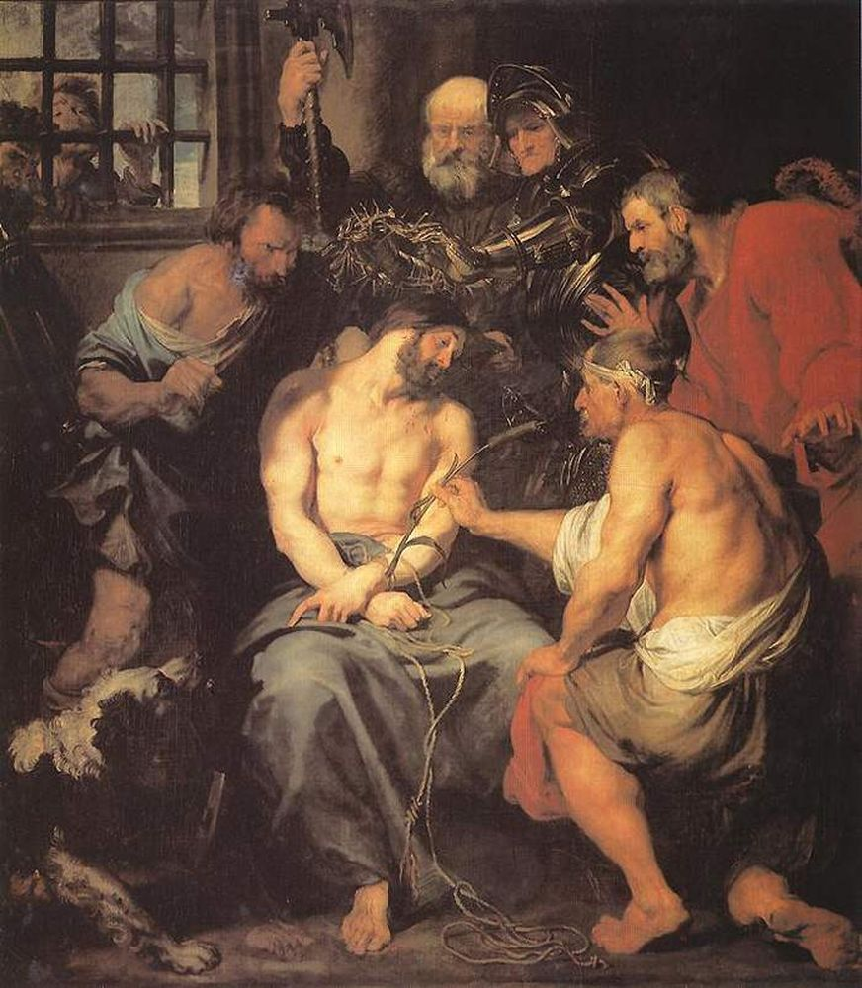
3. Crowning with Thorns

Slide 5
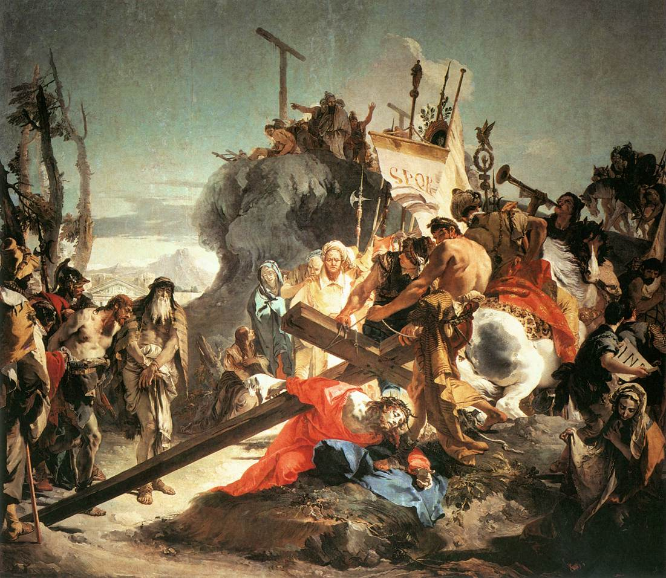
4. Carrying of the Cross

Slide 6
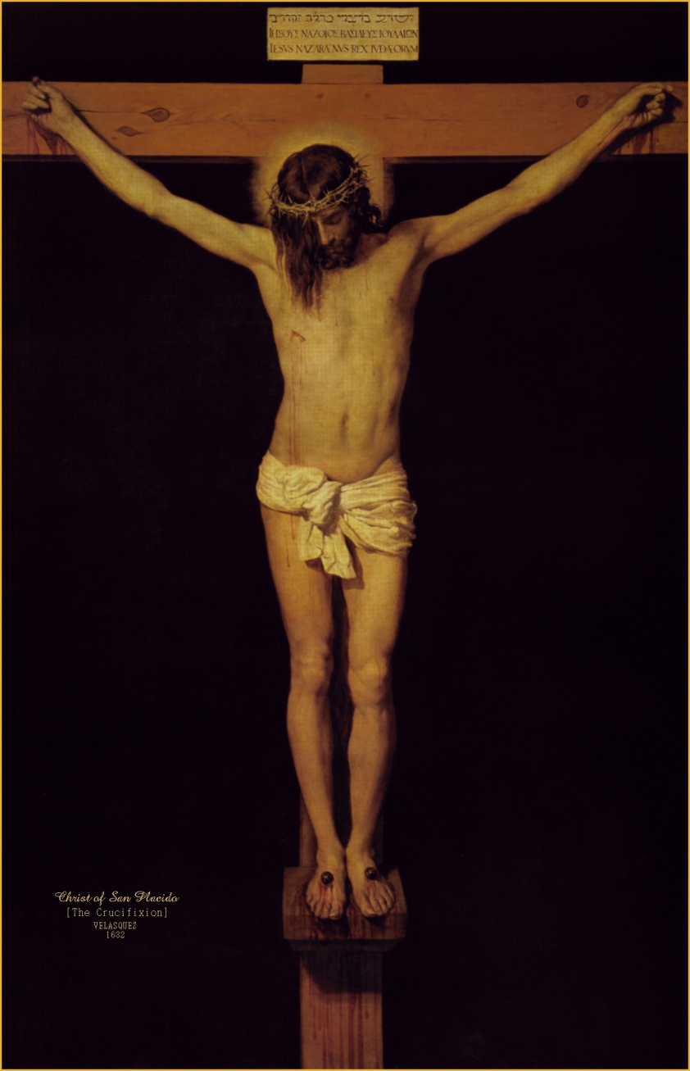
5. Crucifixion and Death

Slide 7
Art Credits
Agony in the Garden http://www.deyave.com/Arte/Pintura/Andrea_Mantegna.htm
Scourging at the Pillar http://orthodoxsojourn.blogspot.com/2011/04/passion-for-good-friday.html
“Crowning with Thorns” by Anthony van Dyck https://picasaweb.google.com/revswain/VanDyckAnthony
“Christ Carrying the Cross” by Giovanni Battista Tiepolo http://www.thechristianwallpapers.com/2009/10/jesus-christ-pictures-carrying-cross.html
Crucifixion http://www.catholictradition.org/Christ/jesus-suffering.htm

