Slide 1
October Adult Meeting

Slide 2
Agenda
Click to add your agenda
Notes:
This PowerPoint includes:
Slides for opening questions to help parents apply what they already know to a new learning experience
Notes for a presentation on this month’s content
Sacred art with discussion questions
Key points from the readings this month

Slide 3
Opening Questions
Whom are we most likely to believe? How about when we are children?
Notes:
We are most likely to believe those who love us and care for us unselfishly. Some parents may believe that their children are more likely to believe outside authority figures than they would be to believe their parents.
Reassure parents that this is not the case. Parents are their children’s first and most natural teachers. We can also ask God to help us, and our children, believe in Him.

Slide 4
Opening Questions
What are some qualities or behaviors others display that make you more likely to believe them?
Notes:
Accept all answers. Allow the conversations to go in unexpected directions.

Slide 5
Opening Questions
How do we find someone who is able to do something for us that we cannot do for ourselves? (e.g., doctors, plumbers, dentists, etc.)
Notes:
Accept all answers.

Slide 6
The Three Phases of Coming to know God
Knowing that God exists through reason
Knowing who He is through Revelation
Having faith: accepting God and His Truth
Notes:
Image of a Dance
Imagine a girl is at a formal ball. While she’s there, she sees a man across the dance floor. She can’t see him too clearly, but she recognizes that there’s something special, something unique about this man.
Then imagine the man has already seen her, and walks across the dance floor toward her. He introduces himself, and asks her to dance.
Finally, imagine she accepts his invitation, and their relationship begins.
These three steps correspond to the three phases of coming to know God
We can know about God through our own reason. This knowledge isn’t very clear, but it’s enough to know that God is unique, and the most important thing there is.
God comes to introduce Himself directly through revelation. He tells us who He is, and invites us into a relationship with Himself.
By faith, we accept God’s revelation, and our personal relationship with Him begins.
We can choose to accept or reject a relationship with God because He gave us free will. We choose to enter a relationship with God, but He invites us to the relationship first.
So let’s look at those three steps in greater detail

Slide 7
What Reason Tells Us about God

Slide 8
We can know God through reason by:
Looking at the external world
Looking at the human person
Notes:
When we talk about “reason” in this context, we’re talking about our natural human intelligence.[1]
Our ability to make observations and draw inferences from our common experiences.
Reason can come to know that God exists in two ways[2]:
By looking at the external world
If the universe had a beginning, what caused that beginning?
If things in the universe don’t have to exist, why do they exist?
How did the universe get to be so orderly and predictable if there was nobody to organize it?
By looking at the human person
Why does everyone want to be perfectly and permanently happy if there is no perfect and permanent happiness?
Why does everyone want to be in a loving relationship with a perfect person if there is no perfect person?
A “good” thing is something that achieves the purpose it was given by its maker (e.g., a pen manufacturer makes a pen to write clearly, and it’s a good pen if it does that). But then how can we talk about people being “good” or failing to be good unless we were given some purpose by a Maker?
[1] The textual support for this material is found in Lesson 2, “We can know God through reason.”
[2] The textual support for this material is found in Lesson 2, “We can know God through His Creation.”

Slide 9
Through reason we can know what God is, but not who God is.
Notes:
God created the world ex nihilo, which means “out of nothing.” He is the one that starts everything; nothing existed before Him.
It makes sense that since God is the sole Creator of the world, that the world would tell us something about Him.
We can know that God exists, and that He is Holy, almighty, all-knowing, eternal and unchanging, and omnipresent (these qualities are called the attributes of God). So we can know by reason that there is a God, and that He’s incredibly important.
But our understanding of Him, just based on reason, is pretty vague. We can’t see Him, we can’t talk to Him, we don’t know where He is.
More importantly, we can know what God is, but we can’t know who God is.

Slide 10
To know who God is, we need Revelation.
Notes:
Which is why, if we’re going to enter into relationship with Him, He’s going to need to take the initiative step. Which He does, in Revelation.

Slide 11
Divine Revelation: God reveals Himself directly to the human race

Slide 12
Revelation begins with Old Testament patriarchs and prophets. God reveals Himself fully in Jesus Christ.
Notes:
What Revelation tells us about God
So God comes to us, and introduces Himself. When God reveals Himself directly to the human race, that’s called Divine Revelation.[3]
It begins in the Old Testament, where God reveals Himself slowly to the patriarchs and prophets.
Then, He reveals Himself fully by coming to meet us in the flesh, in Jesus Christ.
But how do we know about Jesus?
Because the Magisterium
= Peter and the Apostles and their successors (the pope and bishops)
gave us Scripture (The Bible)
= the sacred books written, commissioned, and collected by the magisterium
and Tradition
= the official teachings of the Church down through the centuries
[3]The textual support for this material is found is Lesson 2, “We can know God through Divine Revelation.”

Slide 13
Who is God? The Blessed Trinity
Notes:
Now revelation tells us who God is. In fact, it tells us that God is 3 whos, or 3 persons.[4]
It tells us that God is a Trinity: Father, Son, and Holy Spirit.
God is an infinitely happy, loving community of persons.
[4] The textual support for this material is found in Lesson 2, “The Blessed Trinity is the central mystery of our Faith.”

Slide 14
God is one God in three Divine persons: God the Father, God the Son, and God the Holy Spirit.

Slide 15
The Trinity answers the questions of:
Who is God?
What kind of relationship does He invite us to?
Where does everything come from?
What is the purpose of life?
Notes:
This is the central mystery of our faith. It tells us:
Who God is
The kind of relationship we are invited to enter
In other words, the doctrine of the Trinity answers the two ultimate questions:
Where does everything come from?
What is the purpose of life?

Slide 16
Now the only question is:
Will we accept God’s invitation to join Him?
Notes:
Unlike human beings who sin, or who fail despite their best intentions, God never sins or fails.
We can be surer of our faith in God than we can be in any human knowledge.
Our faith is not a blind leap.
Even if the truths that have been revealed to us aren’t completely clear because of our limited human understanding. We believe, because we trust God.
Only God is completely trustworthy, faithful, and cannot fail.
God is Holy, almighty, all-knowing, eternal and unchanging, and omnipresent. Why would we ever choose to put our faith in something other than Him?

Slide 17
Faith: Entering into Relationship with God

Slide 18
Faith means entering into a relationship with God.
Notes:
This relationship means first of all: believing that what God has revealed is true; and secondly: acting according to your faith.
If you don’t believe what God has told you, then you can’t be in relationship with Him. And if you don’t act like you believe, then have you really made your faith a part of you?

Slide 19
Faith means believing that what God has told you is true.
Notes:
Believing that what God has told you is true[5]
If you reject somebody’s testimony, it means you don’t trust them personally – and you can’t be in a loving relationship with someone you don’t trust.
That’s why accepting God’s testimony is so crucial for your relationship with God.
Also, don’t think that “faith” or “belief in God” means uncertain opinion
God can’t lie or be mistaken, so you can be absolutely certain that what He reveals through the Bible and Church teaching is completely true.
Of course, there’s a lot of stuff in the Bible and two thousand years of official Church teaching – but there are plenty of places to find summaries, like the Creeds and the Catechisms.
That’s why there’s no reason for any Catholic to be ignorant about the basic truths of faith. There’s no reason you shouldn’t know about the God who’s done so much to make Himself known to you.
[5]The textual support for this section is found in Lesson 1, “What is Faith,” “Faith is a theological virtue,” and “Faith means the body of truths we believe.”

Slide 20
Faith means acting according to your faith.
Notes:
Acting according to your faith[6]
A couple who knows they’re having a child, but doesn’t do anything to get ready, is in denial. Their knowledge isn’t doing them any good.
So if you know who God is, what He’s done for you, and His instructions for your happiness – but you don’t do anything about it – what good does it do you?!
Over the course of this program, don’t forget that all this information is meant to lead you deeper and deeper into a relationship with God.
Don’t keep Faith at a theoretical level – let it change your life!
[6] The textual support for this section is found in Lesson 1, “Faith requires obedience.”

Slide 21
The Christian Family reflects the self-giving love of the Trinity.
Notes:
In the Creation story, we learn that human beings are made in the image and likeness of God.
This doesn’t mean that we actually look like God!
Rather, we have intellect, free will, and the capacity to love.
God called man very good (the rest of creation was called good).
The only thing God said was not good was for man to be alone.
Which is why God created Eve.
Man and Woman were made for each other, to love one another.
In this way, the Christian Family reflects the self-giving love of the Trinity.
God invites us to live transformative lives of faith within our own families!

Slide 22
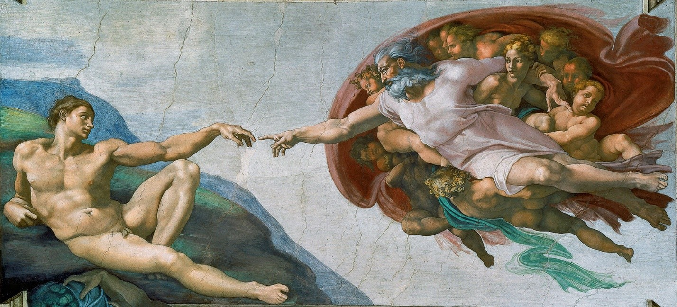
Whom do you see in this painting? What part of the Bible does it depict?
Notes:
Adam is on the left; God the Father is on the right, surrounded by angels. Some scholars believe the woman behind the Father is Eve, yet to be created by Him. The painting depicts the creation of Adam from the Book of Genesis.

Slide 23
Compare and contrast the appearance and posture of God the Father with Adam. Who seems to have more energy?
Notes:
Allow the discussion about this work of art to go in unexpected directions! You might point out that God the Father seems to have more energy, while Adam appears more passive. This helps us see God as the Creator, the one who take the “initiative step” of love with us. He breathes life into Adam, and into all of us. Everything good comes from God.

Slide 24
Why would Adam’s posture mirror God’s?
Notes:
Allow discussion to proceed freely. Notice details such as how Adam’s lower right leg and foot are almost an exact replica of the Father’s. Their arms look very similar. Their bodies seem roughly the same size. If parents do not reach this conclusion on their own, point out that the painting helps us understand what it means to be created in the image and likeness of God. Although God the Father is pure spirit and has no body, the artist has painted Him with a human body. This, along with the fact that Adam’s posture somewhat mirrors God’s, helps us understand that man is created in the image and likeness of God with intellect, free will, and the capacity to love.

Slide 25
Why do you think Michaelangelo painted their hands almost, but not quite, touching?
Notes:
There is no “right answer” to this question!

Slide 26
Some scholars note that the contours of the image behind God look similar to a human brain. If true, what might that signify?
Notes:
You might suggest that Michelangelo was emphasizing that God has given human persons an intellect.

Slide 27
What other connections can you make between our readings this month and this piece of art?
Notes:
Allow the conversation to proceed freely.

Slide 28
Key Points in Our Readings This Month
Faith is:
A gift from God
Necessary for salvation and requires that we follow God’s commandments
Summarized in the Apostles’ Creed
Faith is NOT a blind leap.

Slide 29
Key Points in Our Readings This Month
We can know God through Divine Revelation and through His creation.
Unlike any other creatures, human beings are made in the image of God. This means we are created with intellect, free will, and the capacity to love.

Slide 30
Key Points in Our Readings This Month
God is the Blessed Trinity – one God in three Divine Persons – the Father, the Son, and the Holy Spirit. The Trinity is the central mystery of our faith.
God the Father is the Creator of Heaven and Earth.

