Slide 1
Science and the Shroud of Turin
CHAPTER 9
Chapter 9

Slide 2
In This Chapter You Will Learn That…
The Shroud of Turin contains a miraculous image of a crucified man that all evidence suggests is Jesus Christ.
The shroud has undergone scientific investigations over the years that all support that authenticity of the shroud.
The Shroud of Turin and the Facecloth of Oviedo share numerous details that likely indicate they both were burial cloths of the same person.
The evidence presented by the shroud strongly corroborates the accuracy of the Gospel accounts of Jesus’ Crucifixion and Resurrection.

Slide 3
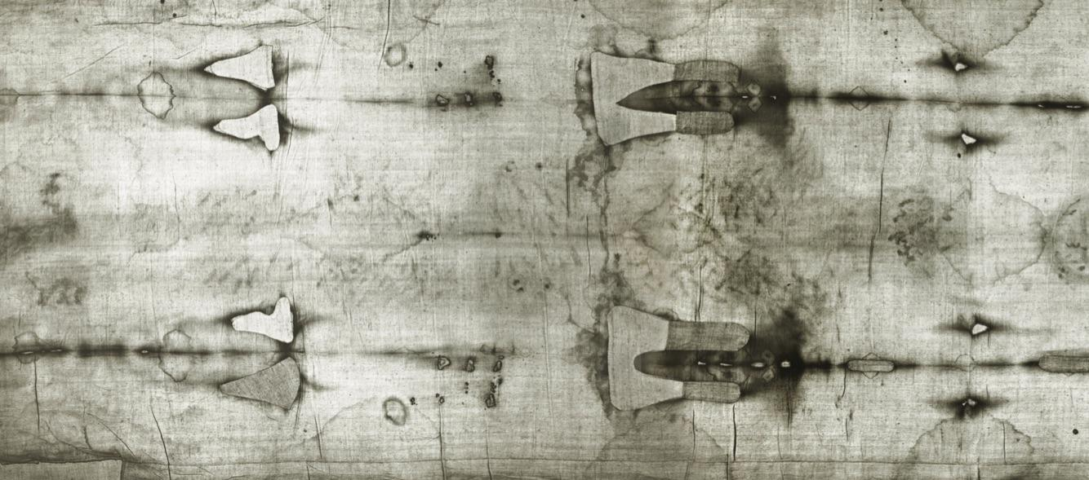
The Shroud of Turin
The numerous and wide-ranging tests on the shroud—anatomical details that correspond to the unusual set of injuries described in the Gospel, dating analyses that place it at the time of Christ, and a scientifically unique image suggestive of the Resurrection — strongly imply that it is the burial shroud of Christ.

Slide 4
Anatomically Accurate Blood Stains
There are several blood stains on the shroud.
The image and blood stains, relative to one another, are anatomically correct.
The blood has been found to be a rare blood type: AB positive, with male DNA.
The precise nature of the torments undergone by the man on the shroud is detailed by Dr. Pierre Barbet in his famous work, A Doctor at Calvary.

Slide 5
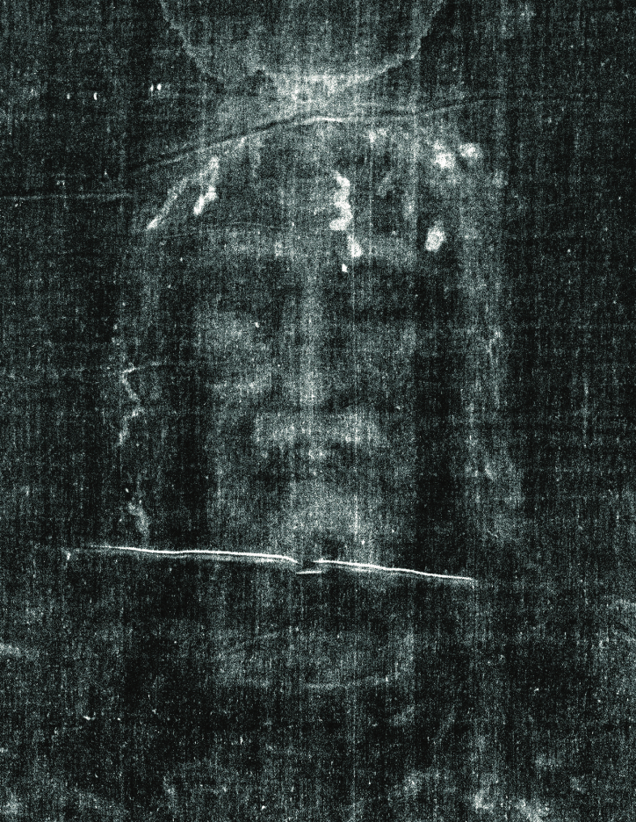
Dating the Shroud
The usual protocol for a carbon-dating test would be to take samples from several parts of the shroud; in this case, however, only one sample thread was taken and used by all three testing labs.
The single 1988 sample was taken from a previously undiscovered repair patch on the shroud.
Since the sample was not part of the original material, the carbon-dating tells us when the shroud was patched, but nothing about when it was originally made.

Slide 6
Other Indications of the Shroud’s Age
Pollen Grains
Roman Coins on the Eyes of the Man in the Shroud
Similarities to the Facecloth of Oviedo
The Image on the Shroud
45 pollen grains were from Israel.
The image has coins minted in Judea in AD 29
the Facecloth of Oviedo was the burial cloth mentioned in Scripture.
There are many striking anomalies about the image.

Slide 7
Conclusion
The odds of this First Century Palestinian burial shroud being of anyone but Jesus is exceedingly remote.
Given all this evidence, we might reasonably infer that the Shroud of Turin is the burial cloth of Jesus which contains not only a detailed account of His crucifixion, but also the remnants of His Resurrection in glory.
It shows both the truth of the most significant event in human history as well as the accuracy of the Gospel accounts of it.

