Slide 1
Jesus Reveals God as Unconditional Love
CHAPTER 12
Chapter 12

Slide 2
In This Chapter You Will Learn That…
Jesus’ revelation of agapē love is also a revelation of the heart and core identity of God.
To live out agapē love is to imitate God Himself.
Though God’s love is extended to us unconditionally, we must want it enough to accept it, enter into it, and make it our own.
Jesus illustrated how God’s unconditional love extends to everyone by seeking out the poor, the sick, and sinners.
False conceptions of God are dangerous because they close us off to Him just when we need to reach out to Him the most.

Slide 3
God Is Love
The two great commandments are a unique teaching in the elevated position it gave love, as well as in the connection it made between the love of God and the love of neighbor.
To live agapē love is to imitate God Himself.
“God is Love” may seem a commonplace expression today, but it was a radical reframing of reality for Jesus’ first listeners.

Slide 4
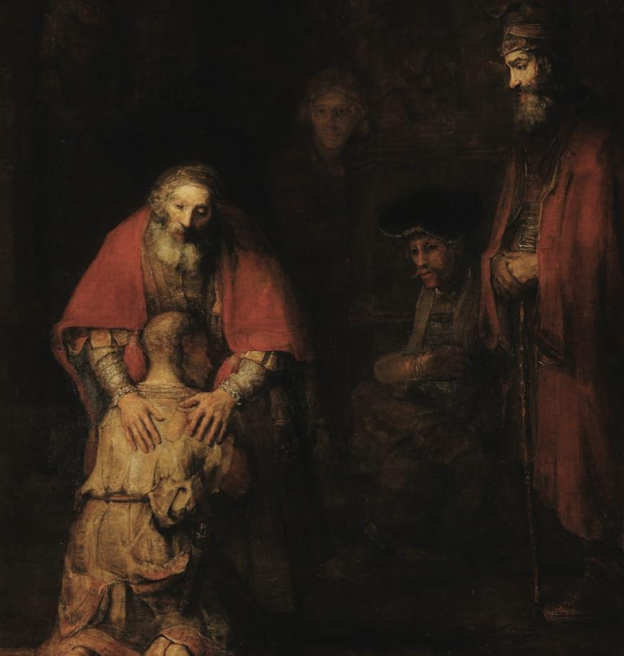
Jesus Called God “Abba”
Abba is an Aramaic term for “Father” that is familiar rather than formal, an intimate form of address typically used by children and carrying a sense of childlike trust.
In one word, Jesus declared God to be at once gentle and affectionate, trustworthy and patient, compassionate and forgiving, and completely concerned with the protection, welfare, and advancement of all His children — just like a perfectly loving Father.

Slide 5
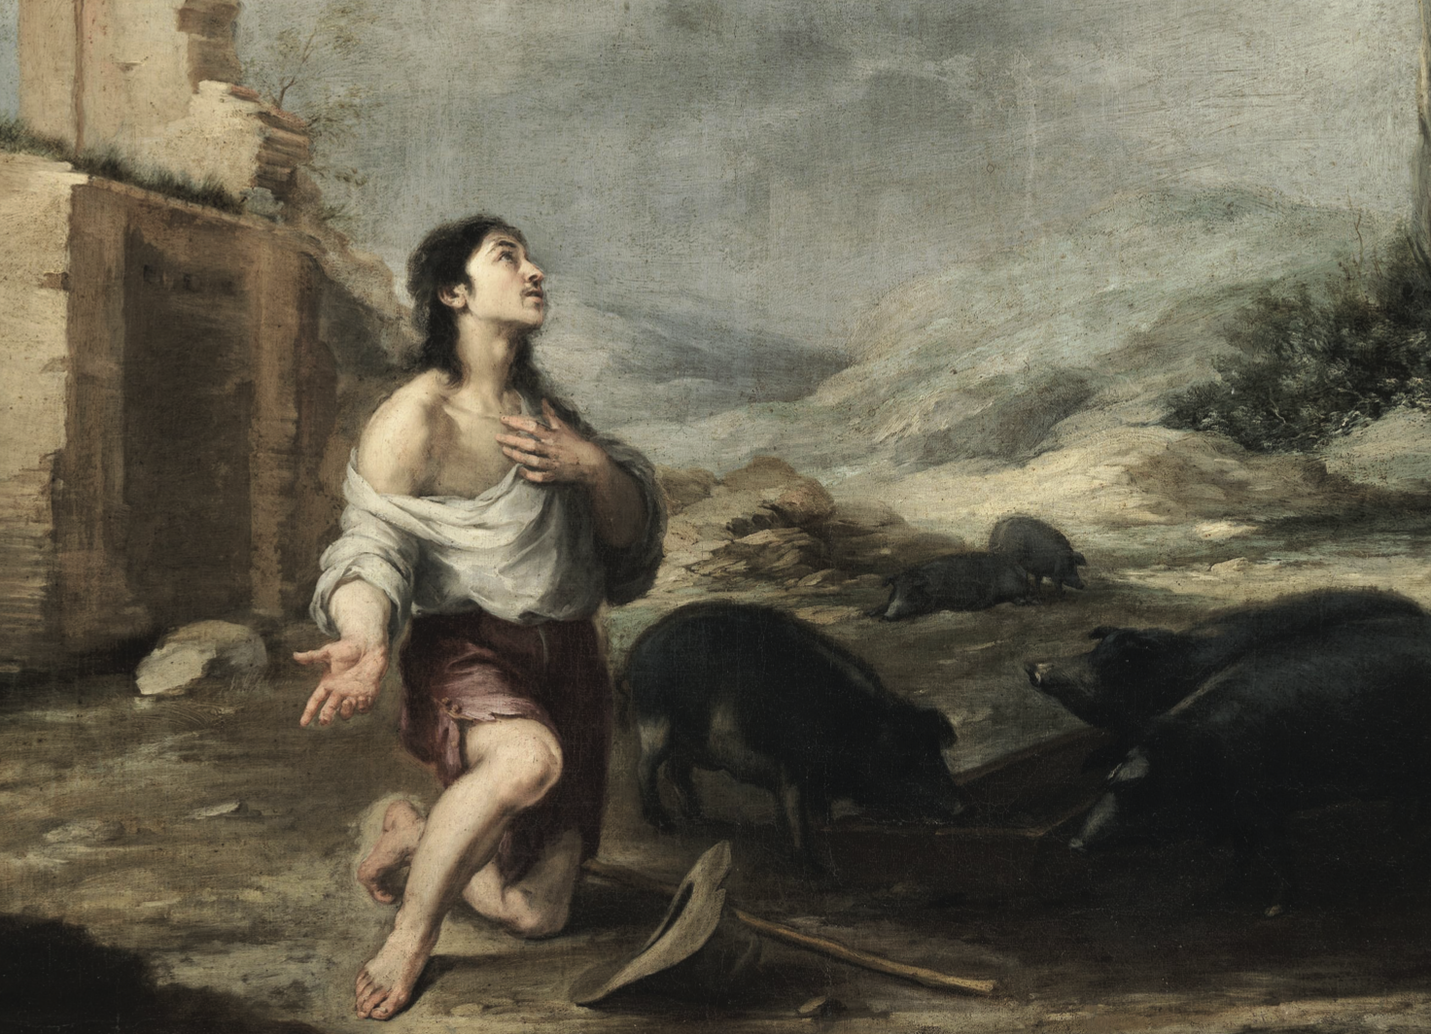
The Parable of the Prodigal Son
The most detailed illustration of God’s unconditionally loving nature might be found in the Parable of the Prodigal Son.
Though God’s love is extended to us unconditionally, there is one important condition on our part to our receiving it from Him — we must want it enough to make it our own.

Slide 6
Jesus’ Love of the Poor, the Sick, and Sinners
Jesus’ Love of the Poor
1st Beatitude
The Sermon on the Plain
The story of the Rich Man and the Beggar Lazarus
The Parable of the Good Samaritan
Jesus’ Love of the Sick
The Healing of Bartimaeus (Mark 10:46-52)
The Raising of the Son of the Widow of Nain (Luke 7:11–17)
Jesus’ Love of Sinners
Matthew’s decision to follow him
Zacchaeus’ decision to reform his ways
Contrition of the woman caught in adultery
The woman washing his feet with her tears

Slide 7
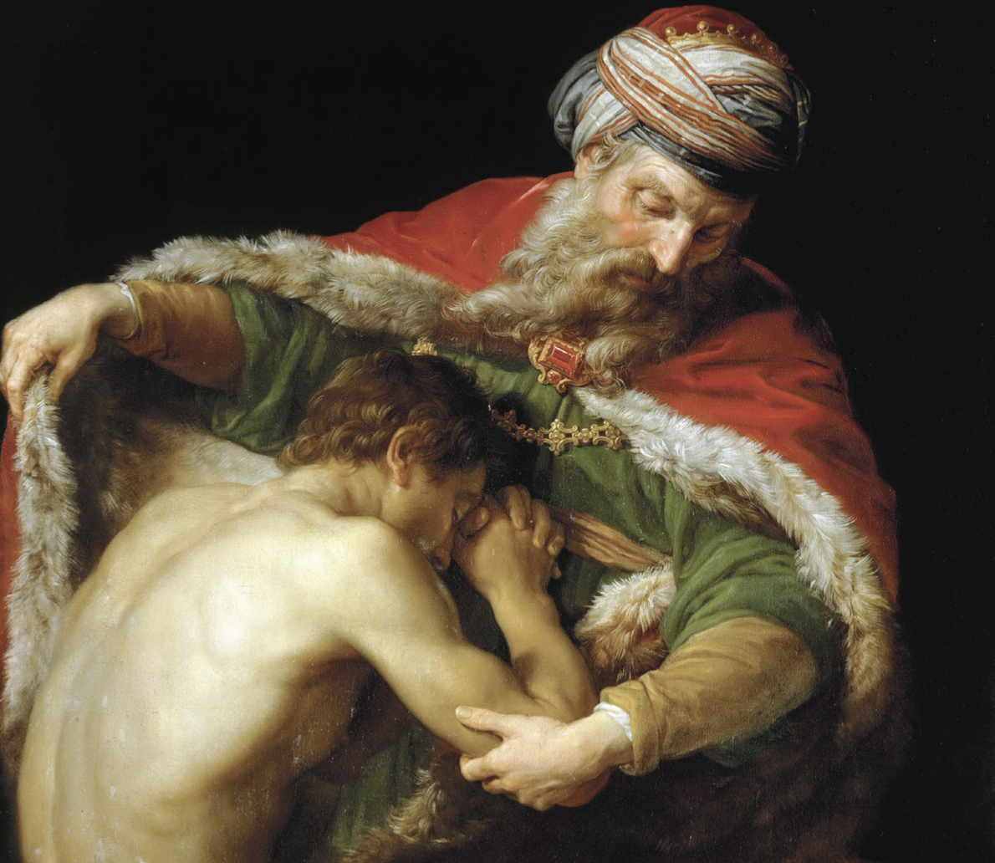
False Conceptions of God
Angry God
Payback God
Domineering God
Terrifying God
Stoic God
Disgusted God

