Slide 1
Responsibilities and Rights
Chapter 8

Slide 2
In this chapter you will learn that...
Rights are best understood in the context of social relationships and responsibilities.
Authentic freedom is the ability to choose what is good, and it is ultimately found in God Himself.
Human rights are grounded in the natural law, the order of justice that is connected to the human goods we attain through the morally responsible exercise of freedom.

Slide 3
In this chapter you will learn that...
There is a proper order of rights
All rights protect the basic human goods that lead to human flourishing. These rights correspond to the individual, to the family, to society, and to God.

Slide 4
Idolization of Choice
Today, “Choice” is valued so much it determines a baby’s humanity.
Our culture believes that consent is all that is needed to make an action morally right.
Secular understanding of freedom: we ought to be free to do whatever we want as long as it does not hurt another person.

Slide 5
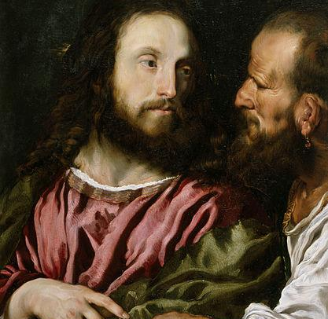
Idolization of Choice
Society claims we have the right to define freedom.
This belief is rooted in absolute autonomy.
“Society becomes a mass of individuals placed side by side, but without mutual bonds.” -St. JPII Evangelium Vitae

Slide 6
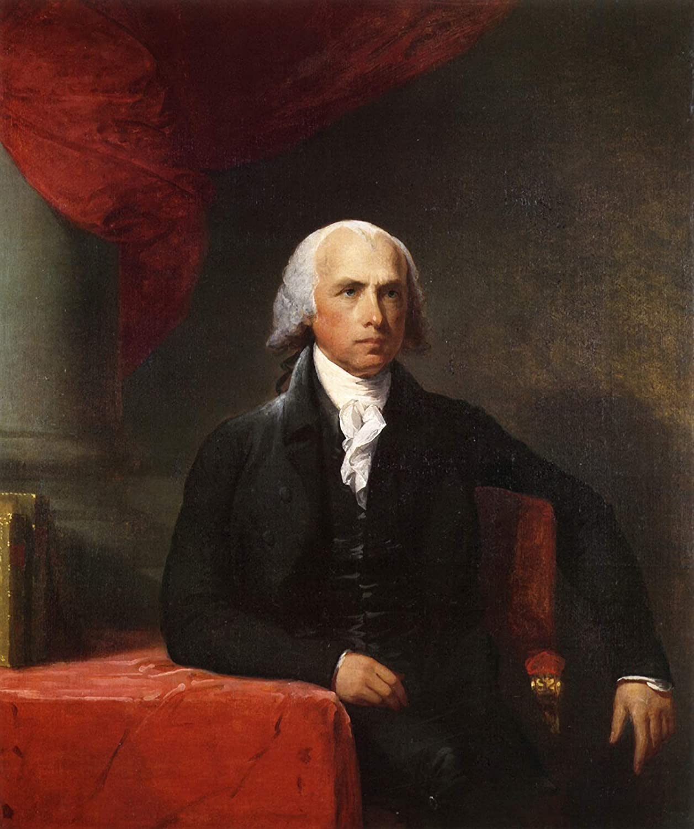
The Origin of Rights
Historically, “right” referred to the dominion or ownership a person had over something within social relations and responsibilities.
Church teaches that the origin of rights is the natural law.
Every right has a corresponding responsibility.

Slide 7
Rights and Our Responsibility to Human Flourishing
Human rights are first and foremost about our personal and social responsibilities.
Our rights can never exist at the expense of our responsibilities.
Rights are the expression of our morally responsible use of freedom.
We do not have the right to things that are contrary to the good and against the moral law.

Slide 8
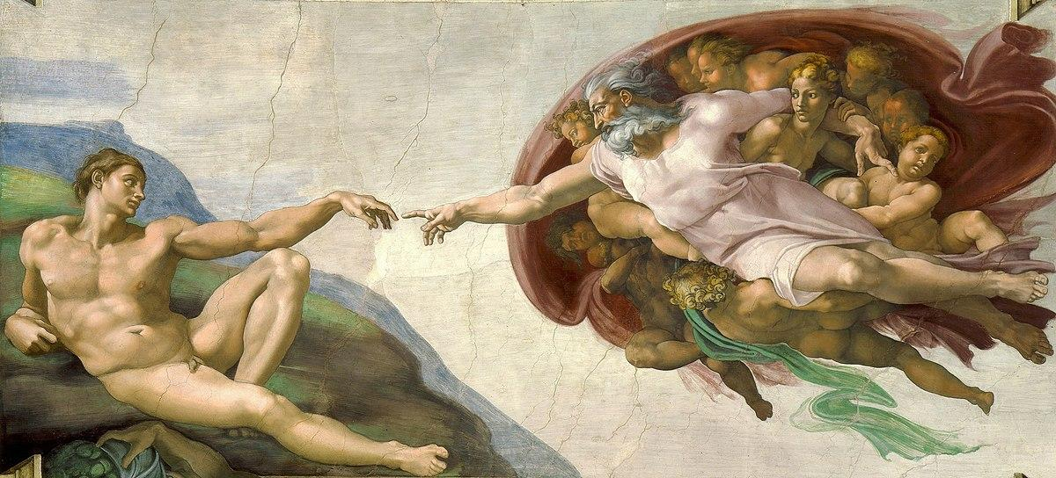
Rights and Our Responsibility to Human Flourishing
Civil Law does not determine morality.
Civil Law allows for immoral behavior contrary to the natural law that we should not participate.
Despite what Civil Law allows we have the responsibility to act with justice and virtue.

Slide 9
God-Given Rights
Human rights originate in the authority of God, the creator of human nature.
Human rights are rooted in human nature.
The Founding Fathers reiterated this idea in the Declaration of Independence: these rights are God-given.
Secular Society argues the individual can define his own nature (and others) the way he wishes.

Slide 10
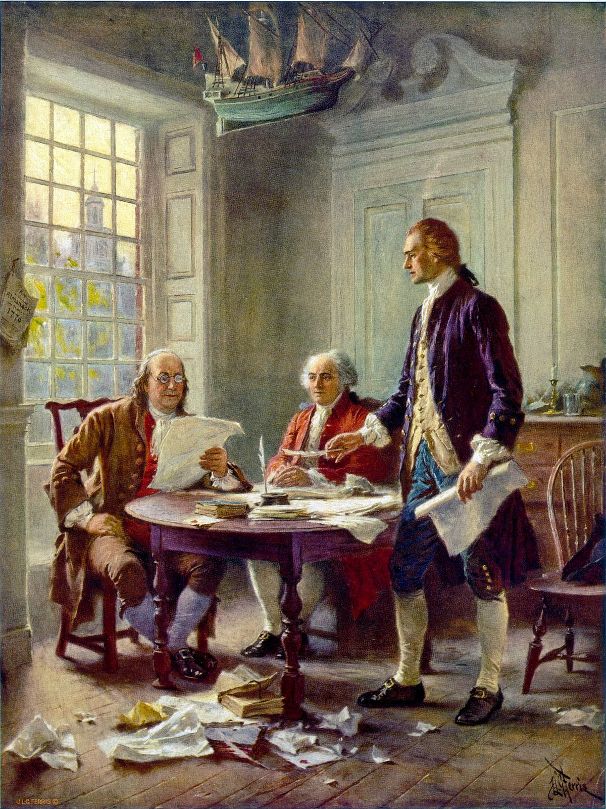
God-Given Rights
This belief “ends up becoming the freedom of “the strong” against the weak.” -St. JPII Evangelium Vitae
We cannot parade the rights of some while denying the rights of others.

Slide 11
God-Given Rights
In our society, the “inalienable right to life” is determined on vote.
“Rights” ceases to be such because of the will of the stronger part.
In this way democracy moves toward totalitarianism.
This logic is based off the modern idea of “consent.”

Slide 12
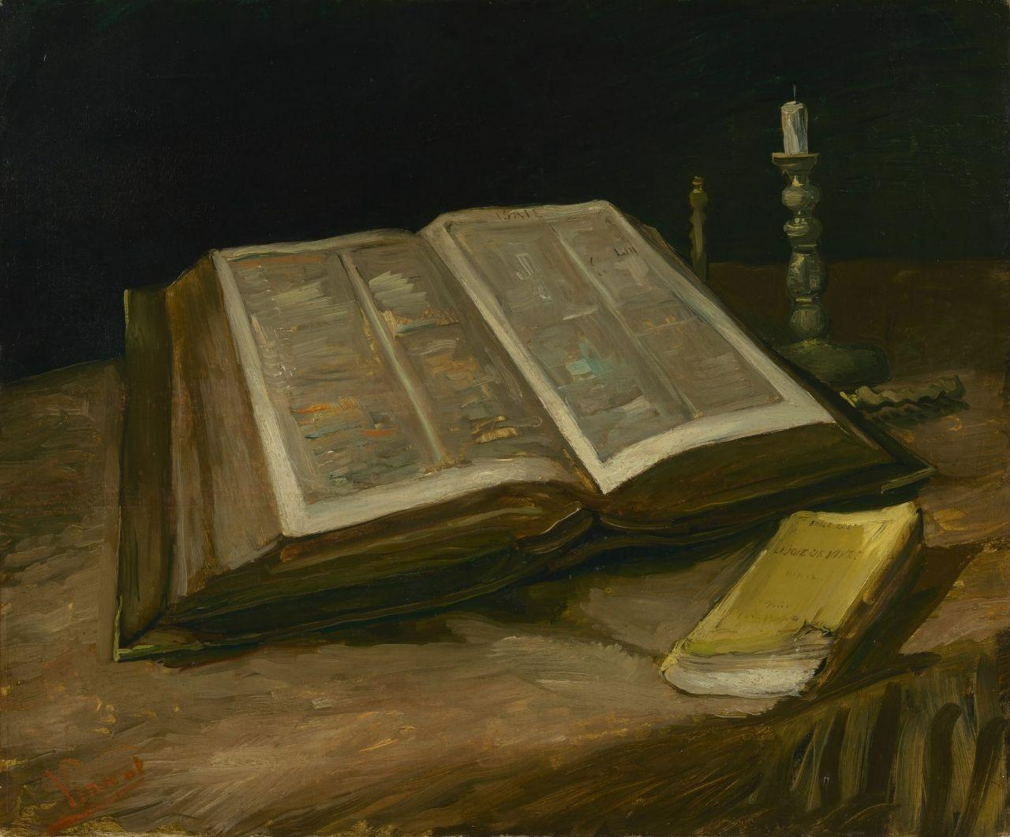
Four Basic Goods That Perfect our Nature
The four basic goods the natural law revolves around were explained by both St. Augustine and St. Thomas Aquinas.
The Four Basic Human Goods
Self-preservation
Family life
Living at peace in society
Knowledge of truth (God)

Slide 13
Four Basic Goods That Perfect Our Nature
These four ends are arranged in ascending order and depend upon each other.
The three previous goods all depend upon the last good: our knowledge and love of God.
The order of the four basic goods is the right ordering of things.
A society upholds human rights when it respects the rights of God as Creator and Lord first, and when it protects the common good and the rights of the family.

Slide 14
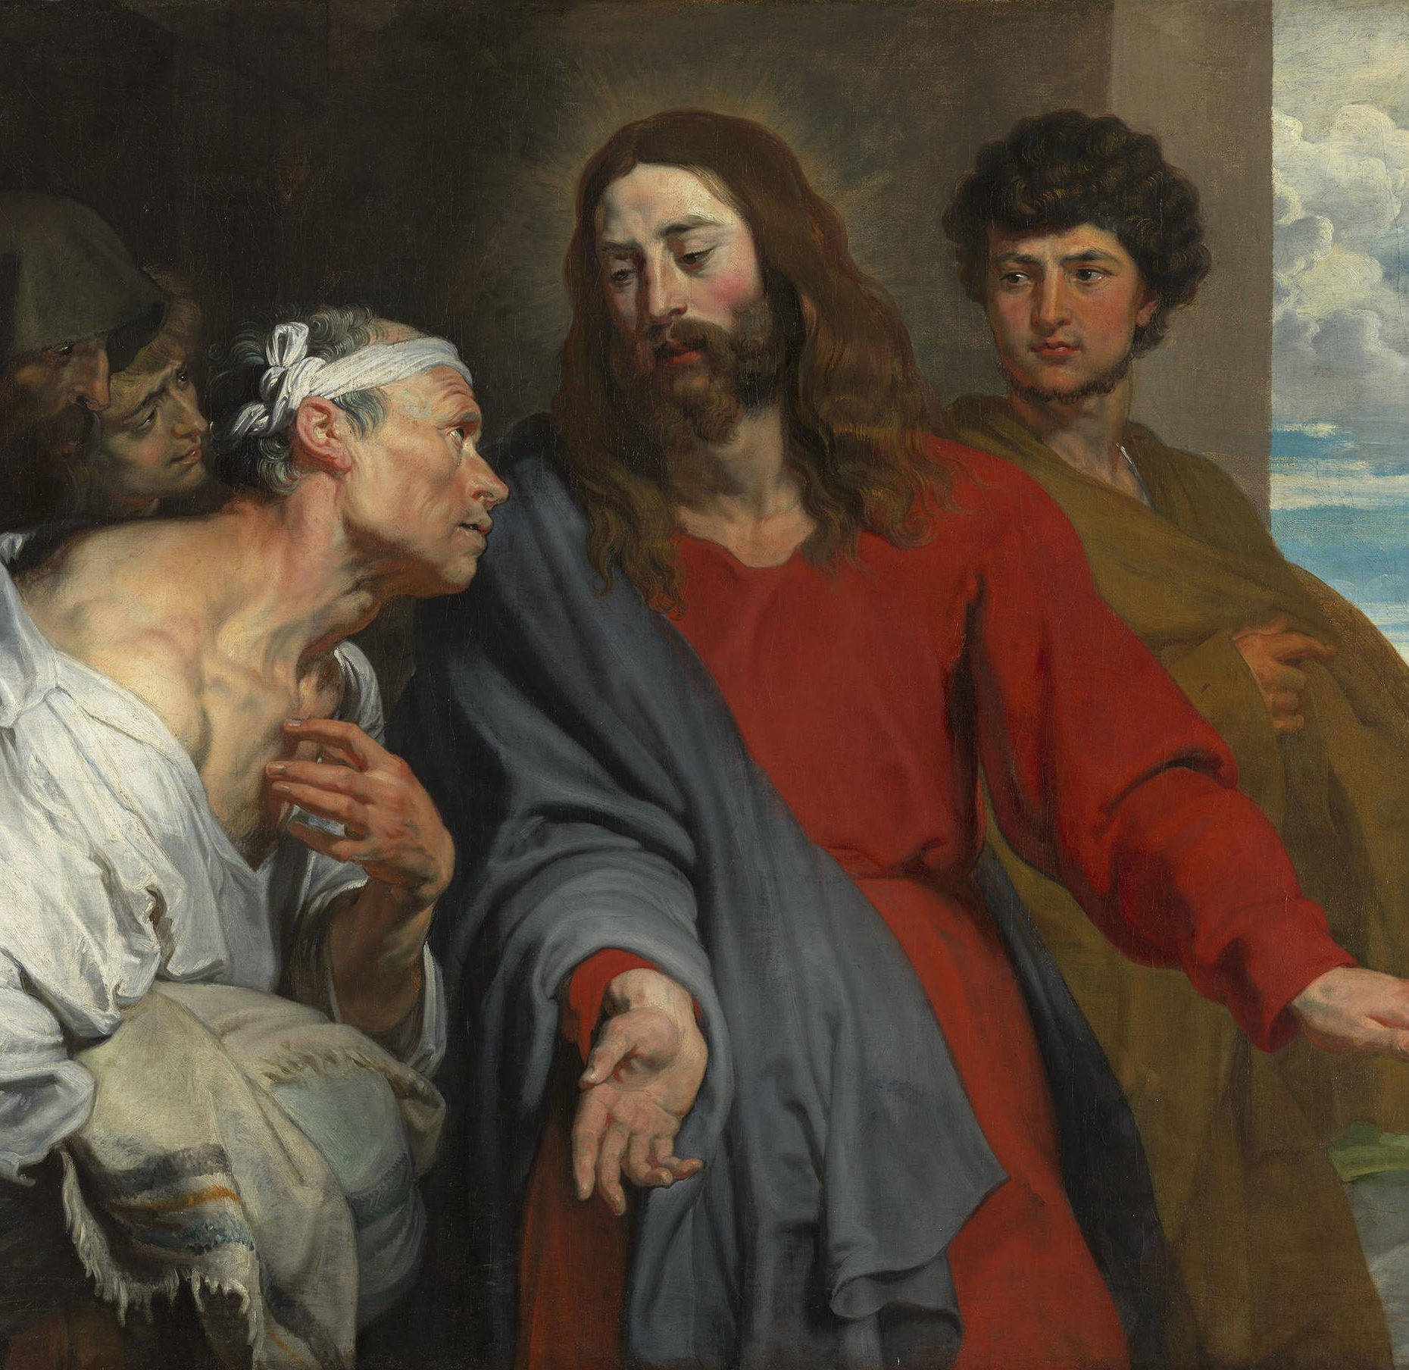
Four Basic Goods That Perfect Our Nature
When society rejects God, it also tends to perpetuate error and corruption.
Certain policies in modern society violate the natural law and the entire spectrum of human rights.
Example: homosexual “marriage.”
The purpose of human rights is to safeguard human dignity and lead to human flourishing

Slide 15
It is easy to allow for immoral behavior through emotions and misplaced compassion.
We forget that we have to work for certain things and not all we desire is good for us.
We must remember that our rights come from God.
God gave us free will so we can exercise these rights for good.
We must take responsibility for our lives and seek true justice in our society.

Slide 16
St. Roque was born in Asuncion, Paraguay in 1576.
He was ordained a priest at 23 years old.
Joined the Jesuits to serve in their “reductions.”
Devoted his life to the indigenous people to bring them to Christ.
St. Roque was martyred by a raiding party in 1628.

