Slide 1
The Social Dimensions of the Beatitudes
Chapter 15

Slide 2
In this chapter you will learn that...
The Beatitudes are dispositions that lead us to God’s blessings.
To be poor in spirit means being emotionally and spiritually detached from the things of this world.
Living the Beatitudes is the true mark of Christian holiness.

Slide 3
In this chapter you will learn that...
The Beatitudes are a perfect depiction of Christ.
Jesus’ two great commandments communicate the whole of the moral life.

Slide 4
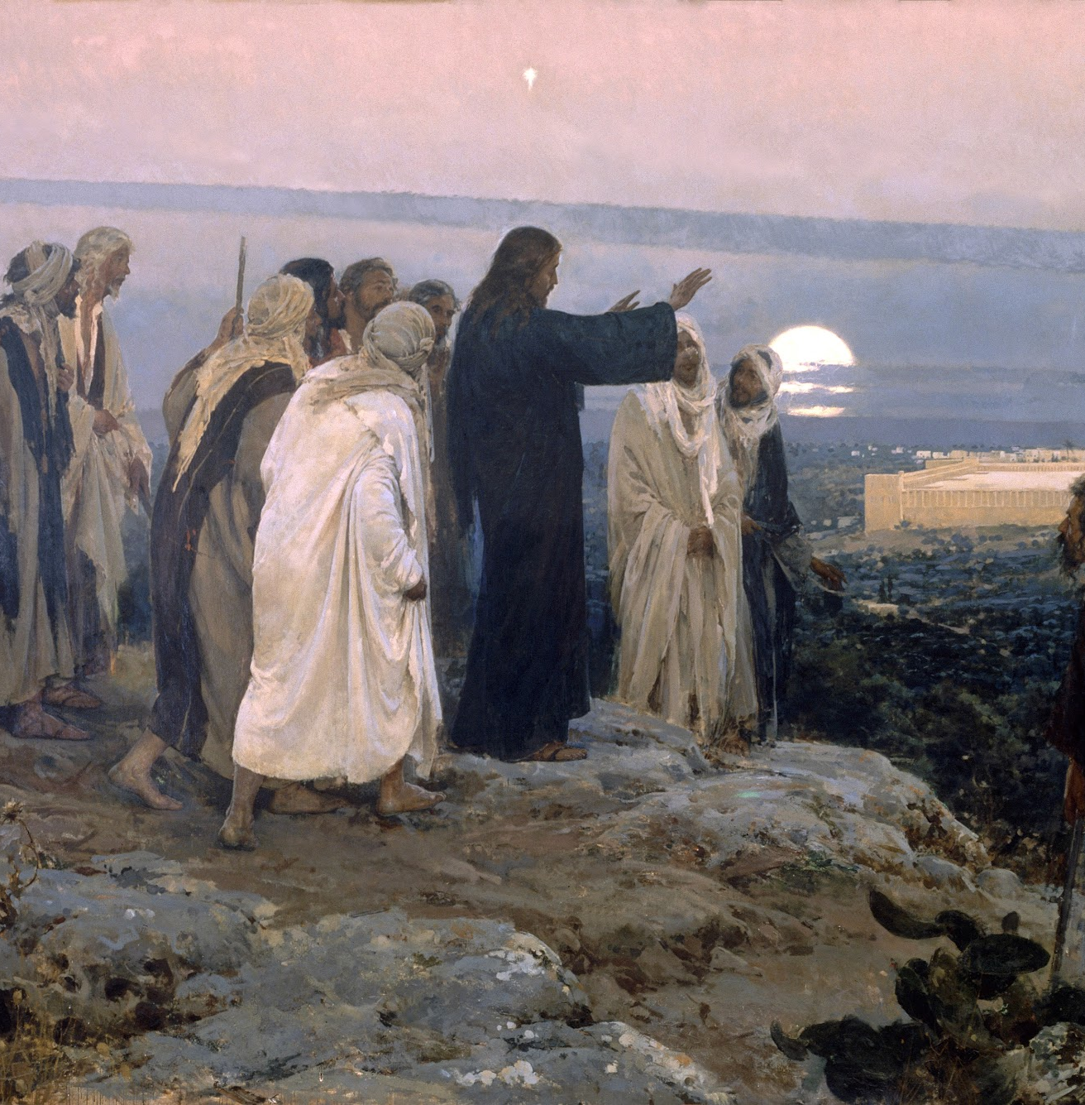
What are the Beatitudes?
The Beatitudes are the first words of Jesus’ Sermon on the Mount.
He gave us eight spiritual dispositions that incline us to God’s blessing and comfort.
Jesus taught us how we might attain the blessedness of Heaven not only in the next life, but here and now.

Slide 5
The First Beatitude
Blessed are the poor in spirit, for theirs is the kingdom of Heaven.
To be poor in spirit means to be emotionally and spiritually detached from the goods of this world.
Does not forbid us from using earthly goods, but it does require that we not invest ourselves in them.
Jesus is a model of detachment for us.

Slide 6
The Second Beatitude
Blessed are they who mourn, for they will be comforted.
Many things cause us grief in this life.
Jesus’ wisdom in the Second Beatitude is that we should be sorrowful over such tragedies.
In sorrow, we become humble and allow ourselves to feel the reality of sin within our own hearts and bodies.
When we avoid the sorrows of this life, we shut ourselves off to God’s mercy and consolation and perpetuate the problem of sin.

Slide 7
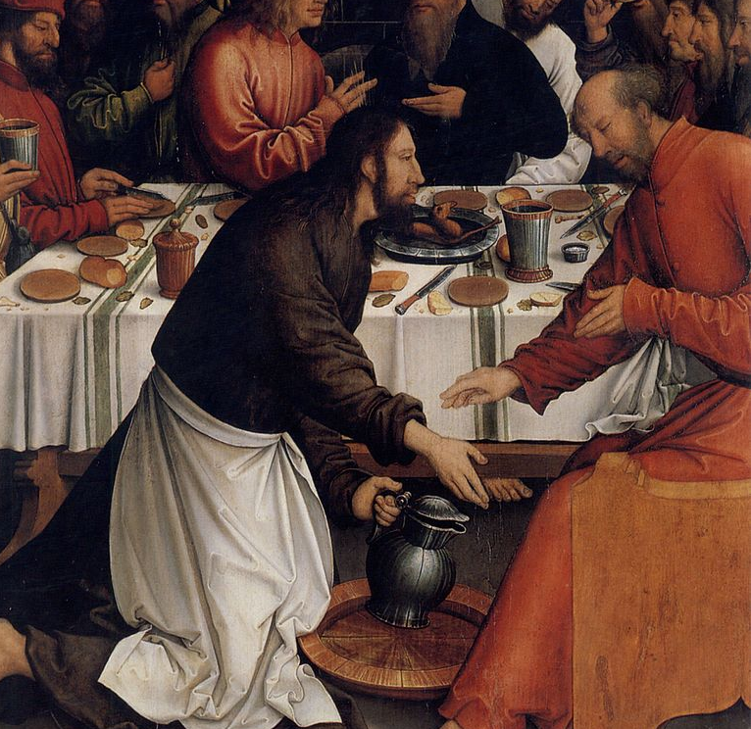
The Third Beatitude
Blessed are the meek, for they will inherit the land.
The meek are simply those who refuse the cardinal sin of pride.
They possess self-discipline in the face of evil and are gentle and unselfish.
Jesus promises us that the meek and humble of heart will inherit the earth.

Slide 8
The Fourth Beatitude
Blessed are they who hunger and thirst for righteousness, for they will be satisfied.
We should desire all that is just, true, good, and beautiful.
Ultimately, to hunger and thirst for righteousness is to hunger and thirst for God.
God gives the righteous what they desire, because what they desire is holiness.

Slide 9
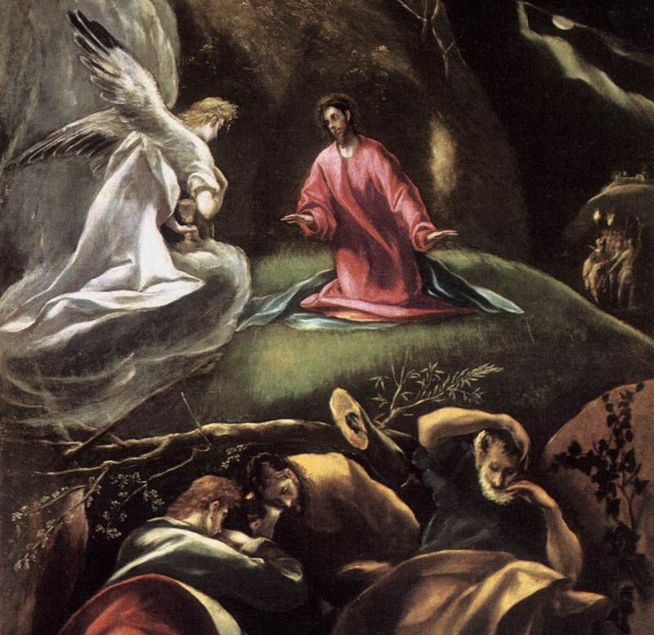
The Fifth Beatitude
Blessed are the merciful, for they will be shown mercy.
To be merciful is to give others love, kindness, forgiveness, or help even if we think they do not deserve it.
Mercy is the form that love takes when it encounters misery, and the merciful do something to alleviate people’s misery.
Jesus’ entire ministry was a mission of mercy.

Slide 10
The Sixth Beatitude
Blessed are the clean of heart, for they will see God.
To be clean or pure of heart is to be able to recognize the good and to love what is good.
The clean of heart do not disregard the dignity of others by objectifying them or turning them into an instrument of personal pleasure or gain.
They work on the virtues of modesty and chastity.

Slide 11
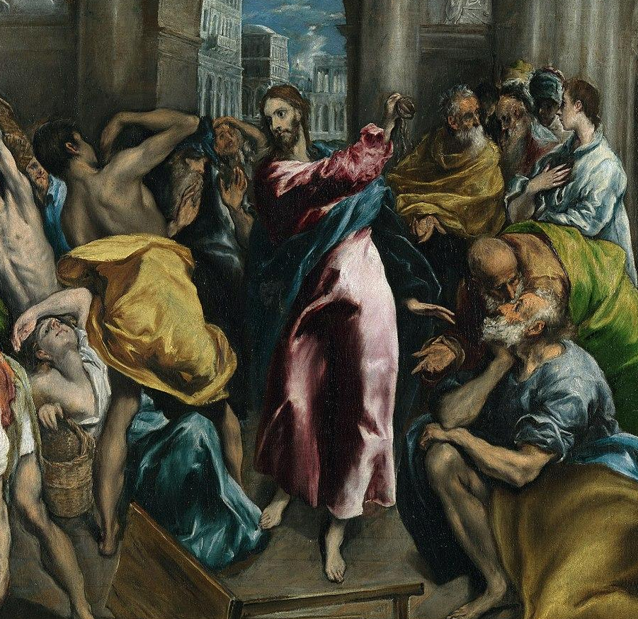
The Seventh Beatitude
Blessed are the peacemakers, for they will be called children of God.
The peacemakers seek reconciliation and the unity of will.
To make peace is to reconcile differences and overcome divisions.
The peacemakers do not necessarily avoid conflict, but they are always working toward reconciling all things in God.

Slide 12
The Eighth Beatitude
Blessed are they who are persecuted for the sake of righteousness, for theirs is the kingdom of heaven.
If we sincerely strive to live the Beatitudes in our social relationships, we may experience persecution.
There are many who want to live contrary to God’s law, and these people find the Christian message disturbing.
Christians must press on in hope
We also must be willing to lay down our lives for the Gospel.

Slide 13
Living the Beatitudes
The Christian way of blessedness—of beatitude—is the most powerful form of resistance to sin.
Living the Beatitudes is the true mark of Christian holiness and the sign of great spiritual maturity.
The heart of Catholic Social Teaching is to live as a disciple of Jesus Christ by following His model of blessedness.

Slide 14
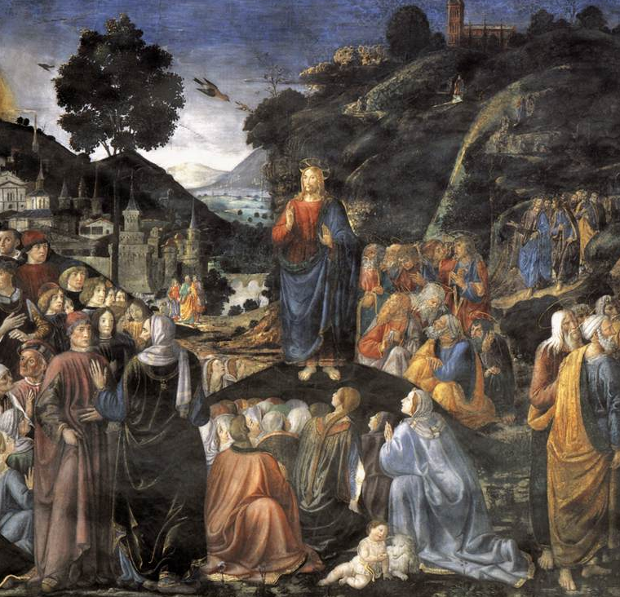
The Great Commandments
“Hear, O Israel! The Lord our God is Lord alone! You shall love the Lord your God with all your heart, with all your soul, with all your mind, and with all your strength.”
"You shall love your neighbor as yourself.”

Slide 15
St. Paul Miki was born into a wealthy military family in Japan.
Miki joined the Society of Jesus in 1580.
He was a powerful and successful teacher and many converted to Christ because of his preaching.
The ruler of Japan at the time became fearful of the influence of the Jesuits and ordered the persecution of Christians in the land.
On February 5, 1597, Miki and 25 other Christians were crucified.

Slide 16
Jesus is the answer to every problem in the world.
Our first step in living the Church’s social teaching is to seek Him above all else.
Every injustice or problem may not be solved right away, but that does not mean we should not try.
We should trust God to guide us, and do the best we can.
Ask Jesus where He needs your hands, feet, eyes, and voice the most and follow Him there.

