Slide 1
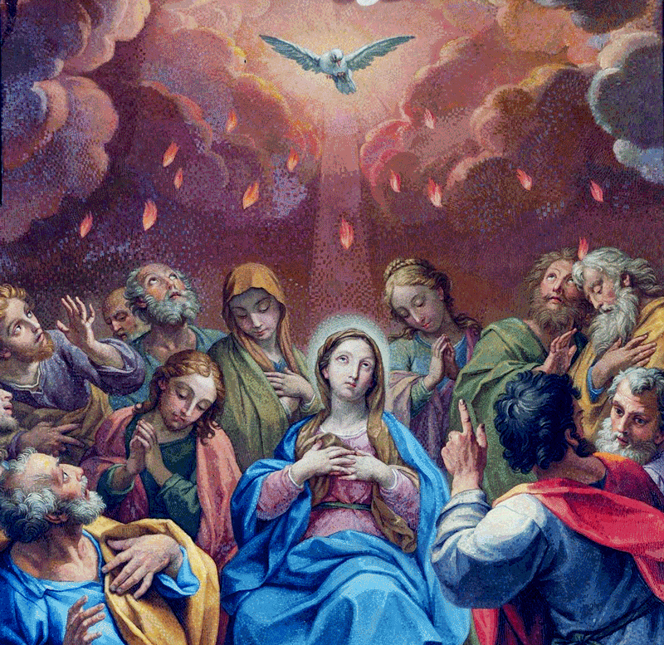
Session 14: The Two Great Commandments
Notes:
This PowerPoint contains all text and images recommended to be projected and/or read aloud in this unit.

Slide 2
Rules In the Home
Parents do not have rules in their homes because they are mean, but because they love their children. They know that their children would be happier following the rules than having to deal with the consequences of bad behavior.
Parents want their children to grow up to be disciplined, happy adults who love God and take care of others. God gives us rules in the same way. He made us, and He knows what makes us happy. If we follow His rules, then we will not have to deal with the negative consequences of sin, and we will also grow to have a loving friendship with Him.

Slide 3
The Ten Commandments
One set of rules God gives us is the Ten Commandments He gave to Moses. These commandments teach us God’s law and guide us away from sin.
When Jesus was asked which of the Ten Commandments was the greatest, He answered with all of them!

Slide 4
The Two Great Commandments
Jesus summarized the Ten Commandments with Two Great Commandments.
The first Commandment Jesus gave, “You shall love the Lord, your God, with all your heart, with all your soul, and with all your mind,” summarizes the first three commandments. These three commandments teach us how to love God.
The second commandment Jesus gave, “You shall love your neighbor as yourself,” summarizes the other seven commandments. These seven commandments teach us how to love our neighbor, or each other.

Slide 5
The Two Great Commandments
Jesus summarized the Ten Commandments with two Great Commandments: Love God above all else, and love our neighbor as ourselves. To Jesus, all of the commandments are important.
The first Great Commandment tells us what the most important thing in our lives should be: God. We should put Him first, above all other things. He is more valuable and important than any possessions we own and all the money in the world. It can be difficult to remember to put God above all other things, especially when our things are good and bring us joy. But Jesus tells us in the Gospels that the first Great Commandment is to love God more than anything.

