Slide 1
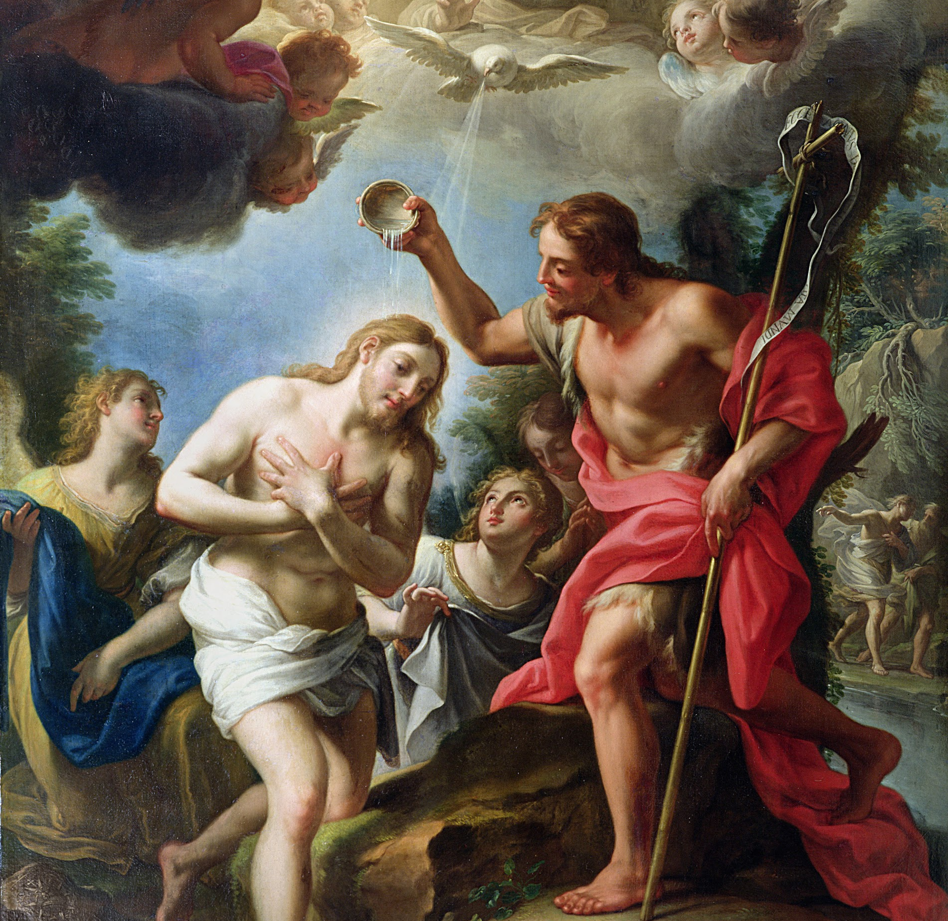
Session 1: God Speaks to Us through Visible Creation

Slide 2
The Creed
A creed is a summary of faith and a profession of belief. We have the opportunity to profess our faith every Sunday at Mass when we pray the Nicene Creed.
The Church has a few different creeds; the most common are the Apostles’ Creed and the Nicene Creed. The Apostles’ Creed dates to the first century and the time of the Apostles. The Nicene Creed dates to the late 300s. Both are still used today. Typically we pray the Apostles’ Creed at the beginning of a Rosary, and we pray the Nicene Creed at Mass. Both creeds, however, profess belief in the same thing: the essential elements of our Catholic Faith.

Slide 3
Signs and Symbols
God uses the visible creation to communicate invisible realities to us, such as who He is and His love and plan for us. This is the way we, as human beings, learn and understand anything that is unseen. Love is invisible. You can’t see love. But there are signs and symbols that help us to know and understand that love is real. A sign is a visible representation of an invisible truth.
As human beings, we recognize and respond to common, universal signs and symbols to know and understand invisible feelings and ideas.

Slide 4
Ruah
Read Genesis 2:7.
The Hebrew word for breath is ruah. It is used interchangeably to mean “wind,” as in Genesis 1:2 (“a mighty wind sweeping over the waters”) and “spirit.” Ruah is most often used in reference to God Himself, describing God’s breath or Spirit, but is also used to describe the spirit or soul of human beings and even the wind blowing through the trees.
Considering the close connection of the word to God Himself, we cannot understand any other usage of the word ruah apart from God.

Slide 5
Ruah
The Spirit of God is present in His creation, but most specifically and importantly, the Spirit of God is present in a special way in human men and women. God has placed within each one of us His breath of life, a spiritual soul. This makes us, as Genesis 1:26-27 tells us, in the image and likeness of God.
As human beings, we are at the same time physical, visible creatures and invisible, spiritual beings. The human soul is what gives us life and gives us dignity as human persons made in God’s image and likeness.

