Slide 1
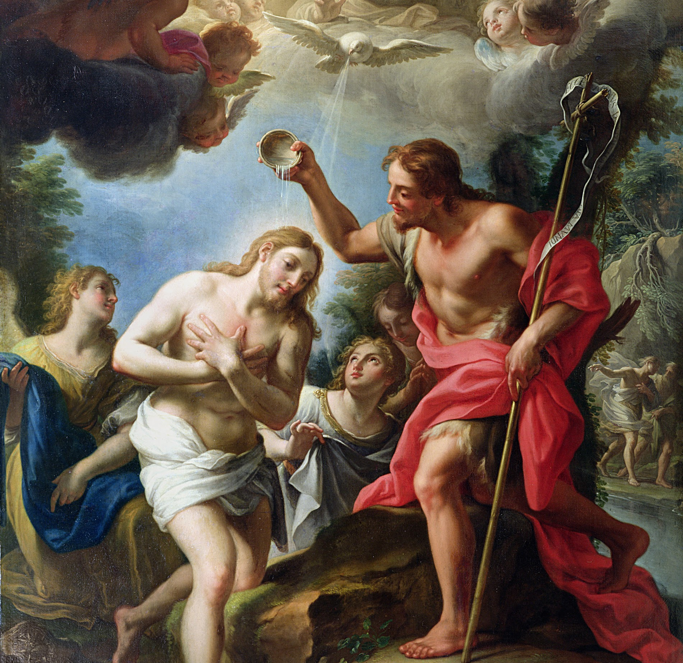
Session 22: Encountering God’s Mercy in Confession

Slide 2
God Wants Us to Be with Him
In the three Parables of the Lost Sheep, the Lost Coin, and the Prodigal Son, the shepherd, the woman, and the father all search for their precious things/people and celebrate when they are found.
We are God’s children. Just as a parent would never disown a child for breaking a rule, God wants to shower us with mercy and rejoice with us in Heaven.
We are like the prodigal son who returns to receive not scorn or rejection, or even a lukewarm welcome, but a celebration, a robe, and a ring — symbols of royalty and sonship.

Slide 3
King David
David was born about three thousand years ago, the youngest of eight children, and was a lowly shepherd. As a young man, he slew Goliath. God picked David to be the new king, promising David and Israel that the Messiah would come from David’s line.
The Messiah would establish a kingdom that would endure forever. “Your house and your kingdom are firm forever before me; your throne shall be firmly established forever” (2 Samuel 7:16).
Later, David abandoned his men in battle, was unfaithful to his wife, tried to cover it up, and then had his mistress’s husband killed. But God kept His promise! All His promises were fulfilled in Jesus.

Slide 4
God’s Grace Has No Limit
Other biblical sinners experienced conversion throughout their lives, such as St. Peter (who thrice denied Jesus); St. Matthew, a sinful tax collector turned Apostle; or St. Paul, who viciously persecuted the Church before becoming the greatest missionary of all time.
God’s grace has no limit. Jesus even forgave His executioners! God freely forgave these people, and He will always forgive you and me when we ask Him to.

