Slide 1
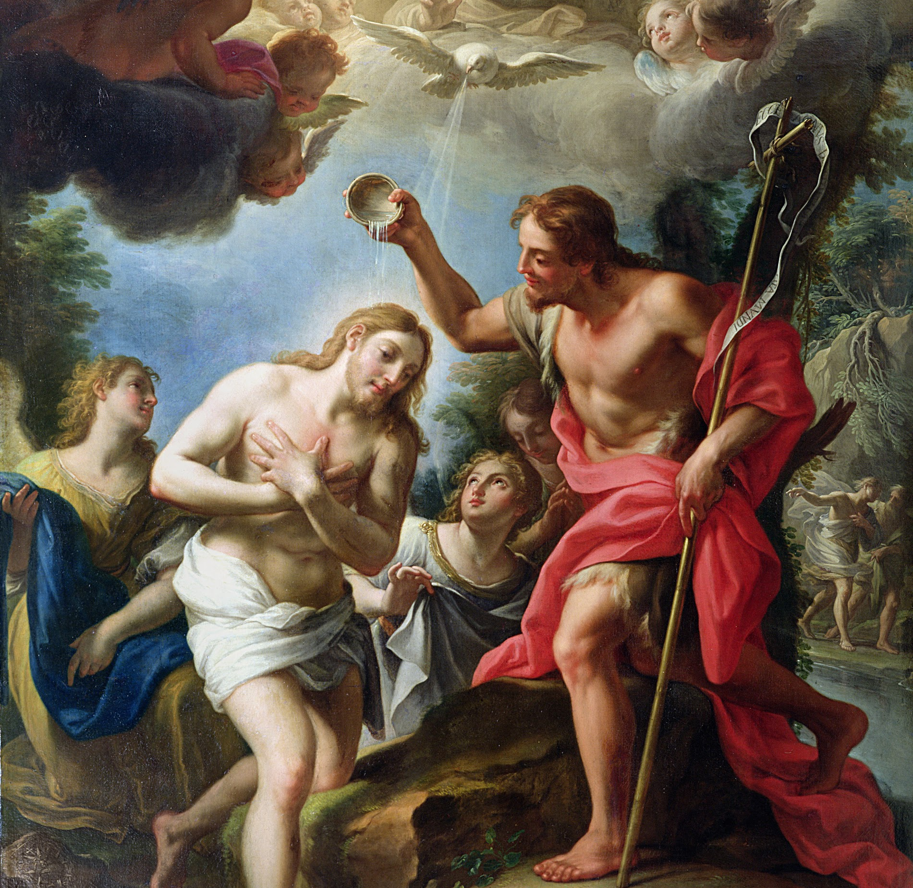
Session 32: The Call to Priesthood

Slide 2
Holy Orders
Jesus became man to be with us, and He is still with us. Through the Sacraments, Jesus gives us real encounters with Him.
Holy Orders is the Sacrament through which Christ continues His ministry in the Church until the end of time.
Called men receive the Sacrament of Holy Orders to give their lives to Jesus’ flock. Jesus gives priests spiritual powers so that all people everywhere would be able to encounter Jesus here on earth through the Sacraments.
The priests’ authority comes from Christ Himself.

Slide 3
Priests Feed Christ’s Flock
Priests are called to give their lives for Christ’s flock. Holy Orders is one of the two Sacraments at the Service of Communion. Like Matrimony, it is the service of others. Christ’s ministry on Earth “is directed at the unfolding of baptismal grace of all Christians” (CCC 1547).
This means that priests serve others to help them grow in their faith, and become more like Christ. Christ gave His life for us. Since priests depend on Christ for their “mission and authority, ministers are truly ‘slaves of Christ,’ in the image of him who freely took ‘the form of a slave’ for us.”

Slide 4
Priests Feed Christ’s Flock
Priests, Christ’s representatives on Earth, “must freely become the slaves of all” (CCC 876). The Apostle Paul wrote to the Corinthians, “Although I am free in regard to all, I have made myself a slave to all so as to win over as many as possible” (1 Corinthians 9:19).
Christ builds His Church through His ministry on Earth.

Slide 5
Jesus’ Priestly Mission
By the Sacrament of Holy Orders, bishops and priests share in what is called the ministerial priesthood.
The ministerial priesthood serves the common priesthood of all the faithful. But persons who have not received Holy Orders also share in the one true priesthood of Christ. Baptized Christians share in the priesthood of the faithful.
We participate in the priestly, prophetic, and kingly mission of Christ. Lay people share in Christ’s priesthood, and witness God’s grace in all areas of their life.

Slide 6
Jesus’ Priestly Mission
People who have not received Holy Orders “share in Christ’s priesthood” when they display “the grace of Baptism and Confirmation in all dimensions of their personal family, social and ecclesial [parish] lives.” All baptized Christians are called to holiness (CCC 941).
In this way, we cooperate with God’s grace to sanctify the world.

Slide 7
We are Called to Witness to Christ
A prophet is someone whom God speaks through. Preaching and teaching is part of this mission. We are all called to be “witnesses to Christ in all circumstances and at the very heart of the community of mankind” (CCC 942).
When we turn away from sin and lead others to Christ, we “have the power to uproot the rule of sin ... [by] self-denial and holiness of life” (CCC 943).

