Slide 1
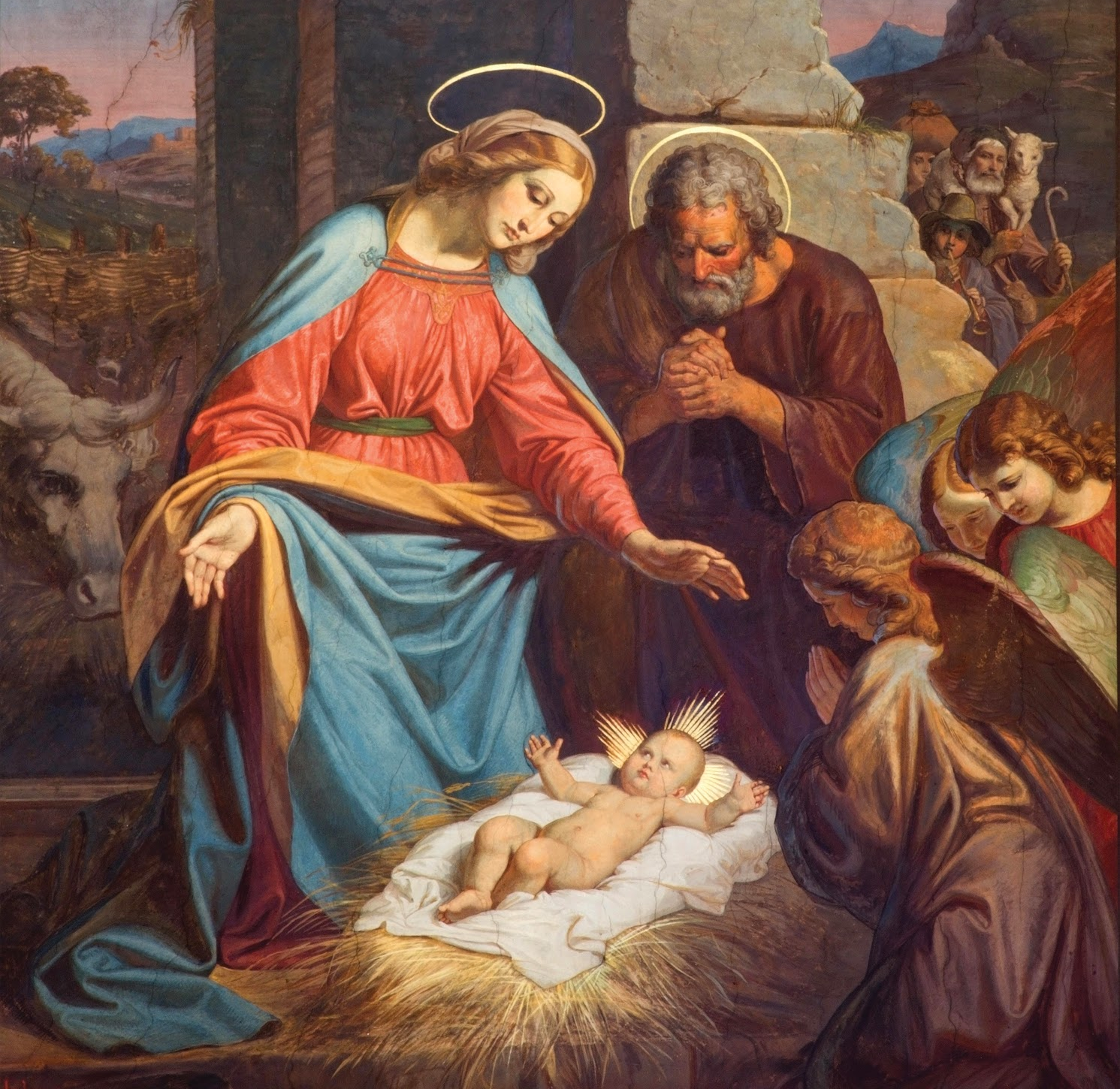
Jesus Loves the Poor
Unit 2, Lesson 8

Slide 2
Jesus Teaches How to Love
Letting people have the first turn or sharing something special is a way of loving that person.
It shows that we love that person more than the things we want to own or use.
Jesus did not choose to be born famous or rich. He chose to be born into a poor family who loved Him and who also loved their neighbors. Jesus teaches us how to love other people by being humble. Being humble means that you love God and your neighbor more than anything else.
Notes:
This image is on page 2 of the student book.

Slide 3
Jesus Teaches How to Be Humble
Read Luke 14:12–14.
This passage teaches us about being humble.
Jesus was invited to a party. It was a very fancy party called a banquet, with lots of important people.
Jesus loved the person who invited Him to the party, and He wanted to tell the host how to throw a party that would please God. He wanted the host to be humble.
Notes:
This image is on page 2 of the student book.

Slide 4
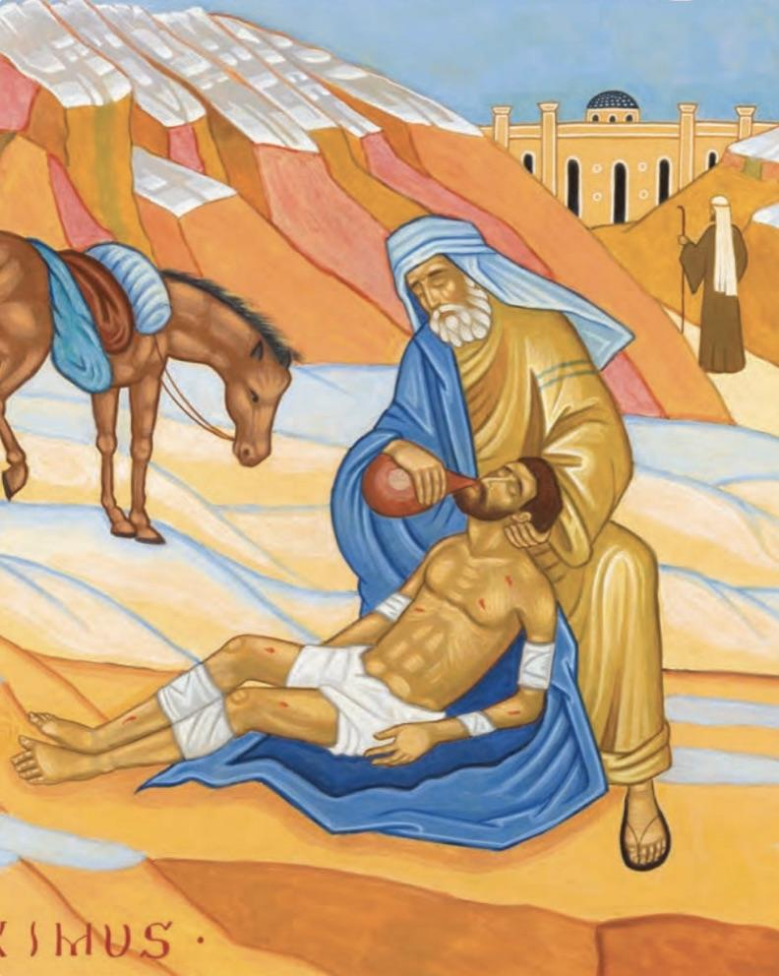
The Good Samaritan
In this picture, one man is helping another man. It is from a parable, or story, that Jesus told His disciples called the Good Samaritan.
The Bible tells us of a man who asked Jesus who his neighbor is. Jesus responded with this parable.
Read Luke 10:30–37.
Notes:
This image is on page 2 of the student book.

Slide 5
Jesus Teaches How to Be Humble
Jesus also gave us other examples of how to show love to our neighbor. Most importantly, He told us, “Love one another. As I have loved you, so you also should love one another” (John 13:34).
Jesus loves us with His whole self. He calls us to love like He loves.
Notes:
This image is on page 2 of the student book.

Slide 6
Jesus Teaches How to Be Humble
Jesus told us that when we help the people who need help the most, we are helping Jesus Himself. In fact, He said that people who help the least among us were the ones who would go to Heaven!
Read Matthew 25:34–36.
Notes:
This image is on page 2 of the student book.

