Slide 1
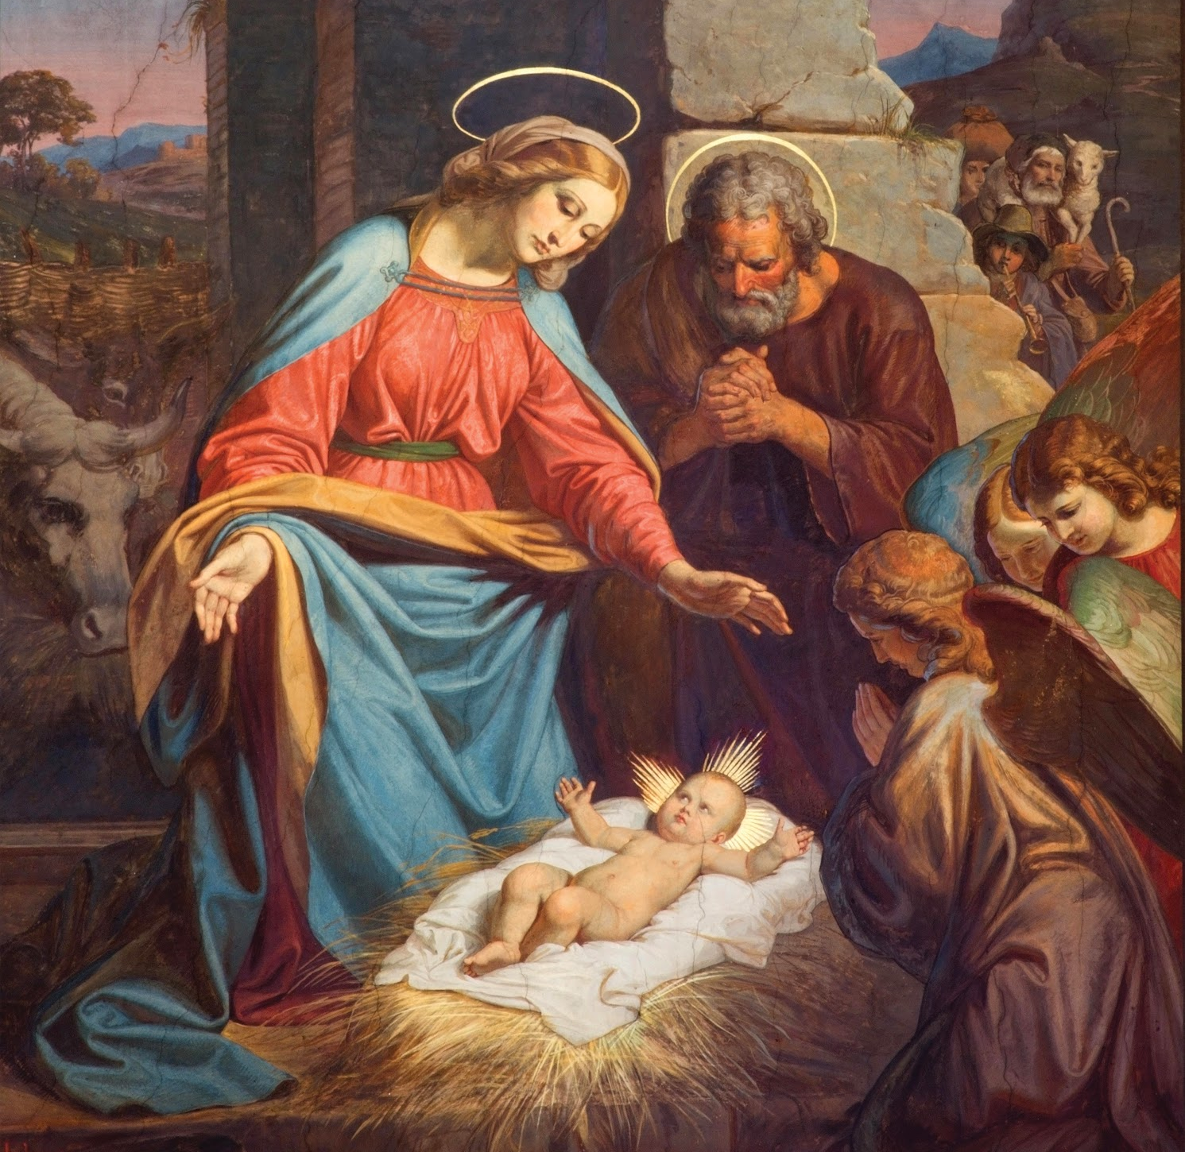
Jesus Performed Miracles
Unit 4, Lesson 16

Slide 2
God’s First Miracle
A miracle is an amazing act of God that shows His power over all things. Those things like walking on water and stopping a thunderstorm are things that only God can do
A very, very long time ago there was nothing. God Himself was all that existed.
Then, God made that nothing into something: he made the world. This was God’s first miracle.
Notes:
This image is on page 2 of the student book.

Slide 3
Jesus Performed Miracles
When He started His public ministry, Jesus performed seven miracles to show people that He was God and so that they might believe in Him.
All of the miracles He performed showed God’s love for us.
Jesus’ first public miracle took place at a wedding. A wedding is an event where a man and woman promise to love each other forever and become a family.
Notes:
This image is on page 2 of the student book.

Slide 4
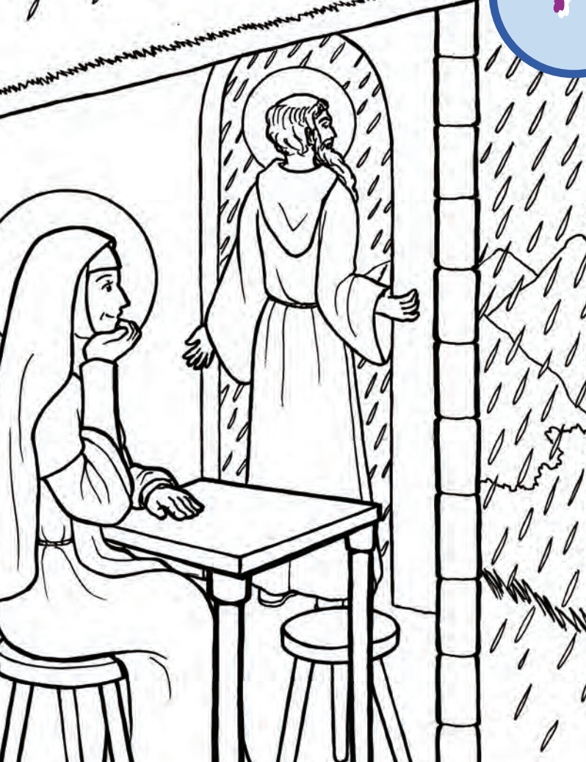
Others Can Perform Miracles Too
Even though only God can allow miracles to happen, sometimes He allows people to perform miracles as well.
These people can only perform miracles because God is helping them.
Sts. Benedict and Scholastica are two saints who performed miracles during their time on earth.
Notes:
This image is on page 2 of the student book.

