Slide 1
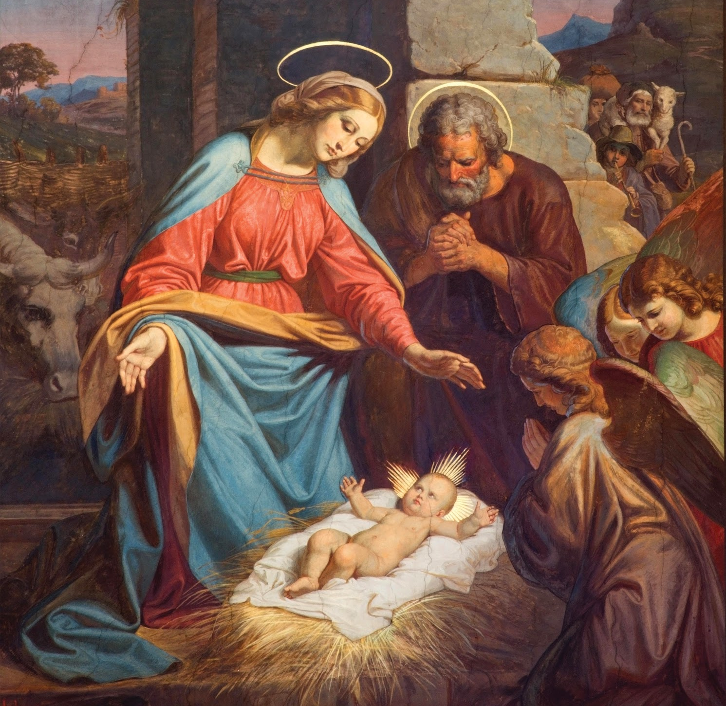
Jesus Suffered for Us
Unit 2, Lesson 23

Slide 2
Luke 22:42
“Father, if you are willing, take this cup away from me; still, not my will but yours be done.”

Slide 3
Luke 22:19b
“This is my body, which will be given for you.”

Slide 4
We Adore You
We adore you, O Christ, and we bless you, because by the Holy Cross you have redeemed the world.

Slide 5
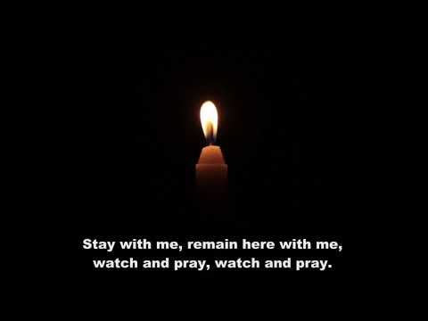
Stay With Me

Slide 6
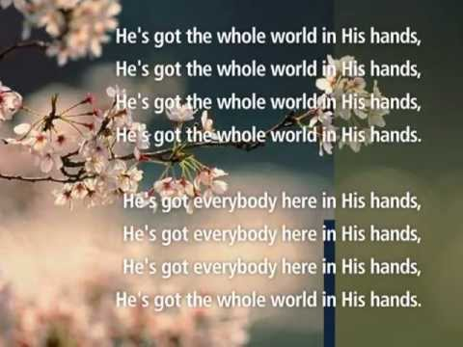
He’s Got the Whole World in His Hands

