Slide 1
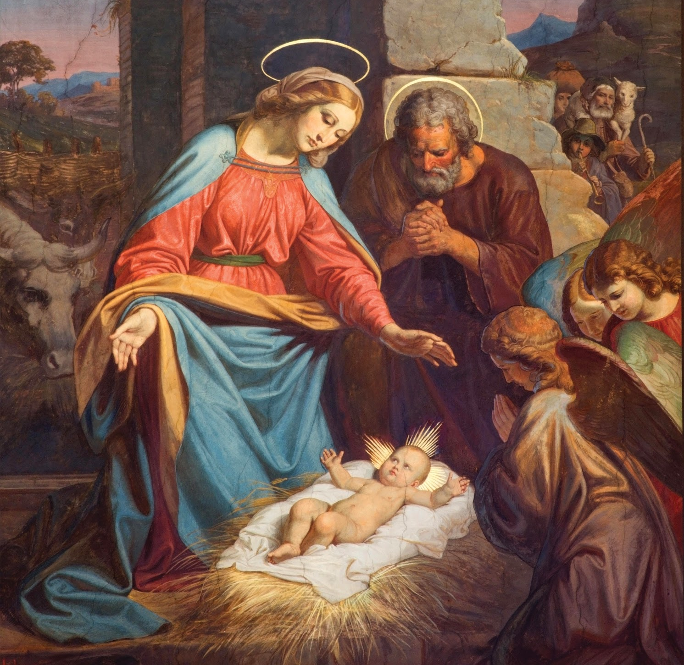
Jesus Founded the Church
Unit 2, Lesson 27

Slide 2
Matthew 16:18-19
“And so I say to you, you are Peter, and upon this rock I will build my church, and the gates of the netherworld shall not prevail against it. I will give you the keys to the kingdom of heaven. Whatever you bind on earth shall be bound in heaven; and whatever you loose on earth shall be loosed in heaven.”

Slide 3
John 21:15-17
Jesus said to Simon Peter, “Simon, son of John, do you love me more than these?” He said to him, “Yes, Lord, you know that I love you.” He said to him, “Feed my lambs.” He then said to him a second time, “Simon, son of John, do you love me?” He said to him, “Yes, Lord, you know that I love you.” He said to him, “Tend my sheep.” He said to him the third time, “Simon, son of John, do you love me?” Peter was distressed that he had said to him a third time, “Do you love me?” and he said to him, “Lord, you know everything; you know that I love you.” [Jesus] said to him, “Feed my sheep.

Slide 4
Prayer to the Holy Spirit
Come Holy Spirit, fill the hearts of your faithful and kindle in them the fire of your love. Amen.

Slide 5
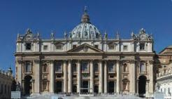
St. Peter’s Basilica

