Slide 1
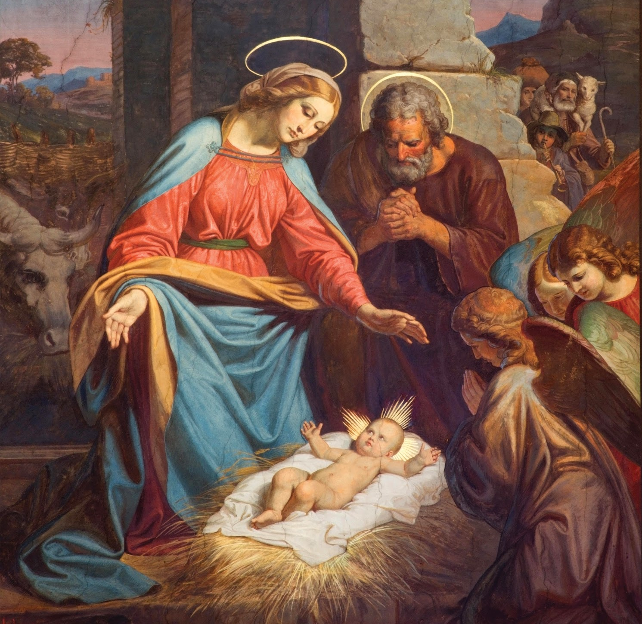
Jesus Is with Us in The Saints
Unit 2, Lesson 32

Slide 2
Romans 12:4–5
For as in one body we have many parts, and all the parts do not have the same function, so we, though many, are one body in Christ and individually parts of one another.

Slide 3
Matthew 6:33
“But seek first the kingdom [of God] and his righteousness, and all these things will be given you besides.”

Slide 4
Prayer
Christ has no body but yours, no hands, no feet on earth but yours.
Yours are the eyes with which He looks compassion on this world.
Yours are the feet with which he walks to do good.
Yours are the hands, with which He blesses all the world.
Yours are the hands, yours are the feet, yours are the eyes, you are His body.
Christ has no body now but yours, no hands, no feet on earth but yours.
Yours are the eyes with which He looks compassion on this world.
Christ has no body now on earth but yours.

