Slide 1
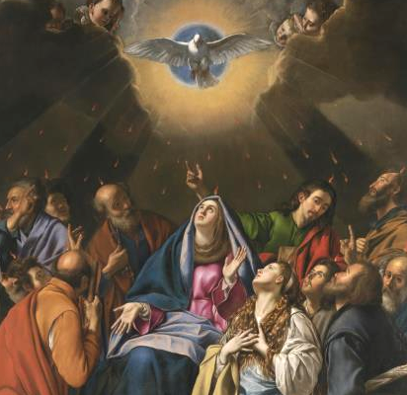
Sealed in Fire
Notes:
This PowerPoint contains all text and images recommended to be projected and/or read aloud in this unit.

Slide 2
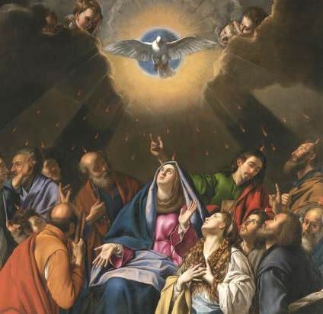
Exploring the Sacrament of Confirmation with Sacred Art
Lesson Two

Slide 3
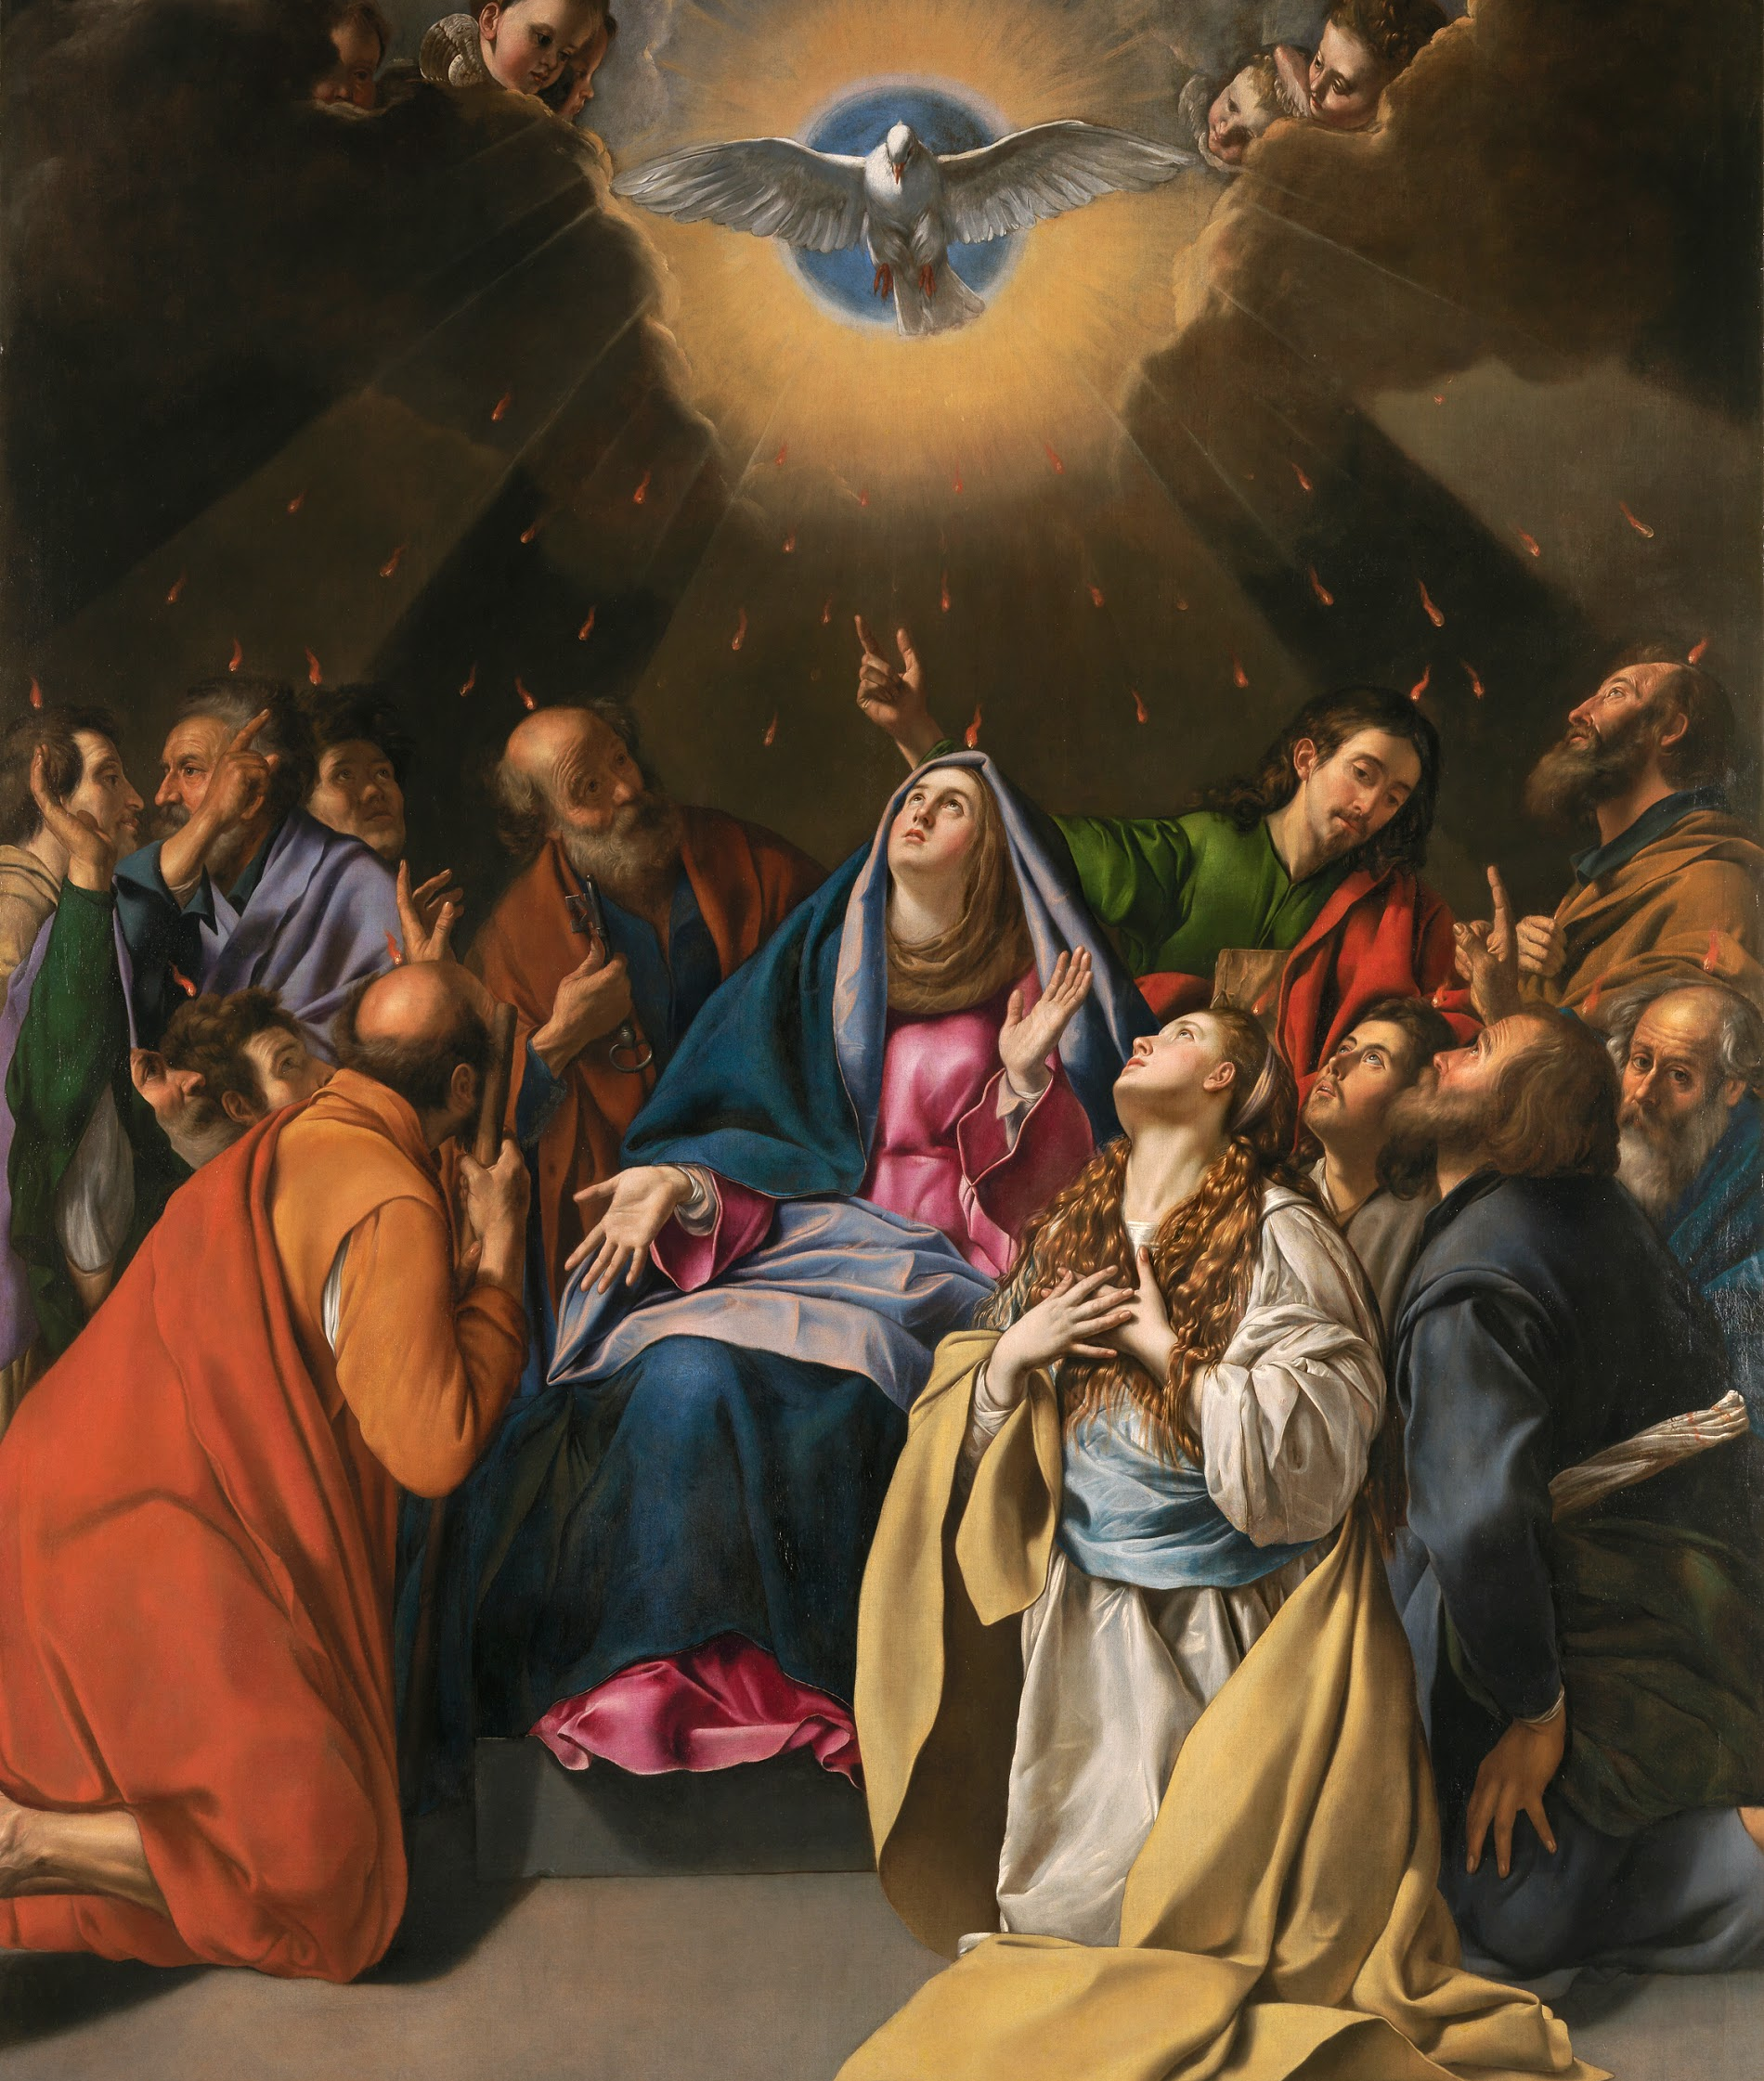
Descent of the Holy Ghost
Notes:
This image is on Page 95 of the student book.
1. What adjectives would you use to describe this painting?
2. Where do your eyes go when you look at it? Do you have a favorite part?
3. What feelings does the painting inspire in you?
4. Where is the light coming from?
5. Of whom or what is the dove a traditional symbol?
6. What event is depicted in this painting?
7. What people do you see in the painting? Who are the men? Who is the woman seated in
the middle of the scene? Who do you think the woman kneeling near the front might be?
8. Does the scene look still, or full of energy?
9. Read Acts 2:1-4:
“When the time for Pentecost was fulfilled, they were all in one place together. And
suddenly there came from the sky a noise like a strong driving wind, and it filled the
entire house in which they were. Then there appeared to them tongues as of fire, which
parted and came to rest on each one of them. And they were all filled with the Holy
Spirit and began to speak in different tongues, as the Spirit enabled them to proclaim.”
10. How does this painting help you understand this Gospel passage?
11. This painting was done for the high altar of the church of the convent of Discalced
Carmelites of Toledo, Spain. Why do you think a painting like this would be in a
convent? Explain your answer.

Slide 4
Definition of Confirmation
“[B]y the sacrament of Confirmation, [the baptized] are more perfectly bound to the Church and are enriched with a special strength of the Holy Spirit. Hence they are, as true witnesses of Christ, more strictly obliged to spread and defend by word and deed” (CCC 1285).
Notes:
According to this definition of Confirmation, what are the two main benefits of the
Sacrament? The Baptized are more perfectly bound to the Church and are enriched
with a special strength of the Holy Spirit.
What symbols of the Holy Spirit do you see in artwork? The dove at the top of the
image. The tongues of fire over the heads of the Apostles, the Virgin Mary, and St. Mary
Magdalene.

