Slide 1
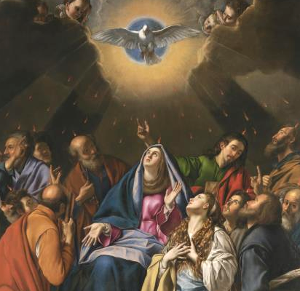
Sealed in Fire
Notes:
This PowerPoint contains all text and images recommended to be projected and/or read aloud in this unit.

Slide 2
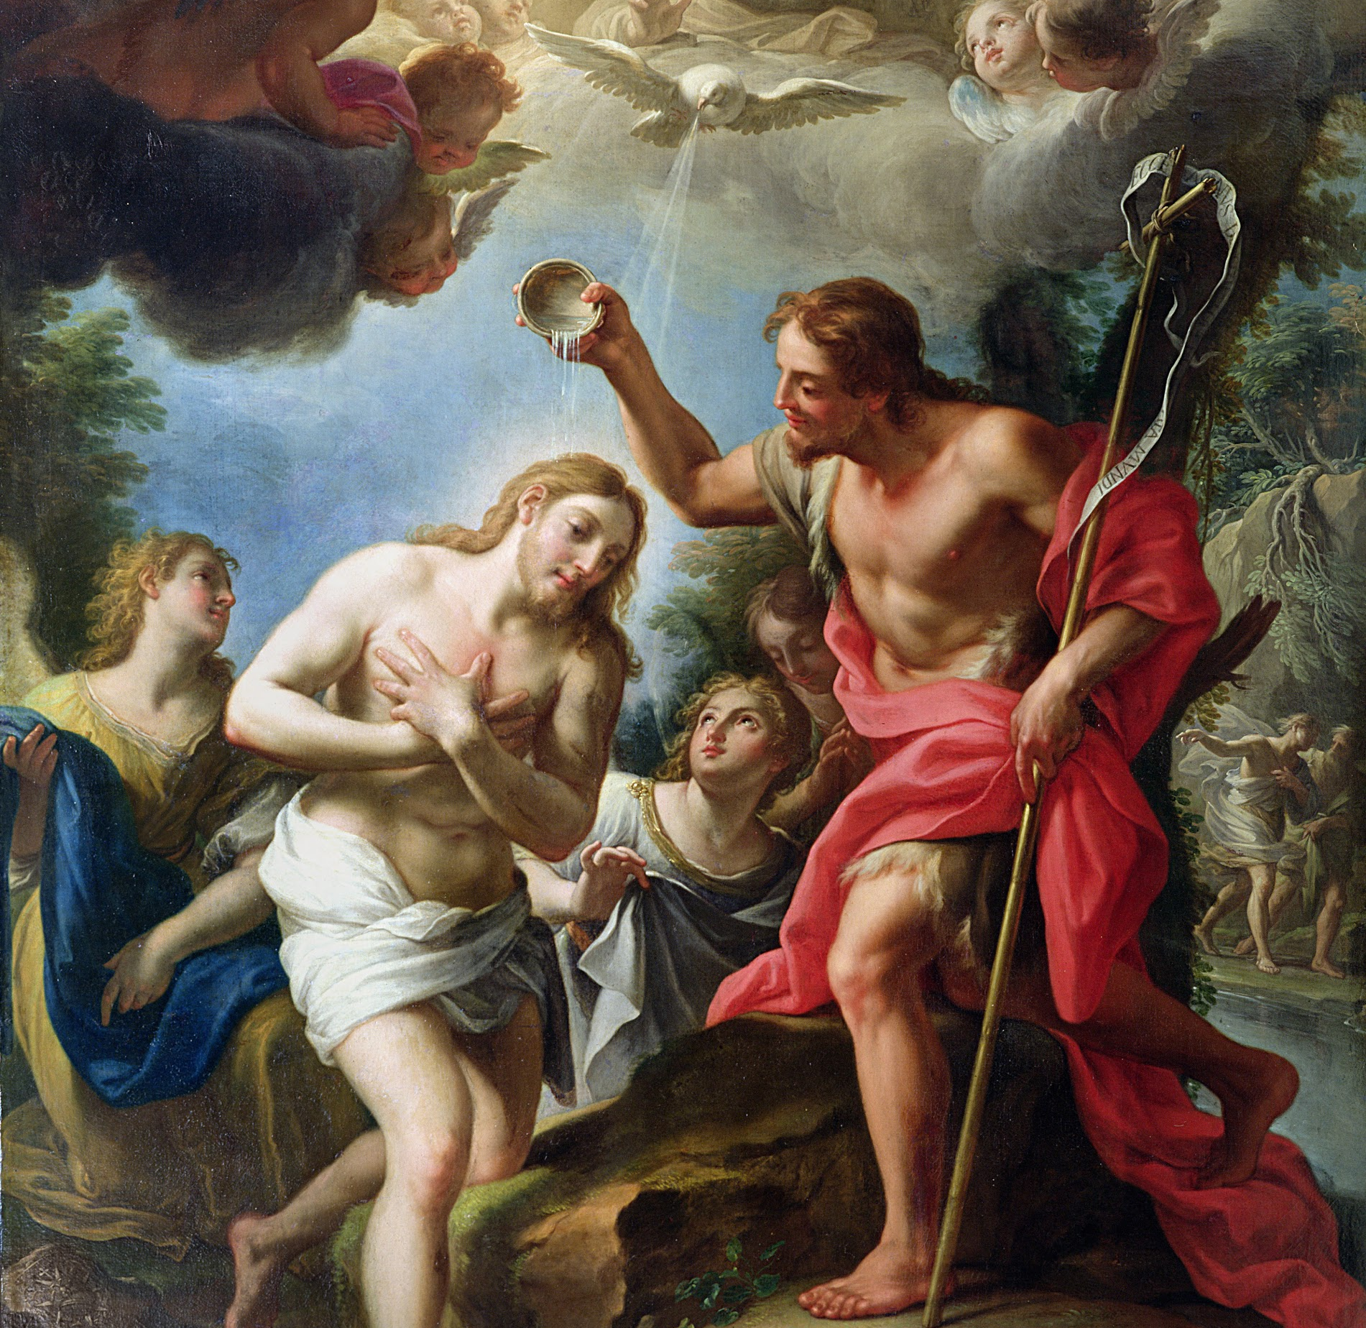
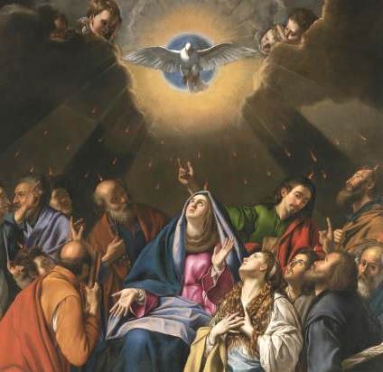
The Effects of the Sacrament of Confirmation
Lesson Five

Slide 3
Ephesians 6:11-17
“Put on the armor of God so that you may be able to stand firm against the tactics of the devil. For our struggle is not with flesh and blood but with the principalities, with the powers, with the world rulers of this present darkness, with the evil spirits in the heavens. Therefore, put on the armor of God ... stand fast with your loins girded in truth, clothed with righteousness as a breastplate, and your feet shod in readiness for the gospel of peace. In all circumstances, hold faith as a shield, to quench all [the] flaming arrows of the evil one. And take the helmet of salvation and the sword of the Spirit, which is the word of God.”

Slide 4
CCC 1297
“[Father ... send your Holy Spirit] on us and on this oil which is before us and consecrate it, so that it may be for all who are anointed and marked with it holy myron, priestly myron, royal myron, anointing with gladness, clothing with light, a cloak of salvation, a spiritual gift, the sanctification of souls and bodies, imperishable happiness, the indelible seal, a buckler of faith, and a fearsome helmet against all the works of the adversary”.

Slide 5
Prayer of the bishop during the celebration of Confirmation
Almighty God, Father of our Lord Jesus Christ, who brought these your servants to new birth by water and the Holy Spirit, freeing them from sin: send upon them, O Lord, the Holy Spirit, the Paraclete; give them the spirit of wisdom and understanding, the spirit of counsel and fortitude, the spirit of knowledge and piety; fill them with the spirit of the fear of the Lord. Through Christ our Lord.

