Slide 1
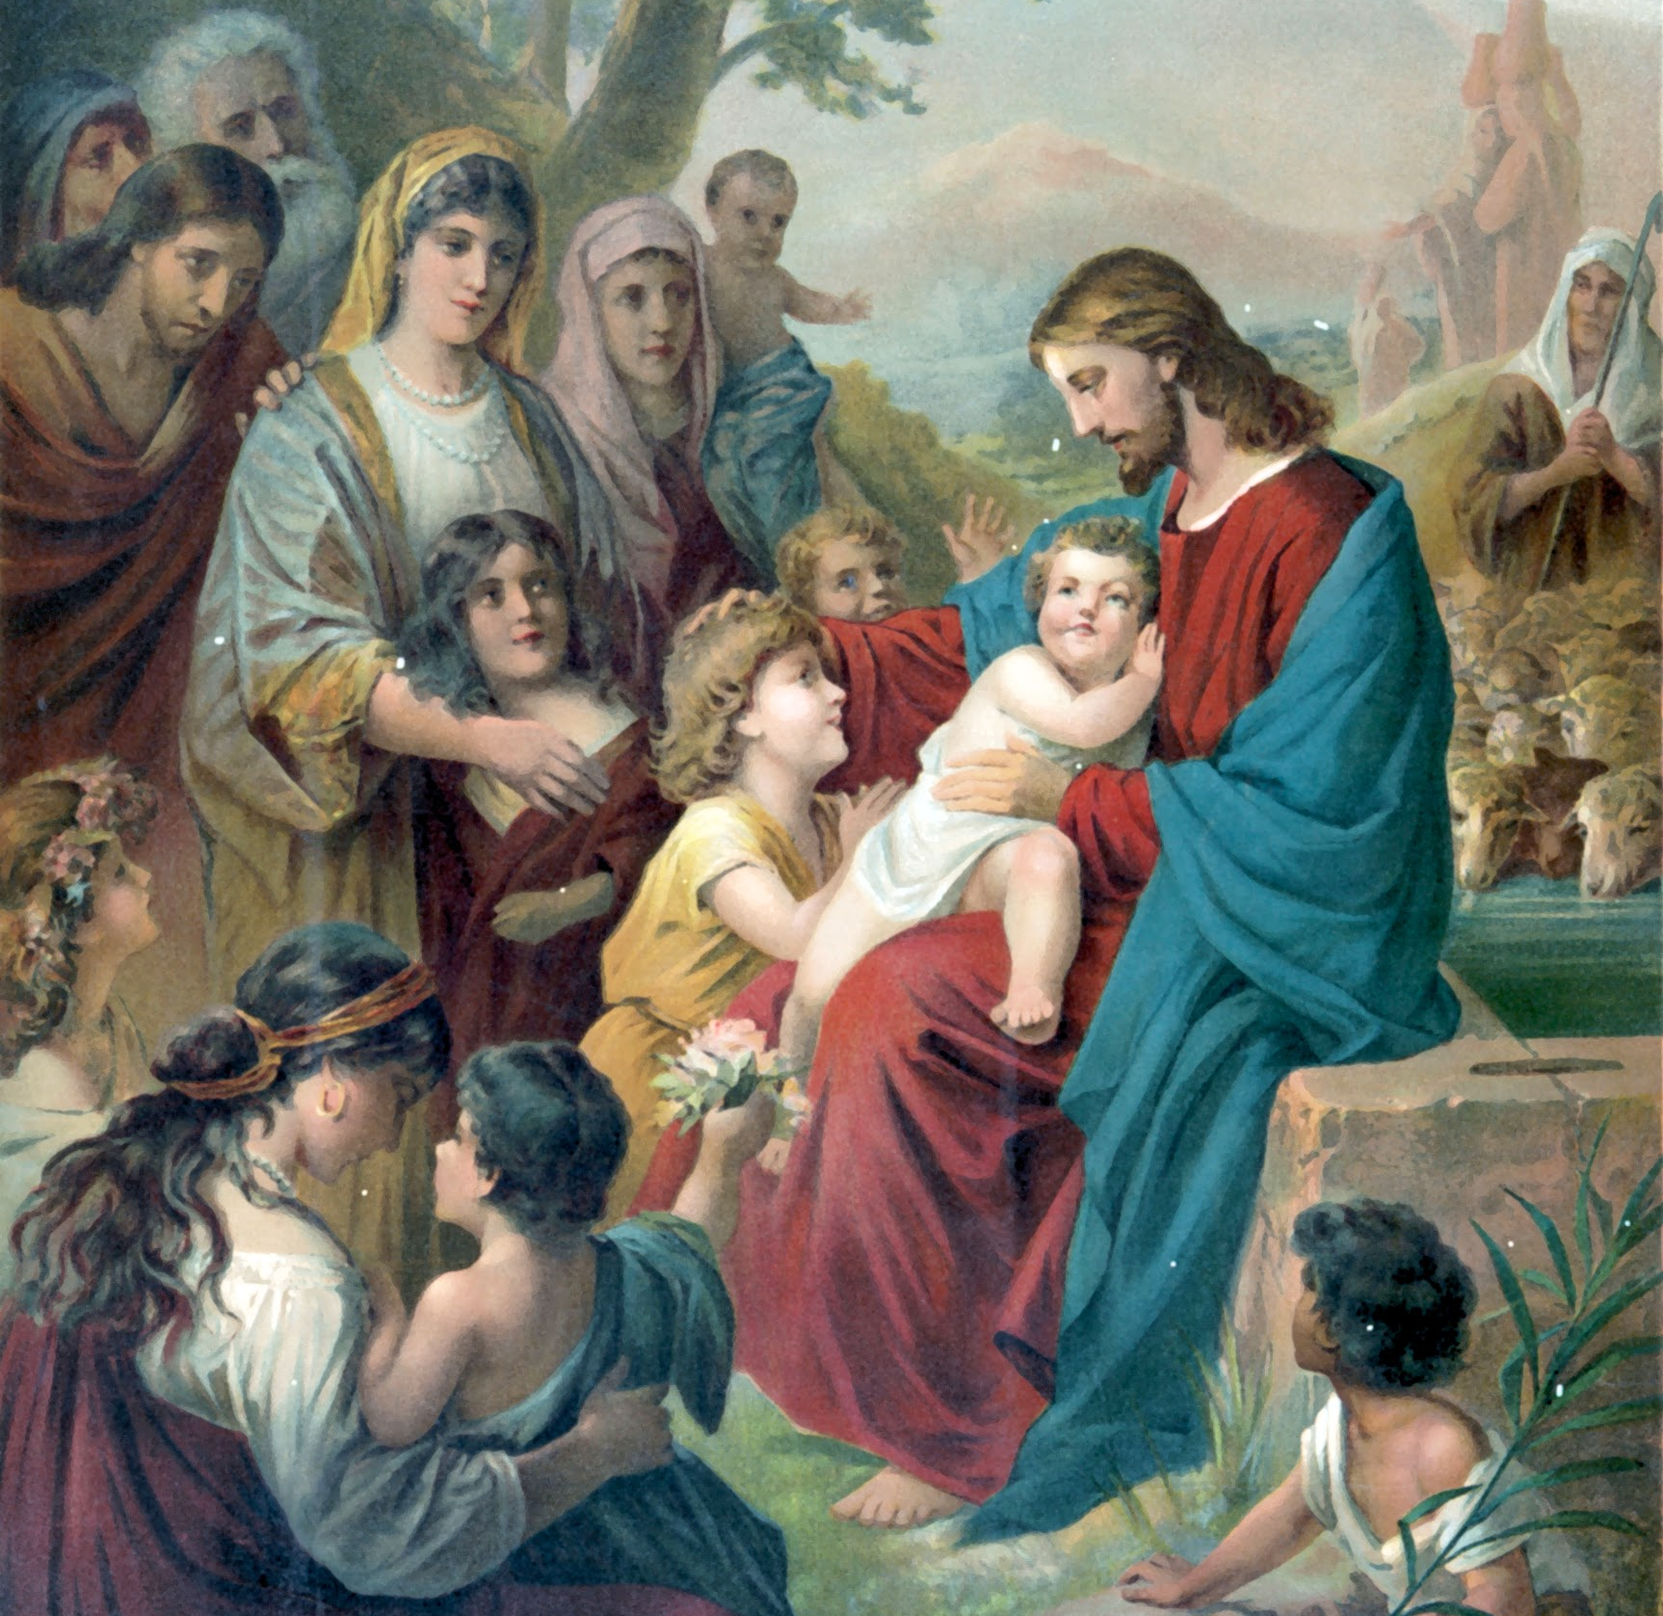
Lesson 2: Jesus Proclaimed the Coming of the Kingdom of God

Slide 2
Jesus Proclaimed the Kingdom of God
Kingdom: a place where a king rules, or reigns. A king’s reign is his authority to govern his kingdom. A king reigns over a land by making and enforcing laws.
Proclaim: to announce something in a way that makes it official, or real.
Parable: a short story that uses characters or situations that we can relate to in order to teach us a deeper lesson. Jesus taught about the Kingdom of God using parables.

Slide 3
Jesus Proclaimed the Kingdom of God
Read Mark 1:14-15.
The central message of Jesus’ public ministry was His proclamation of the coming of the Kingdom of God. In fact, everything that Jesus did, taught, or preached about focused on announcing the coming of the Kingdom of God (also called the Kingdom of Heaven).
When He said that the Kingdom of God was “at hand,” He was proclaiming, or announcing, that the time for the Kingdom of God is now, rather than far off in the future, or in the past. Now is the time for the Kingdom of God to come.

Slide 4
Jesus Proclaimed the Kingdom of God
God’s Kingdom is different from any earthly kingdom.
Earthly kingdoms are physical places where a king reigns. There are borders to earthly kingdoms, limits to the how far the king’s reign stretches.
God’s Kingdom is not a geographical place on a map. God is King of the entire universe. He reigns over all things and all places. He governs all of existence with His power and authority as the Creator of all things. The Kingdom of God is the reign of God over all things. There are no limits to His reign.
Jesus proclaimed the coming of the Kingdom of God — the coming of God’s reign over the entire universe.

Slide 5
Jesus Proclaimed the Kingdom of God
Jesus taught about a lot of different things using parables, but one of the things He taught about often was the Kingdom of God. The Gospels contain a number of parables that focus on the Kingdom of God. Because the Kingdom of God can be difficult to understand, Jesus told many short parables about it.
These parables compare the Kingdom to something more familiar to His listeners. So, each parable helps us understand the Kingdom in a different way. One of the most well known of Jesus’ parables of the Kingdom is the Parable of the Sower and the Seeds.

Slide 6
Jesus Proclaimed the Kingdom of God
Jesus tells us that the seed represents the “Word of the Kingdom” — in other words, the Word of God is like a seed that can grow in our hearts, but only if our hearts have the “right soil,” or attitude.
This is an important key to understanding what Jesus wants to teach us about the Kingdom, and how the Kingdom of God, God’s reign, begins in our own hearts.
Matthew 13:18-23
The type of ground we want to be like is the rich soil.

Slide 7
The Kingdom of God
God is King of the whole universe. Just as an earthly king rules, or reigns, over his kingdom by making its laws and governing his land, God reigns over the entire universe by making the laws of the universe and governing all things.
God made laws for us to follow: The Ten Commandments, the Beatitudes, the Works of Mercy, and so forth. He also made the law of gravity and other laws of physics, and other forces that govern our universe.

Slide 8
The Kingdom of God
Many of the Jews who lived in Jesus’ time thought that God was going to make a kingdom here on earth where they could live, but Jesus taught His followers that the Kingdom of God is different.
Although God does give us rules and laws to follow, He doesn’t force us to follow them; He wants us to choose to be members of His Kingdom. When Jesus talks about the Kingdom of God, He is talking about a Kingdom made up of people who choose to live according to His example (His followers).

Slide 9
The Kingdom of God
Although we are not yet in Heaven, where we will live with God for eternity, the Kingdom of God starts here on earth because God’s kingdom is wherever His followers are.
The more we allow God to reign over our lives by following His laws and imitating Christ, the more we spread God’s reign over all things. This is our part in extending the Kingdom of God.

