Slide 1
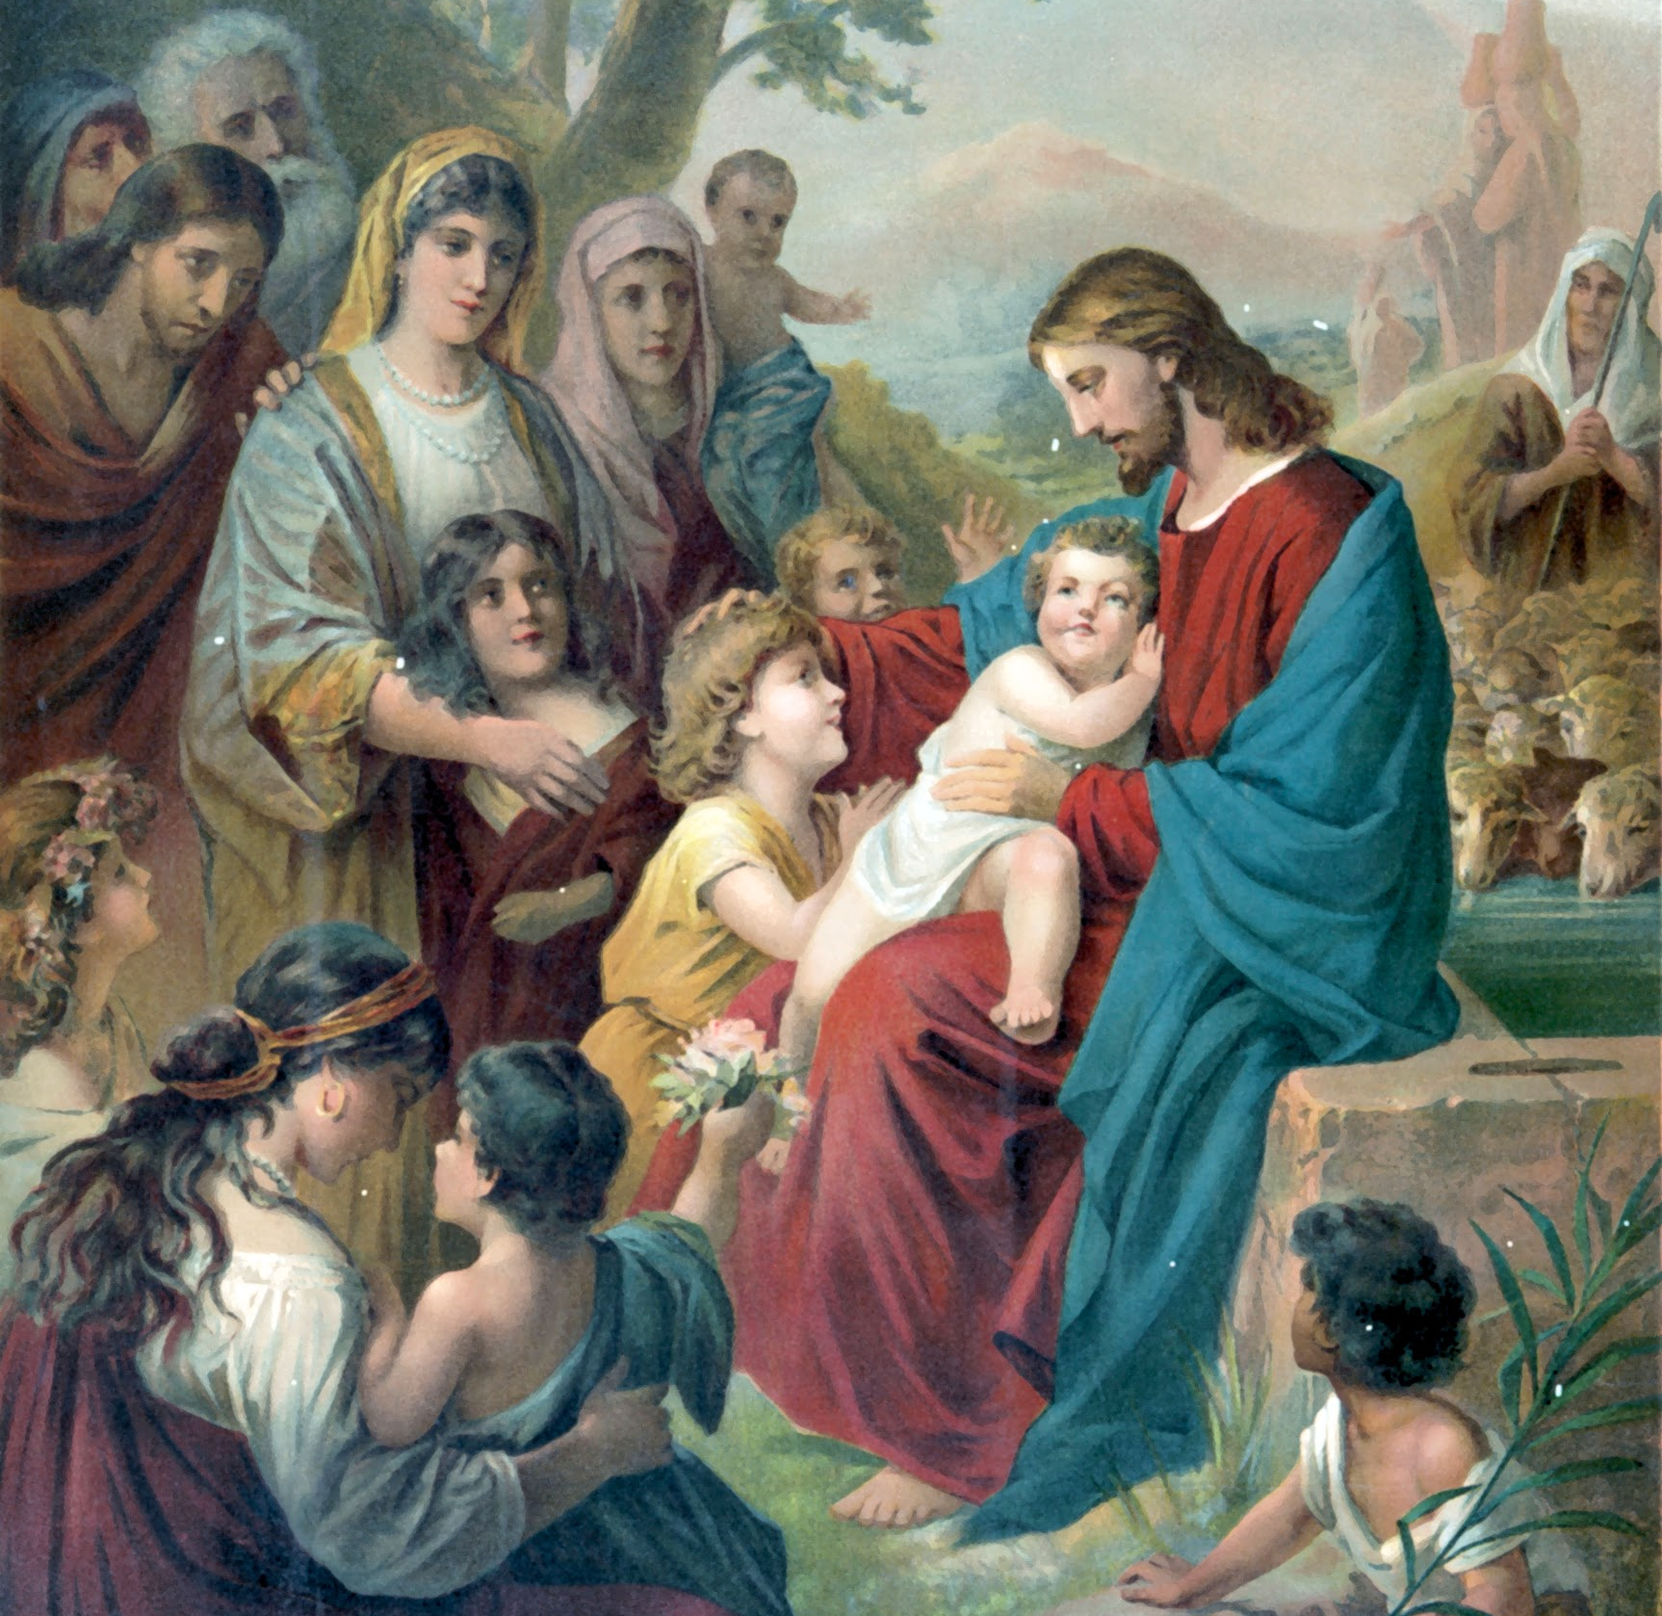
Lesson 22: Heaven, Purgatory, and Hell

Slide 2
Consequences
Our actions have consequences. A consequence is something that happens as a direct result of something we did. We often see the consequences of our daily actions right away, like when we are mean to a sibling and get sent to our room.
At the end of our life, the actions of our whole lifetime will also have consequences. For those who choose God, their reward will be Heaven. For those who rejected God, their punishment will be what they chose — a place without God, or Hell. For those who might not be quite ready for Heaven, they will go to Purgatory to be purified of the remaining effects of sin.

Slide 3
We Must Choose God
God wants everyone to go to Heaven, but He does not force anyone to be His friend. God does not decide ahead of time that only certain people will go to Heaven, and certain others will go to Hell.
We must choose to be God’s friend each day of our lives. We can choose to accept Him or to reject Him. Where we go after we die depends on our own free choice. God offers every human being the gifts of His grace, His love, and His mercy to help us choose His love.
Remember that only God can truly judge. We cannot know what is in another person’s heart. Only God knows that.

Slide 4
We Must Choose God
Read Luke 16:19–31
Entrance into Heaven or Hell is not based on a single choice that we make, but on the sum of all the choices we make throughout our lives. When we make good choices, when we choose to love God daily, we are choosing Heaven.
Sometimes we do not make good choices. Sometimes we sin and fail to love God or others as we should. When we sin, we damage our relationship with God because we choose something other than Him. But even when we sin, God will forgive us if we are truly sorry for it.

Slide 5
Purgatory
Purgatory is where those who die in God’s grace and friendship, but who still need to be purified from the effects of sin on their souls, go after death.
Even though these souls are 100 percent assured of entrance into Heaven, they need our prayers.
The Church teaches us that we should pray for the souls in Purgatory, and that our prayers can even help them on their way to Heaven!
We can and should pray for the dead every day. The Church asks us to remember the faithful departed especially during the month of November.

Slide 6
Heaven
God wants everyone to go to Heaven. He wants everyone to be perfectly happy.
Heaven is the place of perfect happiness because those in Heaven live with God forever. By His Passion, Death, and Resurrection, Jesus opened the Gates of Heaven for all of humanity.
As followers of Christ our duty is to share this Good News with others, and to pray for all souls — especially the souls in Purgatory, who cannot pray for themselves. In fact, prayer is one of the best things we can do for the dead.

Slide 7
Prayer Cards
Prayer cards are a good reminder to pray for people, both living and dead. Our prayers can help souls here on earth as well as those in Purgatory.
Prayer cards are usually given out on special occasions such as weddings, ordinations, religious consecrations, and funerals as reminders to pray for our brothers and sisters in Christ and assist them on their way to Heaven. Prayer cards often include a quote or verse from Scripture that reminds us of our duty to imitate Christ, our hope in the resurrection, and the eternal life after death that Christ has won for us by His Passion, Death, and Resurrection.

Slide 8
Justice in Heaven
Recall the state of Original Justice that existed before the Original Sin of Adam and Eve.
Justice means giving God and neighbor what they are due — good or bad.
In the state of Original Justice, and as it is now in Heaven, there are no wrongs to be made right! The souls in Heaven live in perfect communion and relationship with the Blessed Trinity, the Virgin Mary, and all the angels and saints. They spend eternity contemplating God as He really is — in the Beatific Vision.

Slide 9
What We Need to Go to Heaven
Read Matthew 7:21-23.
Jesus tell us very clearly here in the first part of His first line that not everyone who calls Jesus Lord will enter the Kingdom of Heaven.
Since our souls live forever, but not everyone goes to Heaven, there must be other places that some souls go.
Jesus says those who do the Father’s will will go to Heaven.
Doing some good things in life is not enough to go to Heaven.
Calling Jesus Lord, or believing that Jesus is the Son of God, is not enough to go to Heaven.

Slide 10
What We Need to Go to Heaven
Even after someone feels sorry for a sin and is forgiven, effects of that sin can remain.
Purifying our souls of these effects is the purpose of Purgatory.
God is perfectly true, good, and beautiful. This means that to be with God in Heaven, we also must be pure. This is also true here on earth!

Slide 11
What We Need to Go to Heaven
It is why we perform a penitential rite at Holy Mass, and why we cannot receive Holy Communion if we are in a state of mortal sin — we must seek God’s mercy and have our sins forgiven in Confession first.
It is also why God preserved the Virgin Mary from the stain of Original Sin from the moment of her conception. To be the Mother of God and to carry Jesus in her womb, Mary had to be free from sin.

Slide 12
Pray for the Souls in Purgatory
The souls in Purgatory cannot pray for themselves, but as part of the Communion of Saints, they can pray for us!
We can and should pray for them too, of course. A good prayer we can say every day, and especially during the month of November, when we especially remember the faithful departed, is:
Eternal rest grant unto them, O Lord; And let perpetual light shine upon them. May they rest in peace. Amen.

