Slide 1
Jesus is Our Savior
Grade 2
Unit 3

Slide 2
Heaven, Hell, and Purgatory
Unit 3, Lesson 22

Slide 3
1 Corinthians 2:9
As it is written: “What eye has not seen, and ear has not heard, and what has not entered the
human heart, what God has prepared for those who love him.”

Slide 4
2 Thessalonians 1:6, 8–9
For it is surely just on God’s part to repay with afflictions those who are afflicting you ... inflicting
punishment on those who do not acknowledge God and on those who do not obey the gospel
of our Lord Jesus. These will pay the penalty of eternal ruin, separated from the presence of the
Lord and from the glory of his power

Slide 5
Prayer to the Lord
Eternal Father, we pray for all the holy souls in Purgatory, and for all sinners everywhere. Have
mercy on us all. Amen.

Slide 6
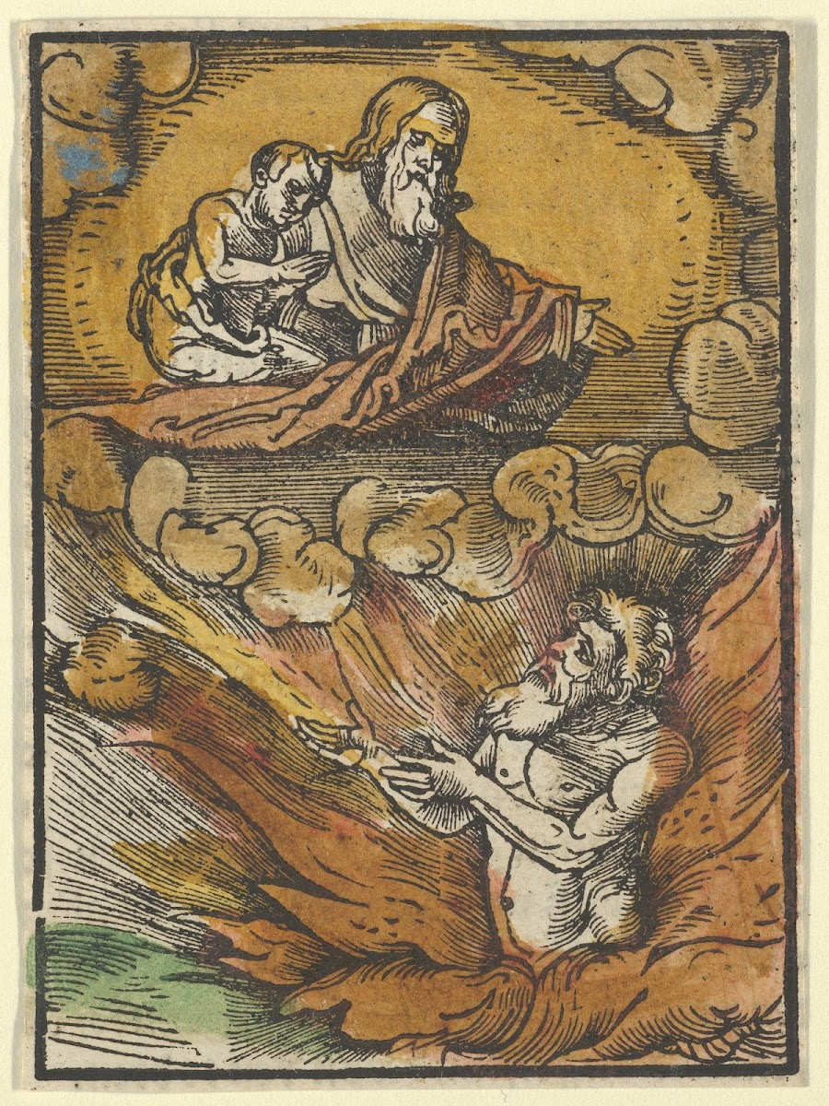
The Rich Man in Hell and the Poor
Lazarus in Abraham’s Lap

