Slide 1
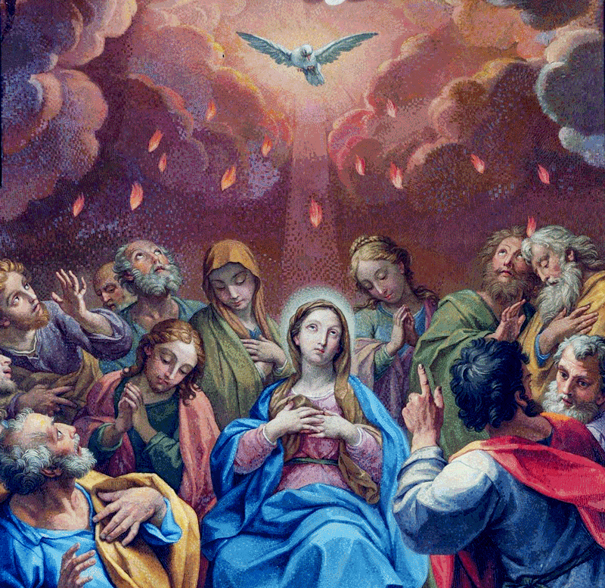
Lesson 4: The Sacrament of Holy Eucharist
Notes:
This PowerPoint contains all text and images recommended to be projected and/or read aloud in this unit.

Slide 2
Jesus Gave Us the Eucharist
Read John 6:48-57.
We understand Jesus to be teaching in this passage about the Eucharist, Jesus’ Body and Blood.
Read Matthew 26:26-29.
At the Last Supper, Jesus transformed the bread and wine into His Body and Blood and gave it to His Apostles to eat and drink. Jesus’ teaching in John was fulfilled at the Last Supper, when He made a New Covenant for the forgiveness of sins.

Slide 3
Source and Summit of Our Faith
The Catechism of the Catholic Church describes the Eucharist as “the source and summit of the Christian life” (CCC 1324).
The source of something is where it begins. Think of the source of a river, where the water begins to flow.
The summit of something is its highest point. Think of the summit of a mountain, the very top peak.
The Eucharist is the source and summit of our faith. That means that our Christian faith begins with the Eucharist or flows out of it, and the Eucharist is the greatest expression of our faith. In other words, the whole of the Christian life begins with the Eucharist and is directed toward the Eucharist.

Slide 4
Jesus Revealed in the Eucharist
Read Luke 24:30-31.
This passage from Luke’s Gospel comes from a story called the Road to Emmaus. This story takes place on Easter Sunday after Jesus has risen from the dead. Two of Jesus’ disciples are walking to a town outside of Jerusalem called Emmaus. Along the way, they meet a stranger and have a conversation with him about Jesus’ suffering and death three days before. The stranger then begins to teach the disciples about everything in the Scriptures that speaks of Jesus. When they reach their destination, the two disciples and the stranger gather together to break bread.

Slide 5
Jesus Revealed in the Eucharist
One of the many titles for the Eucharist is the Breaking of the Bread.
Just as with the disciples in this story, Jesus is revealed to us in the Breaking of the Bread, the Eucharist. When we participate in the Eucharist at every Mass, Jesus is made known to us.
He is literally there with us, Body and Blood, Soul and Divinity.

