Slide 1
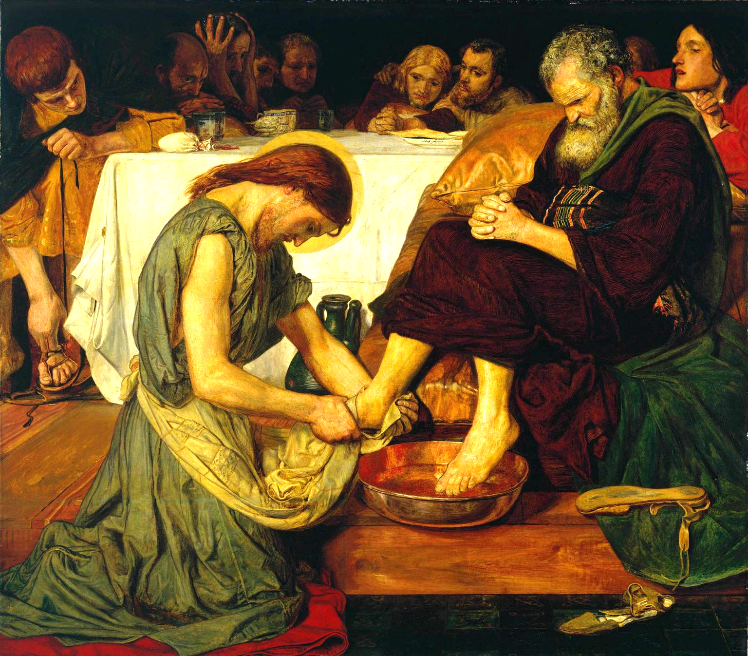
Lesson 8: Conscience and Responsibility

Slide 2
Freedom and Responsibility
Read Genesis 4:1-7
Cain, like all of us, has the ability to make good moral choices. God’s advice to Cain shows us how Cain (like all of us) has free will and therefore is responsible for his choices.
God loves us all and wants us to choose the good freely.
If you are not free to choose an action, you cannot be responsible for it. On the other hand, if you are free to choose, then your choice is your responsibility.
Read Genesis 4:8-16

