Slide 1
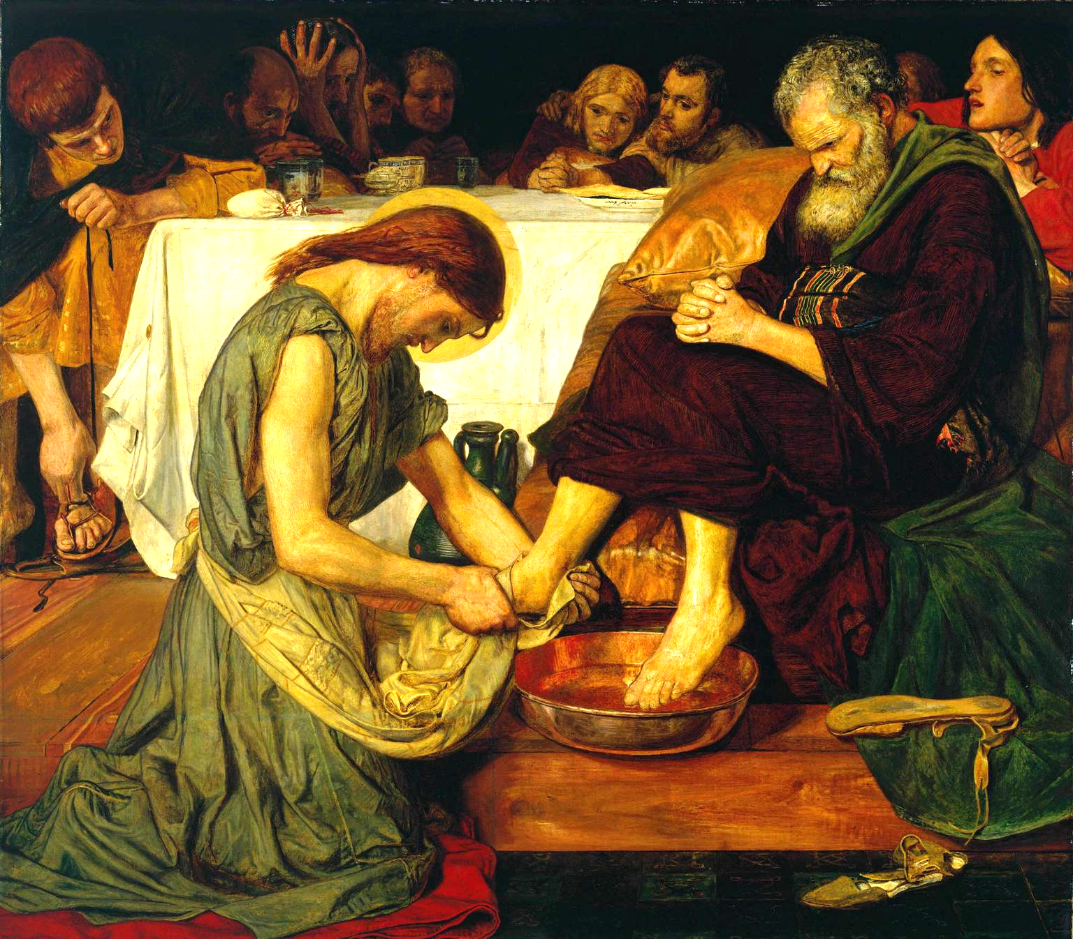
Lesson 2: Does “Freedom” Mean Doing Whatever We Want, Wherever We Want?

Slide 2
Freedom
The world’s definition of freedom is something similar to “Having no restraints,” or “Following your feelings,” or “Doing whatever you want to do:
The true meaning of freedom is the ability to choose one’s actions and direct them toward God. For example:
If you goof off rather than study, you’ll do poorly in school and have less freedom in your career choices.
If you never exercise, your body will be weak and you’ll have less freedom to play sports, do physical activities, and so forth.
If you take drugs, your body will begin to want more drugs. Abusing your body with drugs leads to addiction and less freedom.
If you take out loans to buy things you don’t need, you’ll go into debt. Spending without limits leads to slavery to debt and less freedom.

Slide 3
Freedom
First, if you always let your feelings guide your decisions, you will become a slave to your feelings (less freedom).
Secondly, the more you practice a certain skill, the easier and more enjoyable it becomes. True freedom is the same way. The more we use our freedom well, the freer we become. For example:
If you study and do well in school, you can learn more. Learning will become easier, and you will have more freedom in your career choices.
If you exercise and eat well, your body will be healthy. You will enjoy healthful foods more and have more freedom to do the physical activities you want to do.

Slide 4
Freedom
Freedom consists not in doing what we like, but in having the right to do what we ought.” -St. John Paul II

