Slide 1
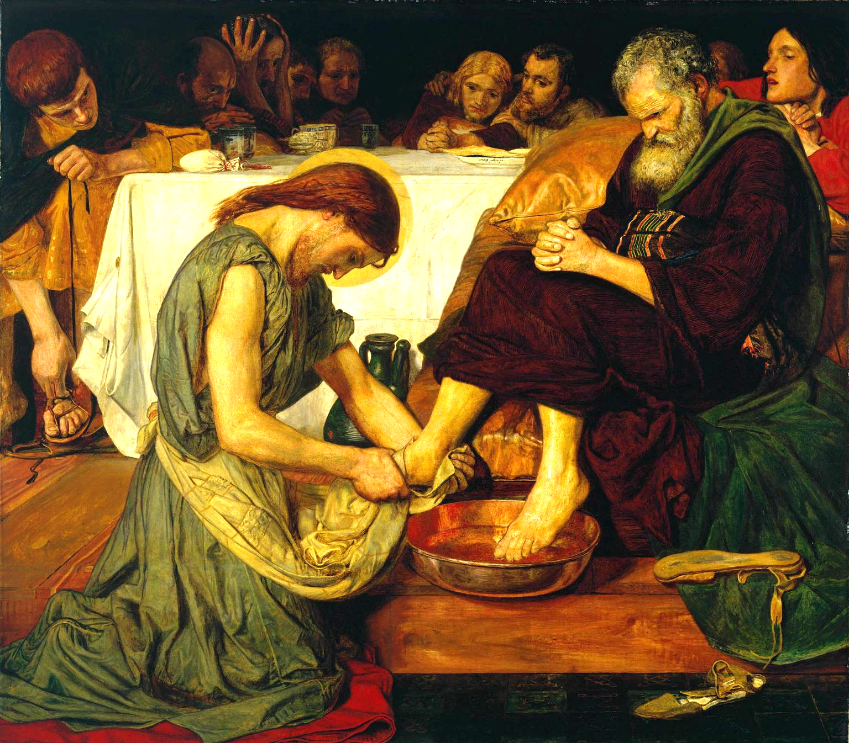
Lesson 7: The New Commandments

Slide 2
Jesus Shows Us True Love
The world often uses a term differently from the way our Lord uses it. This is the case with the word love. If we want to get closer to following God’s will in our lives, one thing we can do is try to understand more fully the teachings He has given us in Scripture in light of Church teaching.
“Love one another as I love you.” Jesus tells us to love each other in a very specific way. He says we should love one another the way He has loved us. If we want to know what love is, we have to find out how Jesus has loved us.

Slide 3
Jesus Shows Us True Love
Jesus tells us that He is the example of what it means to love someone. Jesus’ entire mission was based on giving Himself to others for their good. This is the fundamental definition of love.
Read John 13:34-35:

