Slide 1
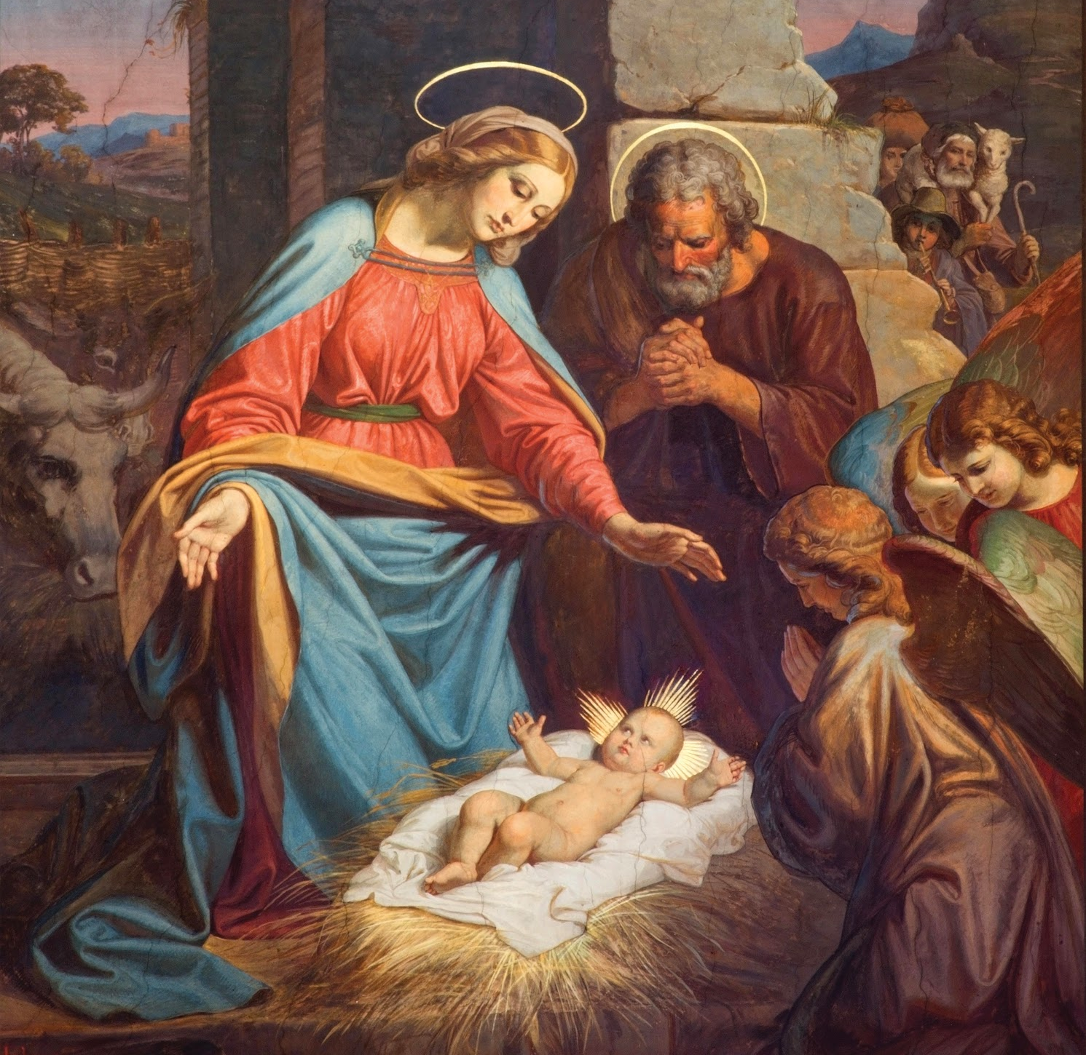
Jesus Made Many Friends
Unit 2, Lesson 19

Slide 2
John 15:15
“You are my friends if you do what I command you.... I have called you friends, because I have told you everything I have heard from my Father”

Slide 3
Our Father
Our Father, who art in heaven, hallowed be thy name; thy kingdom come, thy will be done on earth as it is in heaven. Give us this day our daily bread, and forgive us our trespasses, as we forgive those who trespass against us; and lead us not into temptation, but deliver us from evil. Amen.

Slide 4
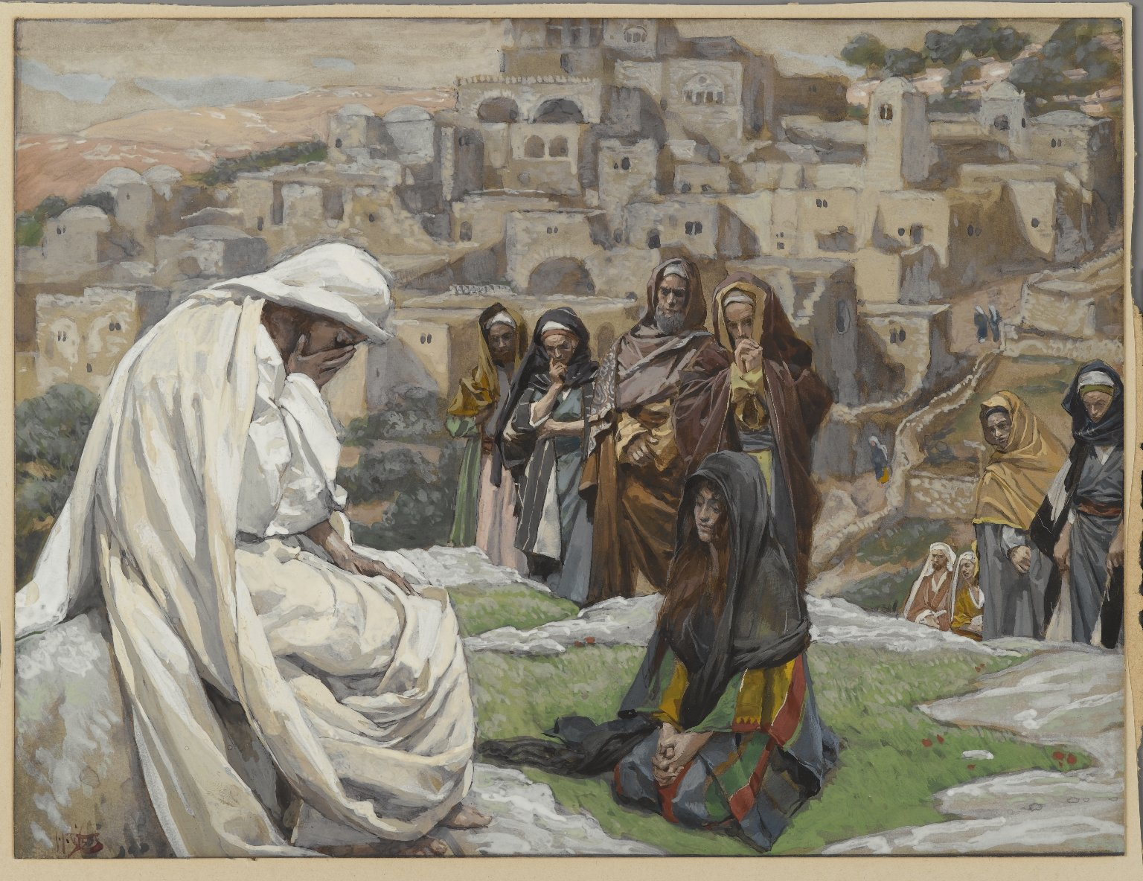
The Sermon on the Mount

