Slide 1
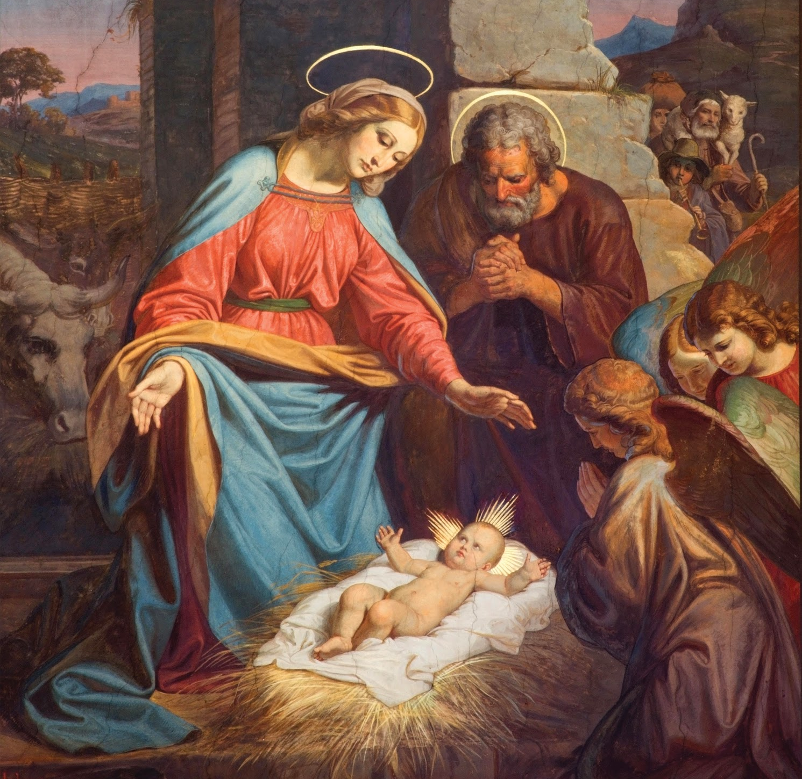
Jesus has a Heavenly Father
Unit , Lesson 2

Slide 2
Jesus’ Gift
Remember how happy Mary and the Apostles were when Jesus rose from the dead? But they would not have Jesus with them on earth for very much longer. Soon He had to go back to His Father in Heaven.
Jesus knew they would be sad that He was gone, so He gave them a very special gift. He had promised to send this gift before. Before He died on the Cross He told His disciples that He would ask the Father to give them a Comforter to be with them always.
Notes:
This image is on page 2 of the student book.

Slide 3
Jesus’ Comforter
Jesus sent His Comforter on a very special day called Pentecost.
It was 50 days after Easter, and ten days after Jesus went back up to Heaven. Mary and the disciples were hiding away in an upper room because they were afraid. The people of Jerusalem did not like them because they were followers of Jesus.
The Bible tells us what happened in the upper room.
Notes:
This image is on page 2 of the student book.

Slide 4
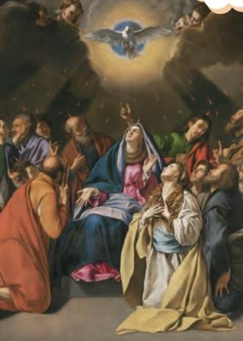
Jesus’ Comforter
Read Acts 2:1-4.
In this painting, we can see signs of people feeling comforted.
The Virgin Mary is in the center, and St. Mary Magdalene kneeling beside her.
Can you imagine how they were comforted at the Holy Spirit’s coming?
Notes:
This image is on page 2 of the student book.

Slide 5
The Gifts of the Holy Spirit
Those in the upper room were not afraid anymore, because the Holy Spirit gave them special gifts!
These gifts aren’t like the ones we get for Christmas or birthdays. You can’t see these gifts, but they are very special because they helped the disciples do Jesus’ work, which was to spread the Gospel to the whole world.
Notes:
This image is on page 2 of the student book.

Slide 6
The Gifts of the Holy Spirit
These gifts are such wonderful gifts that not only the disciples and Mary received them.
People who are baptized can receive them as well, even to this day!
There is also a special Sacrament called Confirmation in which the Holy Spirit strengthens His Gifts, just like He did in the disciples and Mary.
Notes:
This image is on page 2 of the student book.

Slide 7
Confirmation
At Confirmation, the Holy Spirit comes down on the person being confirmed just like at Pentecost. Confirmation is usually given to older children.
Bishops ordinarily give people the Sacrament of Confirmation, because it was first given to them by the Holy Spirit.
Notes:
This image is on page 2 of the student book.

Slide 8
Confirmation
At Confirmation, the bishop uses blessed oil, but you will be pretending.
The bishop makes the Sign of the Cross on the confirmand’s forehead and says these words: “Be sealed with the gift of the Holy Spirit.”
At that moment the Holy Spirit comes down on the confirmand just like at Pentecost, and he or she receives the seven gifts.
Notes:
This image is on page 2 of the student book.

