Slide 1
Christ’s Passion in Sacred Art
(According to the Gospel of Luke)
(2022 | Year C)

Slide 2
Last Supper by Jacopo Bassano (c. 1542)
“When the hour came, Jesus took his place at table with the apostles…”

Slide 3
The Agony in the Garden by El Greco (c. 1590)
“Then going out, he went, as was his custom, to the Mount of Olives, and the disciples followed him…”

Slide 4
The Taking of Christ by Caravaggio (c. 1602)
“While he was still speaking, a crowd approached and in front was one of the Twelve, a man named Judas. He went up to Jesus to kiss him…”

Slide 5
St. Peter’s Denial by Rembrandt (c. 1660)
“After arresting him they led him away and took him into the house of the high priest; Peter was following at a distance…”

Slide 6
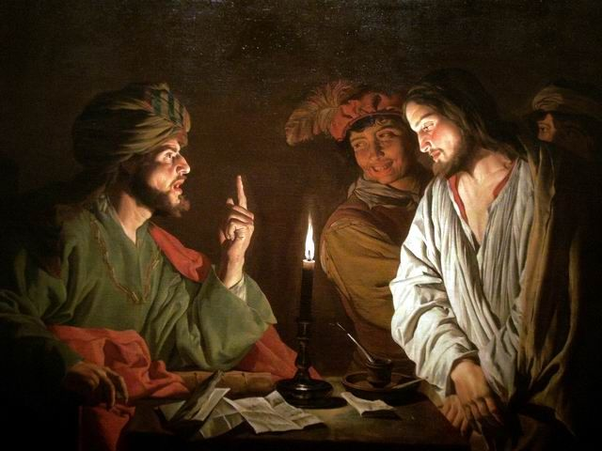
Christ Before Caiaphas by Matthias Storm (c. early 1630’s)
“When day came the council of elders of the people met…and they brought him before their Sanhedrin.”

Slide 7
Christ before Pilate by Mihaly Munkacsy (c. 1881)
“Then the whole assembly of them arose and brought him before Pilate…”

Slide 8
Ecce Homo by Mihaly Munkacsy (c. 1896)
But all together they shouted out, "Away with this man! Release Barabbas to us."

Slide 9
Christ Carrying the Cross by Titian (c. 1565)
“As they led him away they took hold of a certain Simon, a Cyrenian, who was coming in from the country; and after laying the cross on him, they made him carry it behind Jesus…”

Slide 10
What Our Lord Saw from the Cross by James Tissot (c. between 1886 and 1894)
“When they came to the place called the Skull, they crucified him and the criminals there…”

Slide 11
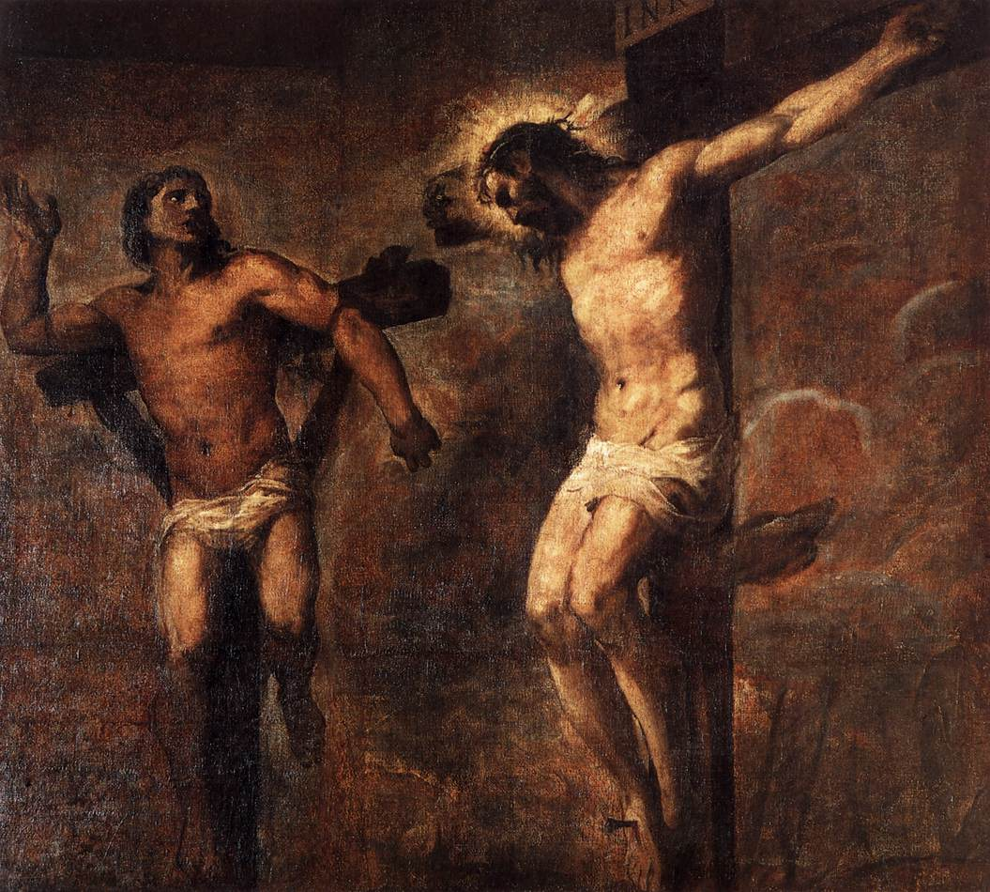
Christ and the Good Thief by Titian (c. 1566)
“Now one of the criminals hanging there reviled Jesus, saying, “Are you not the Christ? Save yourself and us.’…”

Slide 12
Christ Crucified by Diego Valazquez (c. 1632)
“It was now about noon and darkness came over the whole land until three in the afternoon because of an eclipse of the sun…”

Slide 13
The Entombment by Peter Paul Rubens (c. 1612-1614)
“Now there was a virtuous and righteous man named Joseph who, though he was a member of the council, had not consented to their plan of action…”

