Slide 1
Christ’s Passion in Sacred Art
(According to the Gospel of Matthew)
(2023 | Year A)

Slide 2
Last Supper by Jacopo Bassano (c. 1542)
“When it was evening, He reclined at table with the Twelve…”

Slide 3
The Agony in the Garden by El Greco (c. 1590)
“Then Jesus came with them to a place called Gethsemane…”

Slide 4
The Taking of Christ by Caravaggio (c. 1602)
“While he was still speaking, Judas, one of the Twelve, arrived, accompanied by a large crowd…”

Slide 5
St. Peter’s Denial by Rembrandt (c. 1660)
“Those who had arrested Jesus led Him away to Caiaphas the high priest…”

Slide 6
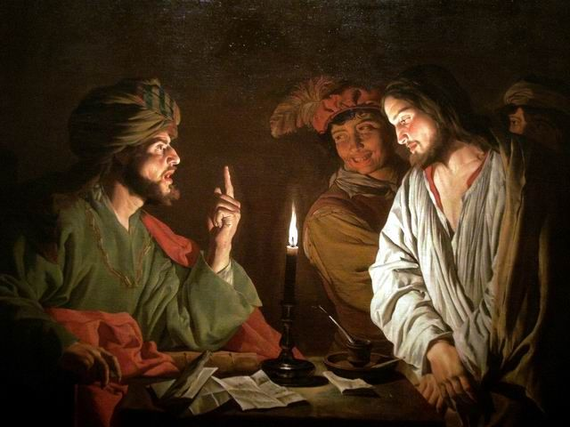
Christ Before Caiaphas by Matthias Storm (c. early 1630’s)
“The chief priests and the entire Sanhedrin kept trying to obtain false testimony against Jesus in order to put Him to death…”

Slide 7
Christ before Pilate by Mihaly Munkacsy (c. 1881)
“They bound Him, led Him away, and handed Him over to Pilate, the governor.”

Slide 8
Ecce Homo by Mihaly Munkacsy (c. 1896)
”But he said, ‘Why? What evil has he done?’ They only shouted the louder, ‘Let him be crucified!’”

Slide 9
Christ Carrying the Cross by Titian (c. 1565)
“As they were going out, they met a Cyrenian named Simon; this man they pressed into service to carry His cross.”

Slide 10
What Our Lord Saw from the Cross by James Tissot (c. between 1886 and 1894)
“After they had crucified Him, they divided His garment by casting lots…”

Slide 11
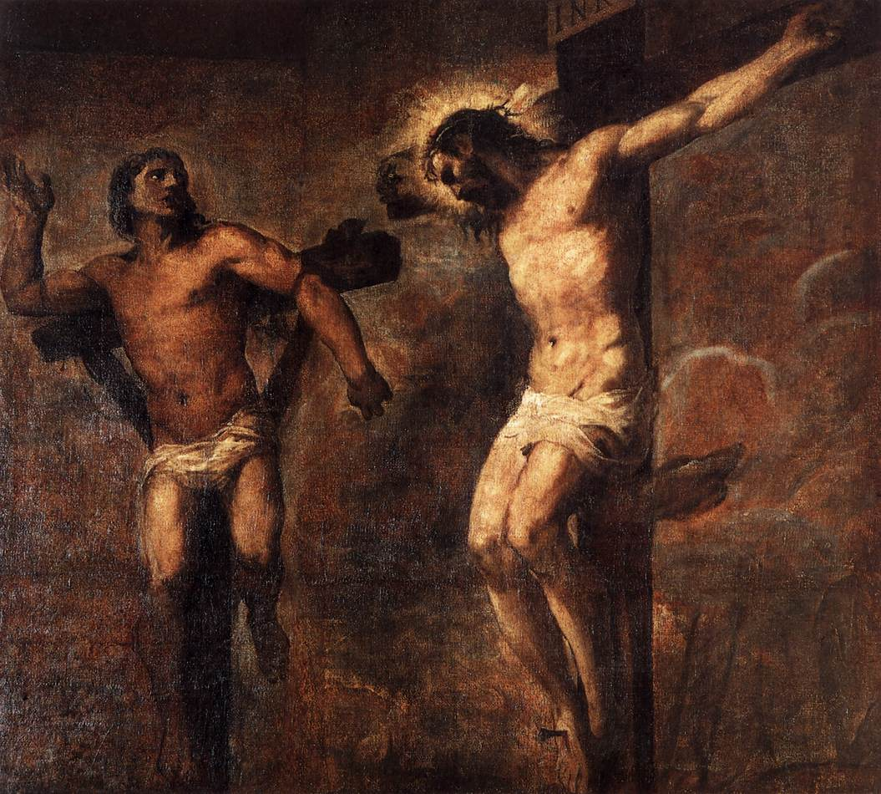
Christ and the Good Thief by Titian (c. 1566)
“Two revolutionaries were crucified with Him, one on His right and the other on His left.”

Slide 12
Christ Crucified by Diego Valazquez (c. 1632)
“From noon onward, darkness came over the whole land until three in the afternoon.”

Slide 13
The Entombment by Peter Paul Rubens (c. 1612-1614)
“Taking the body, Joseph wrapped it [in] clean linen and laid it in his new tomb that he had hewn in the rock.”

