Slide 1
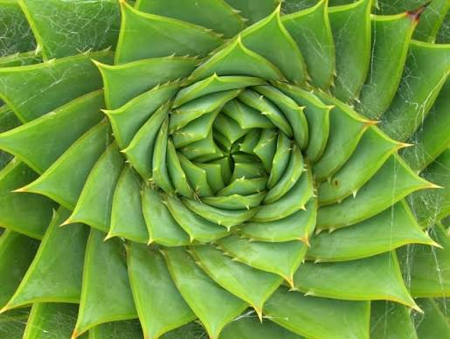
The Fibonacci Sequence in Nature
The Fibonacci Sequence and the Golden Spiral

Slide 2
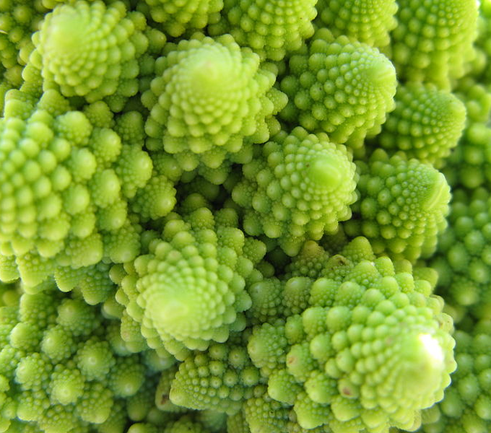
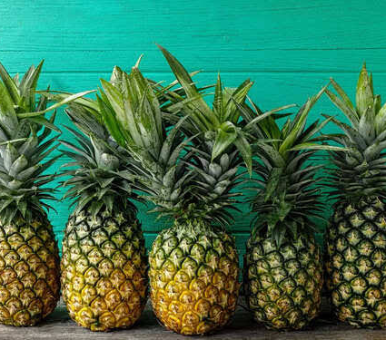
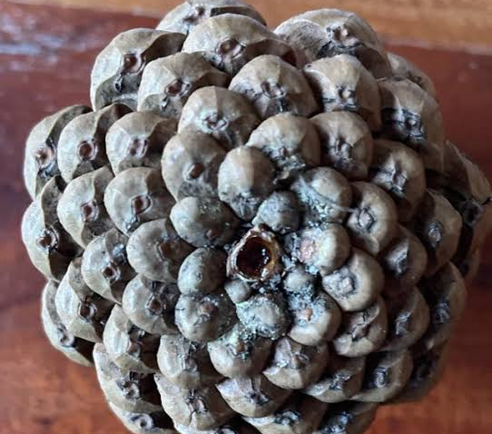
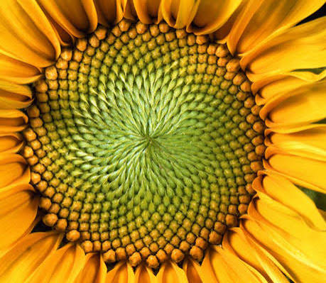
The Golden Spiral
Patterns such as the Fibonacci sequence in nature point to a universe that is intelligible, beautiful, and ordered, and to a Creator whose wisdom is reflected in the harmony of all He has made.

Slide 3
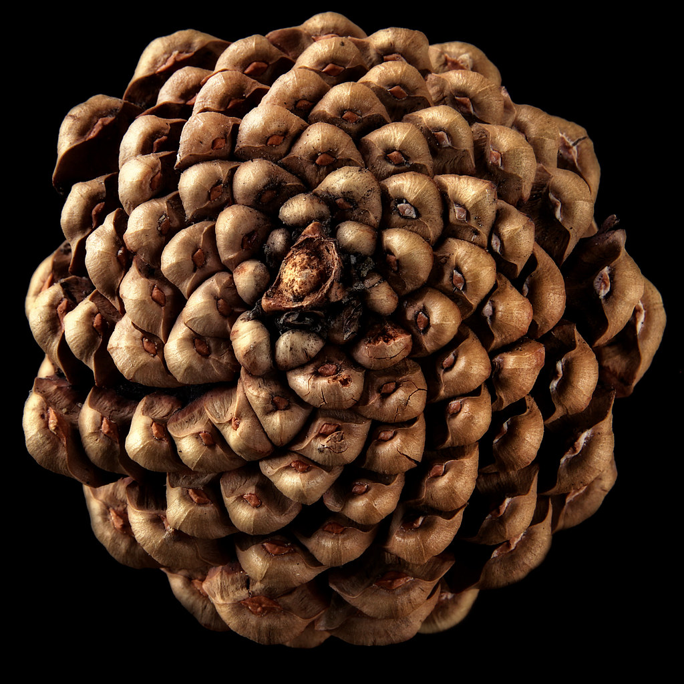
The Fibonacci Sequence in Nature
The Fibonacci Sequence and the Golden Spiral

Slide 4
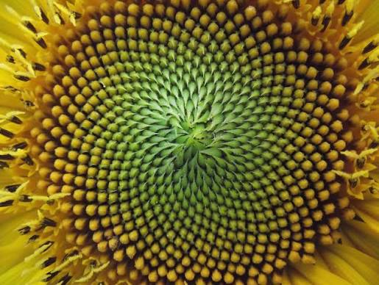
The Fibonacci Sequence in Nature
The Fibonacci Sequence and the Golden Spiral

Slide 5
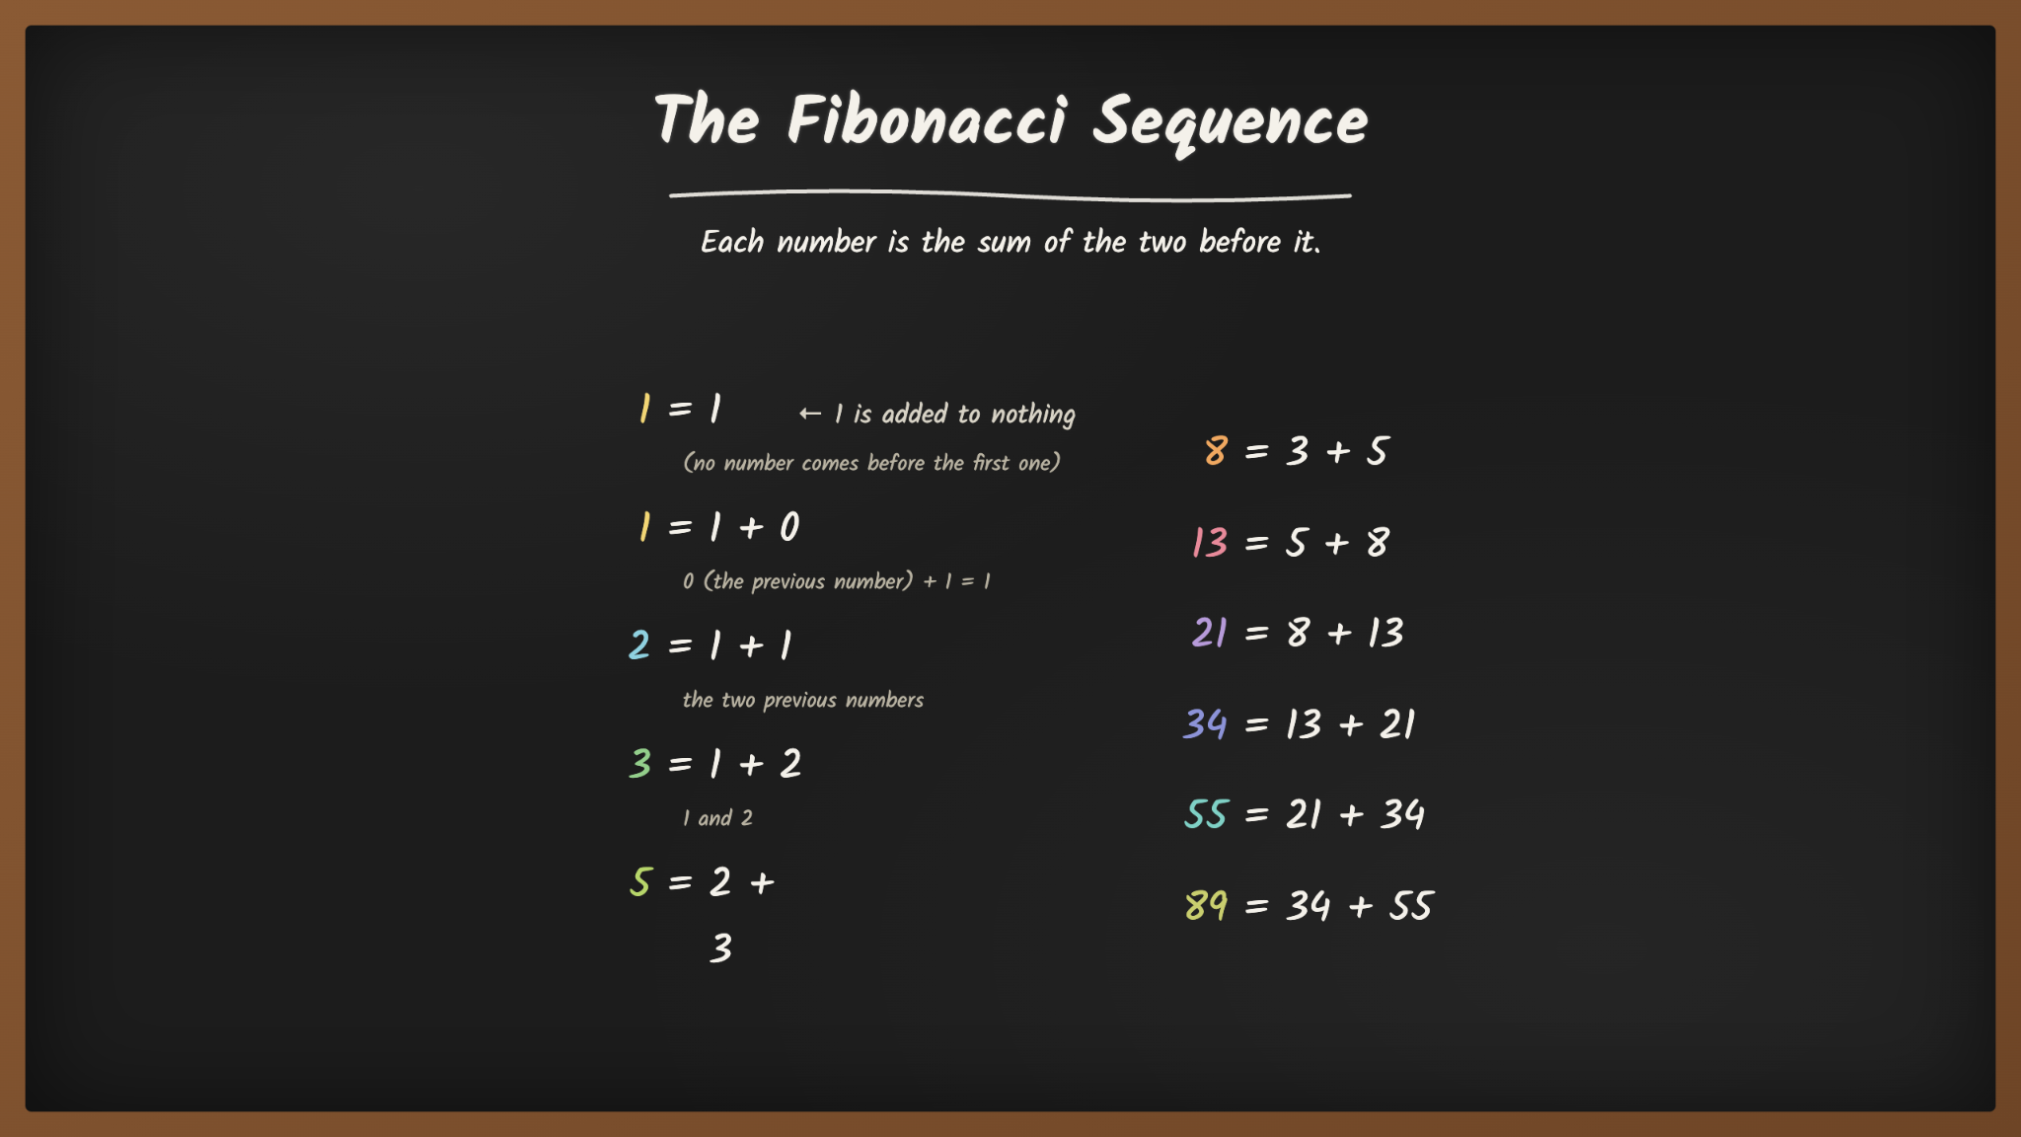
Notes:
Explain the fibonacci sequence and what it is.
The sequence is 1, 1, 2, 3, 5, 8, 13, 21, 34, 55, 89
Each number in the sequence is the sum of the two numbers before it.

Slide 6
Experiment at Your Desks
The Fibonacci Sequence and the Golden Spiral
Using your note paper, choose any two numbers AT RANDOM and write them, one above the other like an addition problem.
Add them and write the sum below
Then add the sum to the previous number.
Continue 10-12 more times.

Slide 7
Experiment at Your Tables
The Fibonacci Sequence and the Golden Spiral
After you have about 12 numbers, divide the last number by the one just above it.
On your whiteboards: write your result on your whiteboard
Shhh….Do not reveal until it’s time.
Notes:
Walk around and make sure the understand they are dividing the last number on their series by the number just above it. For example, if they had 55 and 89, they would divide 89 by 55. 89/55 = 1.618

Slide 8
Experiment at Your Tables
The Fibonacci Sequence and the Golden Spiral
The Fibonacci Sequence is a sequence where every number after the first two is the sum of the two numbers before it.
When Fibonacci numbers get larger, the ratio between neighboring numbers approaches the Golden Ratio (about 1.618) This number is so significant that it has several names, including the “Golden Ratio” or Phi, represented by the Greek letter φ.
Notes:
Have everyone reveal at once -- the ratios should all be around 1.618!
Also ask what their starting numbers were, to establish that no matter what you start with, the process converges on PHI.

Slide 9
The Fibonacci Sequence on Graph Paper
The Fibonacci Sequence and the Golden Spiral
Now, render the Fibonacci Sequence on graph paper. Begin with 1 and 1: draw two single squares on the grid paper, adjacent to each other.
Next to them, draw a 2x2 square, and, next to that, a 3x3 square (i.e., the sum of the previous two).
Continue with this pattern with the Fibonacci numbers and see how many squares you can draw. Finally, draw a curved line through the opposite corners of each square
Notes:
We’ll go step by step and I’ll have slides to help give you a visual!

Slide 10
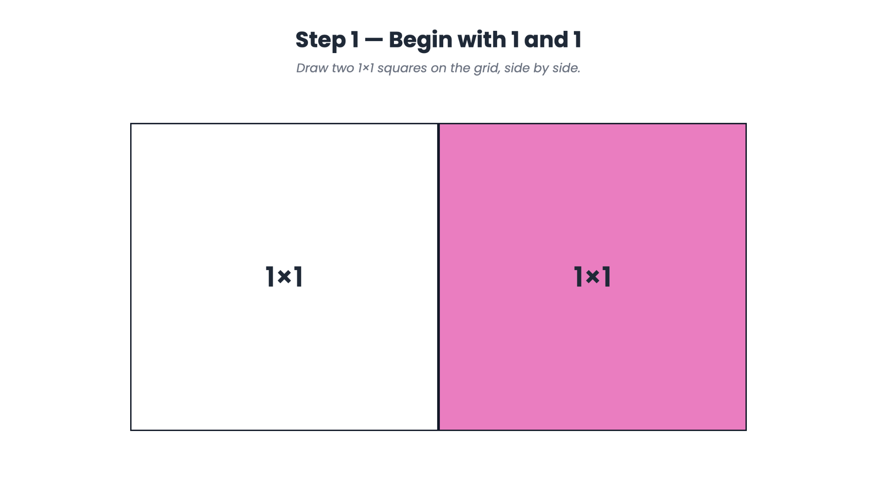

Slide 11
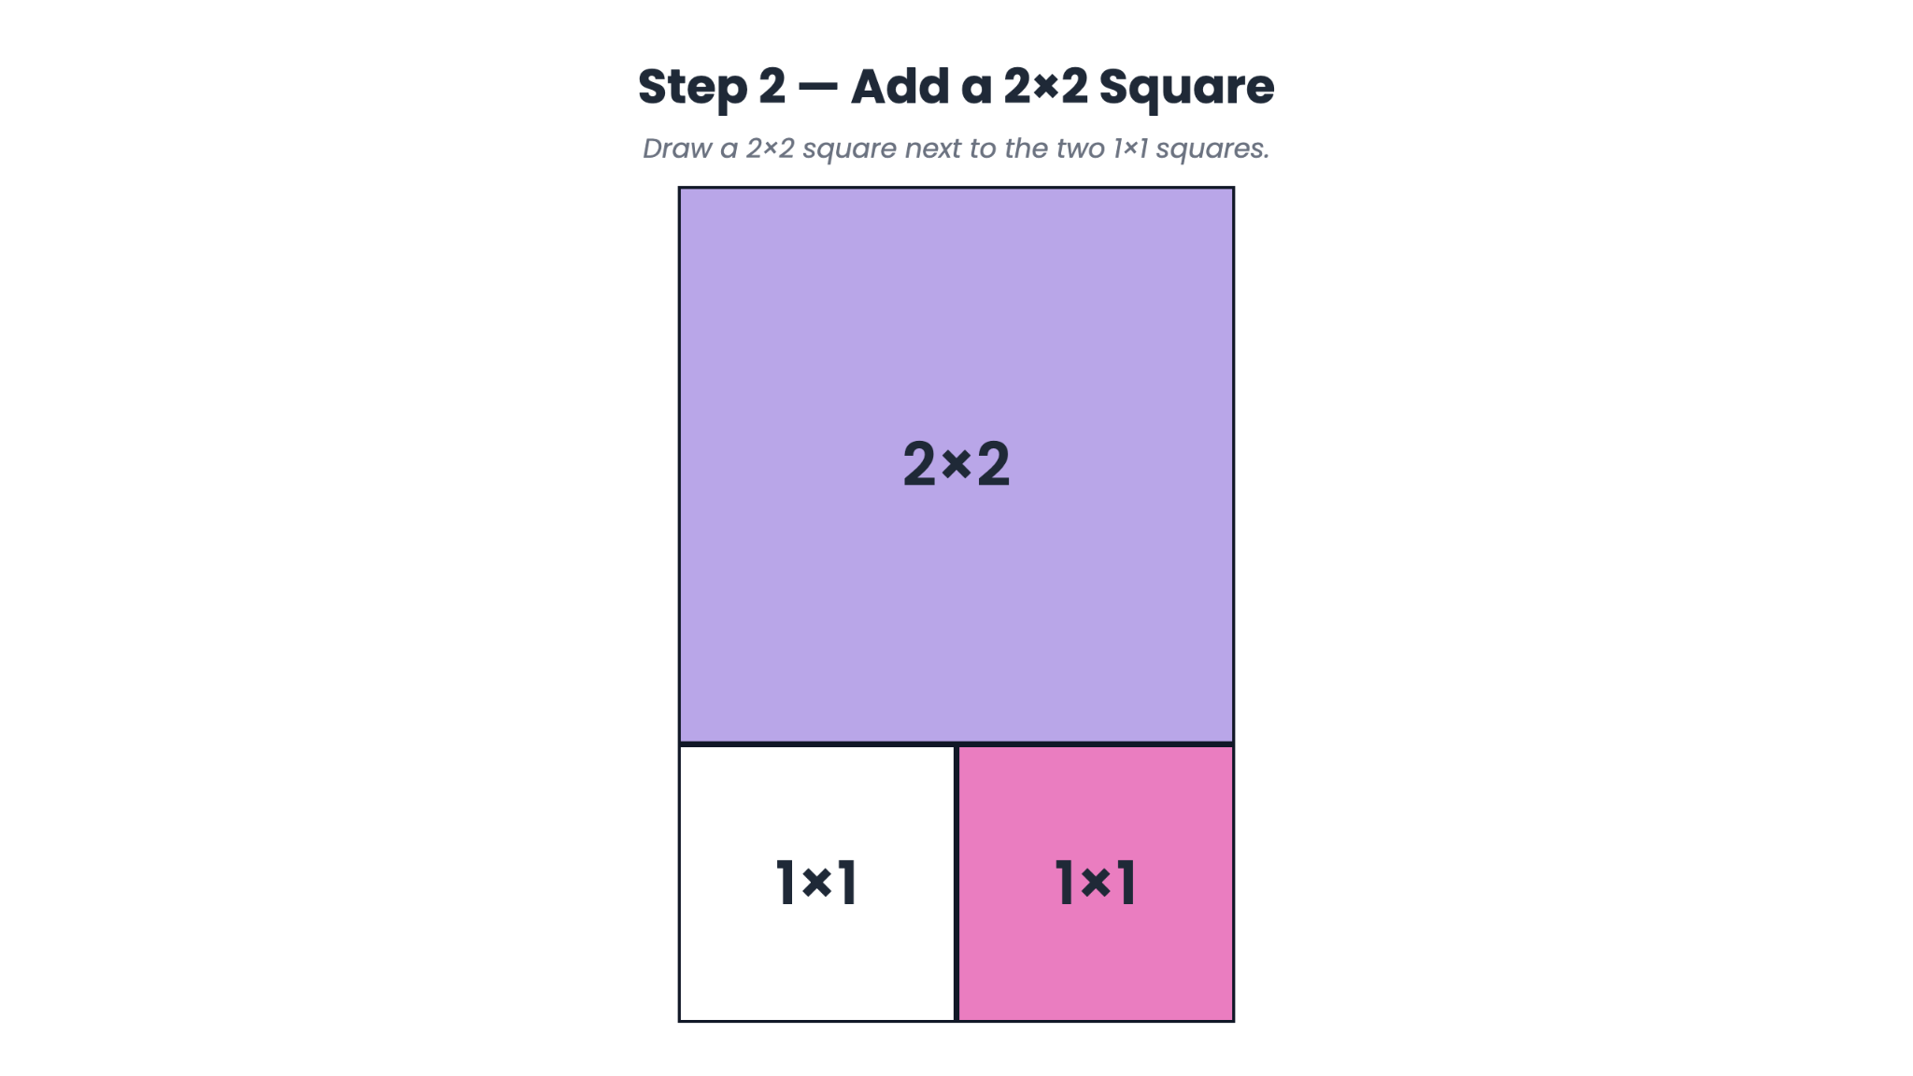

Slide 12
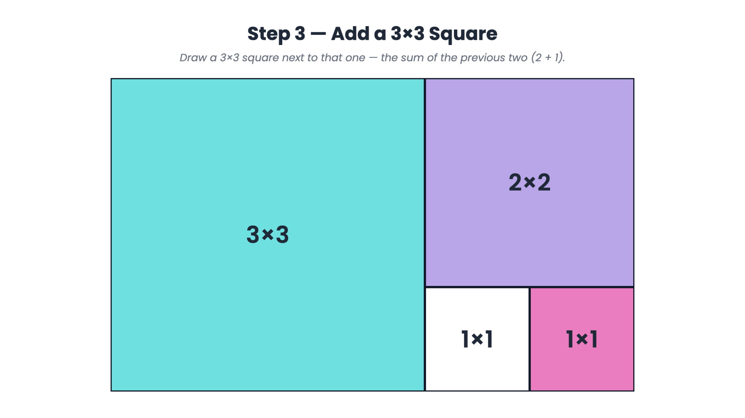

Slide 13
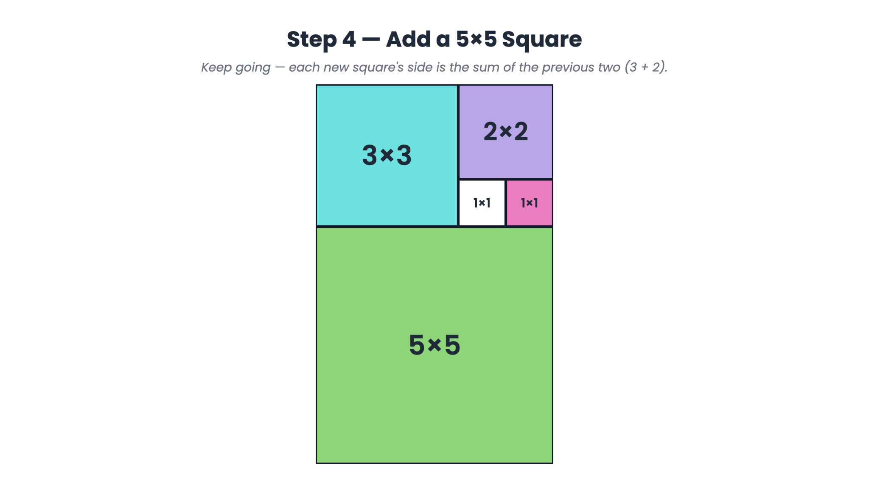

Slide 14
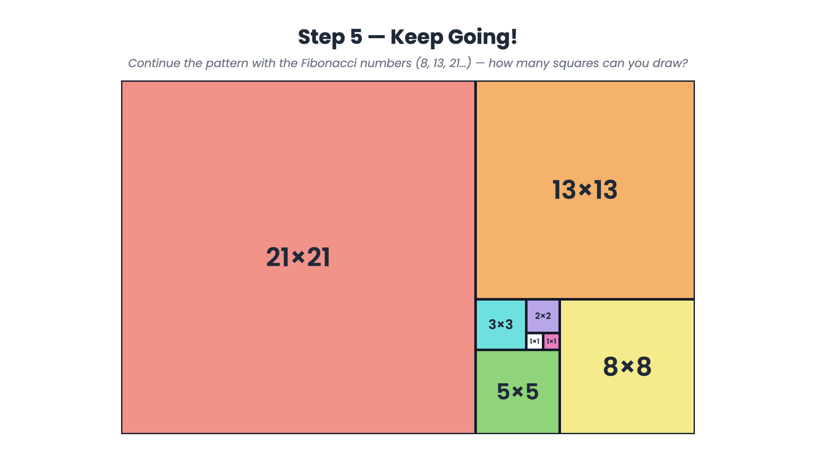

Slide 15
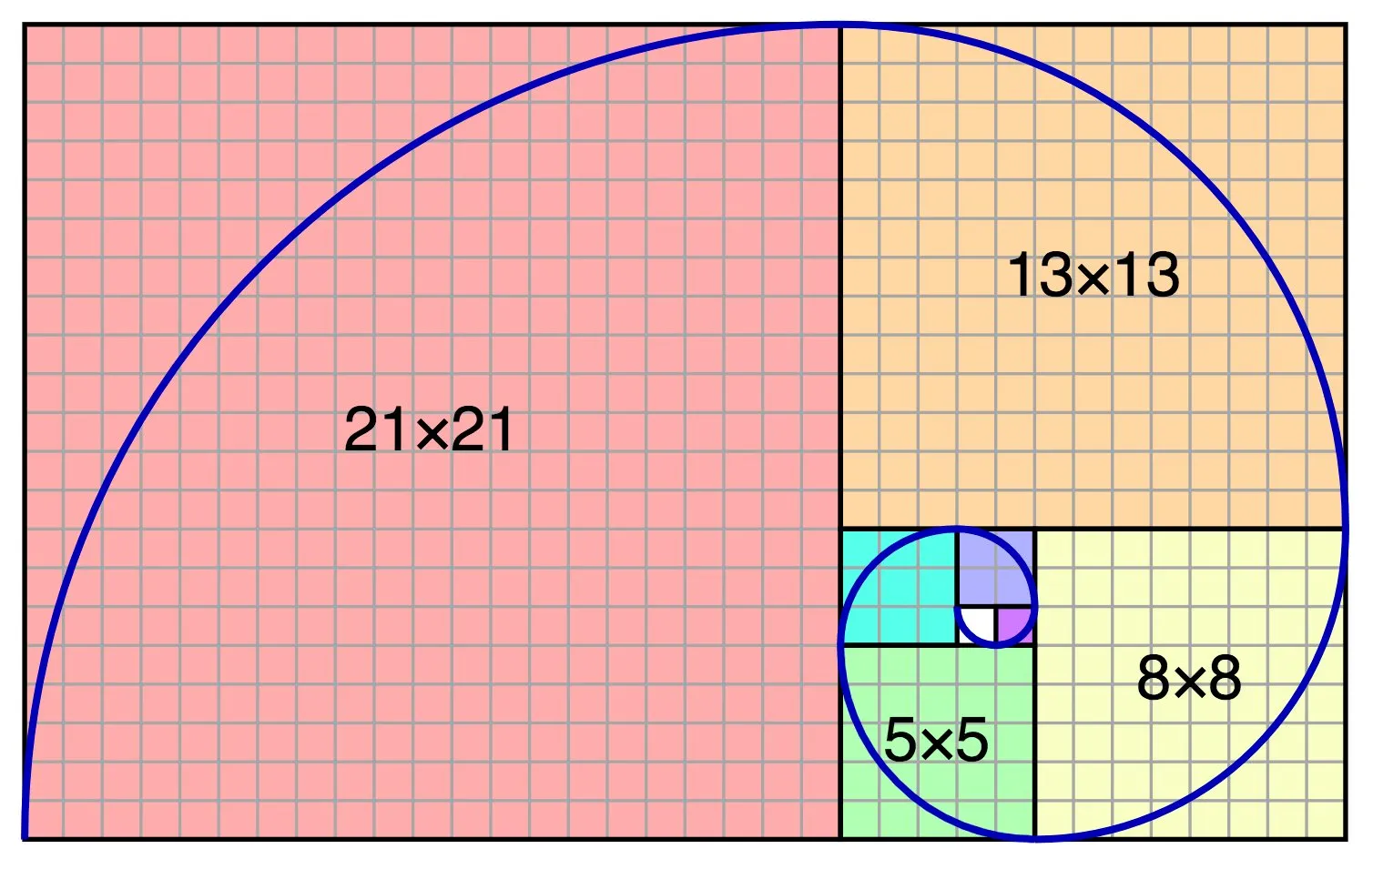

Slide 16
The Golden Spiral
Patterns such as the Fibonacci sequence in nature point to a universe that is intelligible, beautiful, and ordered, and to a Creator whose wisdom is reflected in the harmony of all He has made.

Slide 17

Vi Hart: Doodling in Math
Notes:
Here is the Vimeo links incase the link breaks: https://vimeo.com/147913571

Slide 18
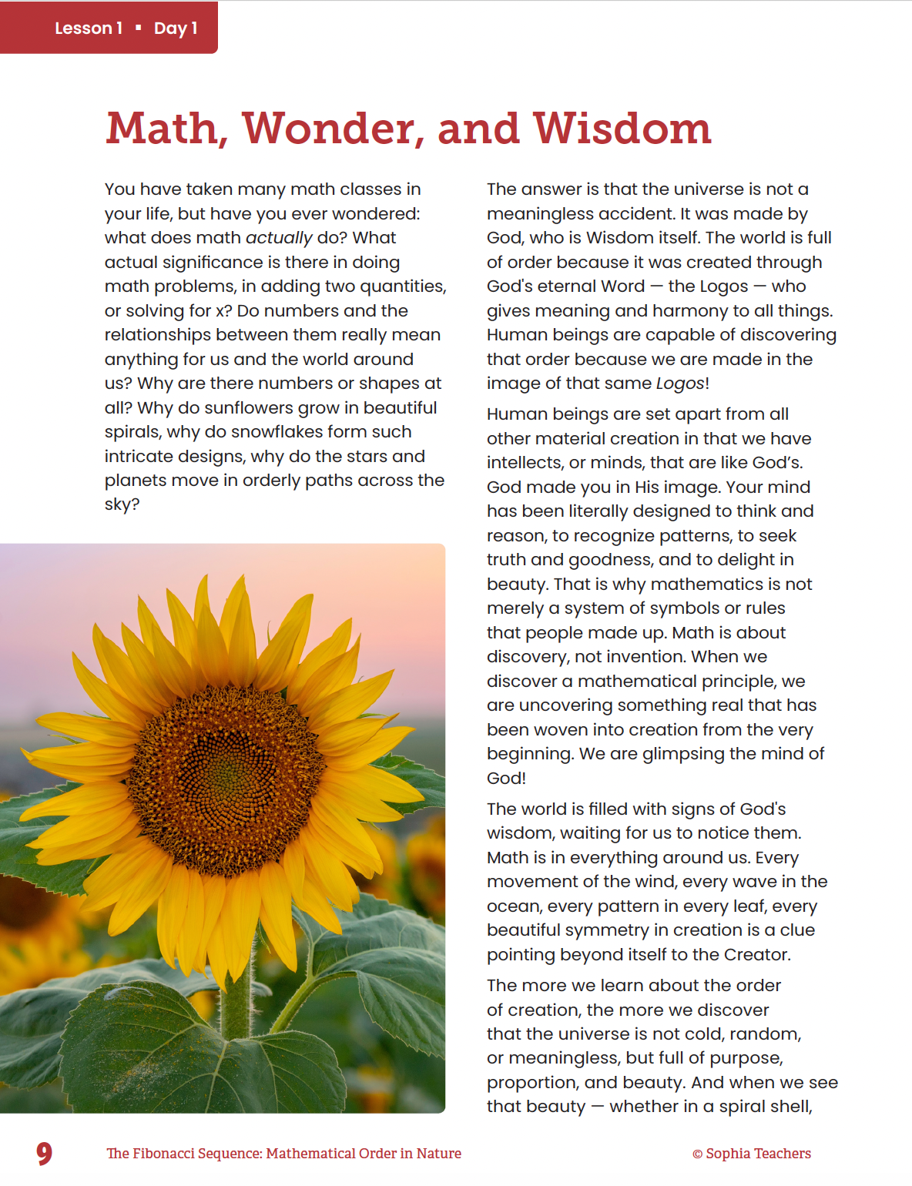
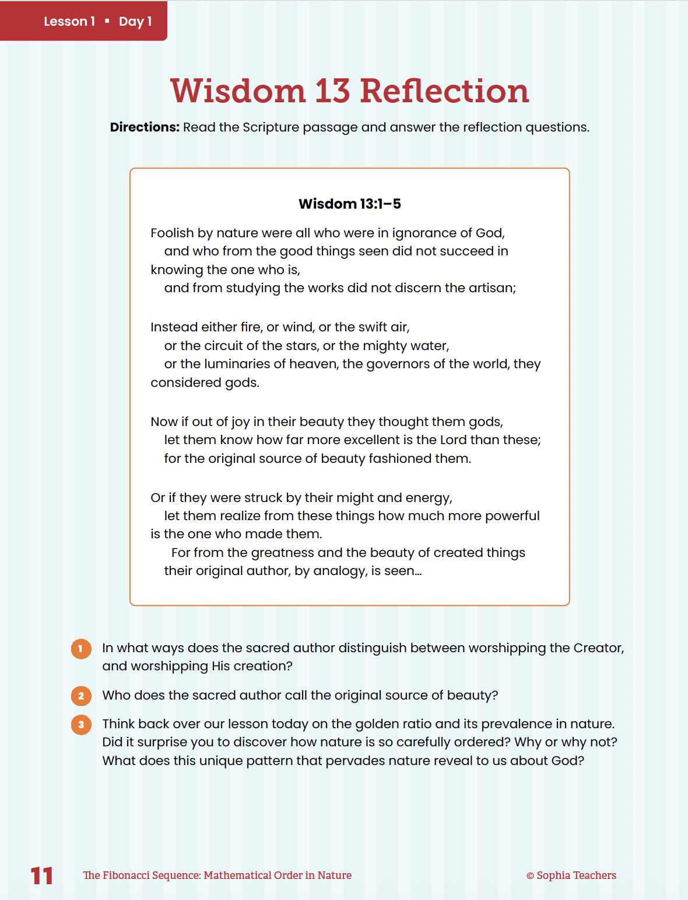
Skim the essay and discuss the questions with your neighbors
Use your tape measures to do the measurements
Practicum

Slide 19
Art, Architecture and Music
Mathematical Beauty and Design
Lesson 2 turns from what God has created to what human beings make. Students explore how architects, artists, and musicians have used ratio and proportion, sometimes deliberately and sometimes intuitively, to make beautiful works.

Slide 20

Close your eyes and listen
You will hear two pairs of notes.
Listen for which pair sounds “better.”

Slide 21
Beauty in Music
We have been experiencing ratios, or proportion. Proportion is the relationship between the size of one part and another part (or the whole), often expressed as a ratio.
(i.e. the pairs of notes we heard came from plucking pairs of string lengths of different proportions.)
Consonance is a combination of tones that sounds pleasing, typically produced by frequencies form a simple whole-number ratio.
Aquinas taught that proportion (along with integrity and clarity), was essential to beauty.

Slide 22
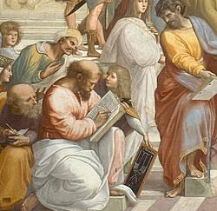
Pythagoras
2,500 years ago, Pythagoras discovered this pattern: the musical intervals people find most pleasing correspond to simple whole-number ratios. This discovery became a foundation of music theory for the next 2000 years.

Slide 23
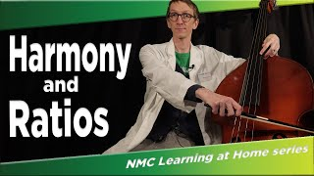
Notes:
Shorter video is here if you’re short on time: https://www.pbs.org/video/how-music-is-made-up-of-math-tsmmzo/

Slide 24
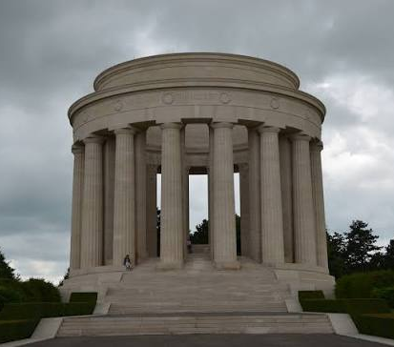
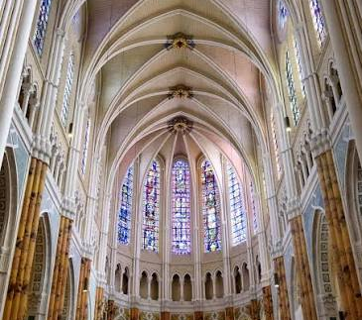
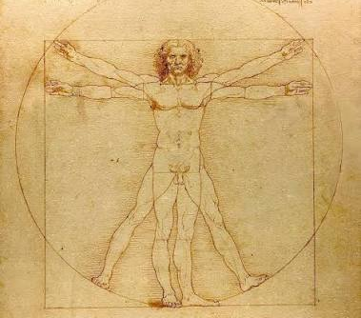
Ratios in Art and Architecture
Whole-Number Ratios in Classical Architecture
Proportion in Gothic Cathedrals
Leonardo da Vinci and the “Divine Proportion”
Pythagoras and the Music of Ratios
Notes:
Whole-Number Ratios in Classical Architecture: Ancient Greek and Roman builders, following principles later written down by the architect Vitruvius, used simple whole-number ratios — such as 1:2, 2:3, and 4:9 — to proportion buildings. Scholarly reconstructions of the Parthenon, for example, find that its footprint approximates a
9:4 ratio, a relationship that recurs at several scales throughout the design.
 Proportion in Gothic Cathedrals: Medieval masons used geometric methods called
ad quadratum (nesting rotated squares) and ad triangulum (nesting triangles) to
lay out floor plans, elevations, and window tracery, generating consistent ratios
throughout a building. This is documented not just by the finished cathedrals,
but by surviving medieval drawings, prick-marks left by masons’ compasses, and
instructional handbooks.
 Leonardo da Vinci and the “Divine Proportion”: Leonardo illustrated the geometric
solids for the mathematician Luca Pacioli’s 1509 book De Divina Proportione. This
collaboration is well documented and reflects a real and rich Renaissance interest
in geometry and proportion — even where specific popular claims about individual
paintings go beyond the evidence historians have found.
 Pythagoras and the Music of Ratios: As we have learned, Pythagoras discovered
that the musical intervals people across cultures find most pleasing — the octave
(2:1), the perfect fifth (3:2), and the perfect fourth (4:3) — correspond to simple wholenumber
ratios of string length or frequency. This discovery shaped Western music
theory for over two thousand years.

